Slide 1
Gerunds and Egyptian Mythology

Slide 2
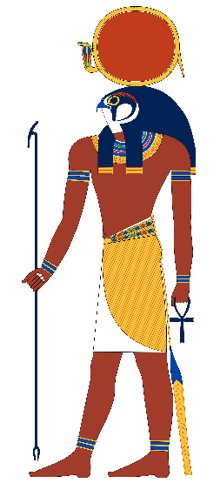
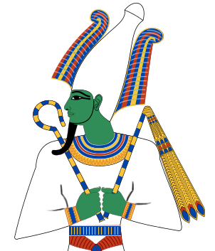
Definition
Examples:
A gerund is the noun form of a verb. It is created by adding –ing onto the end of a verb.*
The sun god Ra enjoys shining.
(Note that we could replace “shining” with a noun, like “pizza.”
Gerunds belong to a category of verb forms called verbals. There are two other kinds of verbals (participles and infinitives), which we will discuss later.
Osiris taught people about farming.
(Note that we could replace “farming” with a noun, like “horticulture.”)
*Be careful! Not every verb with –ing at the end is a gerund. Make sure that it is functioning as a noun before calling it a gerund.

Slide 3
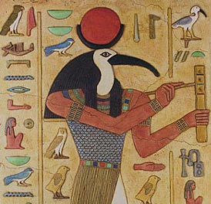
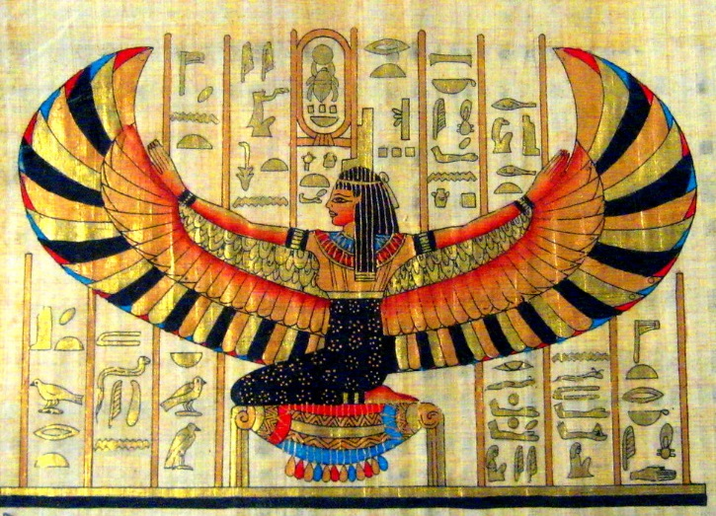
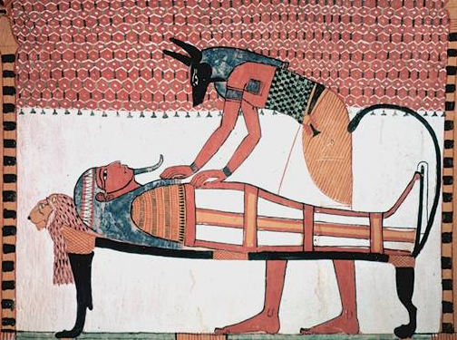
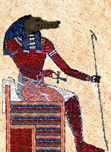
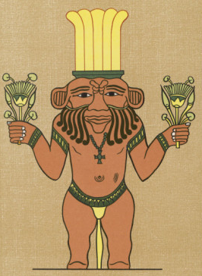
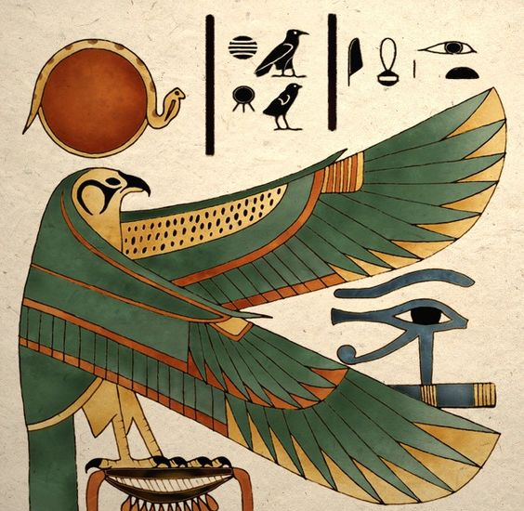
Gerund or Not-a-Gerund?
not a gerund
gerund
gerund
Thoth is the god of writing.
Isis is flying.
Anubis is good at making mummies.
not a gerund
not a gerund
gerund
Screeching, Horus turned himself into an owl.
The crocodile god Sobek looks frightening!
Bes believed partying was the most important part of life.

Slide 4
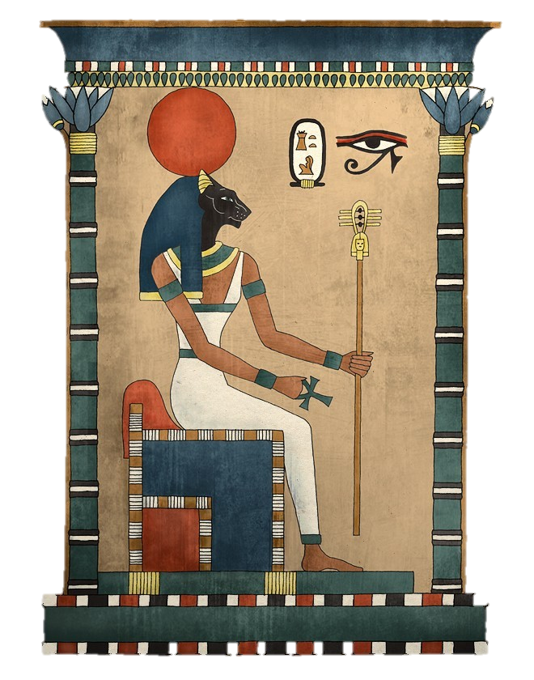
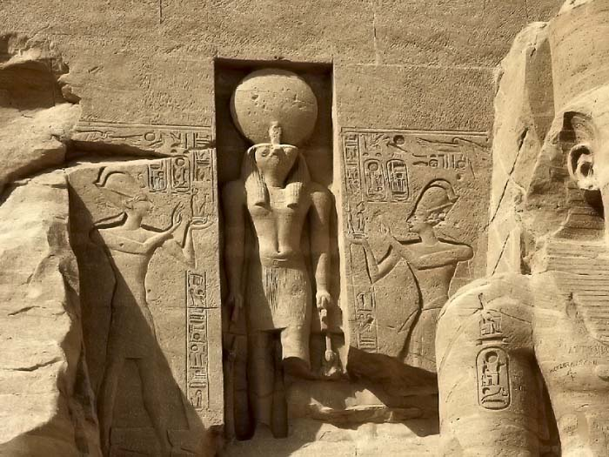
Anywhere you could use a noun, you can use a gerund.
If you are having trouble deciding whether something is a gerund or not, try replacing it with a noun (or noun phrase).
The cat goddess Bastet was loved by the Egyptian people for protecting the pharaoh.
People in Egypt prayed to Ra to help them with their suffering.
her generosity
pain

Slide 5
Do not mistake the progressive/continuous form of a verb for a gerund.
Remember that the progressive/continuous aspect of a verb will also end in –ing. Look at how the word in function in the sentence to determine if it is acting as a verb or a gerund.
I am studying mythology.
Studying takes effort.
“Studying” is the action of this sentence, so this is a past progressive/continuous verb.
“Studying” is the subject of this sentence and “takes” is the action, so we know that “studying” must be a gerund.

Slide 6
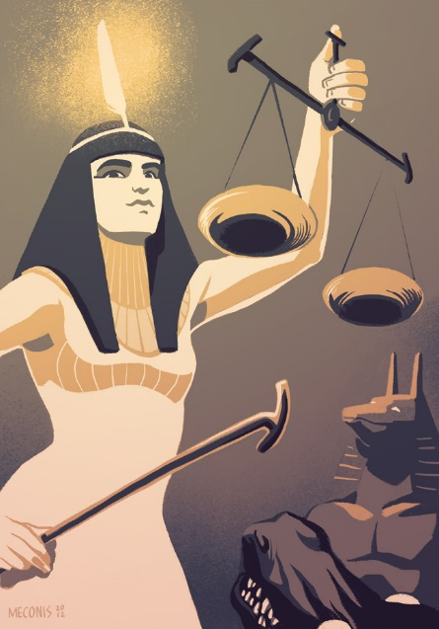
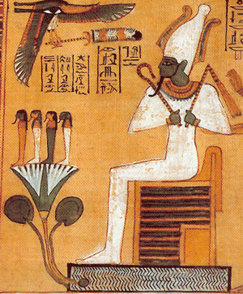
Gerund Phrases
formula for a gerund phrase:
a gerund + its modifiers = a gerund phrase
Maat judged the dead by weighing their hearts against a feather to test the purity of their souls.
After rising from the dead, Osiris became the King of the Underworld.

