Slide 1
The Odyssey Schema Guide

Slide 2
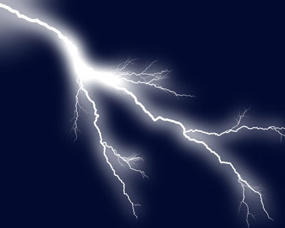
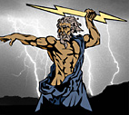
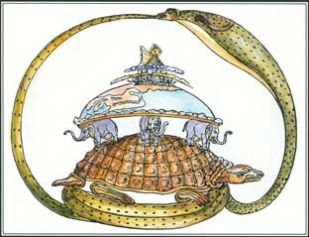

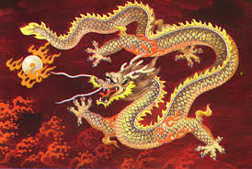
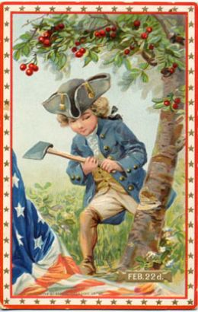
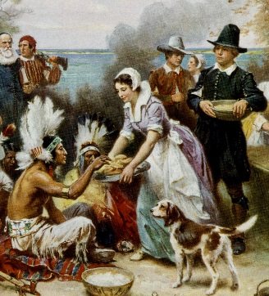

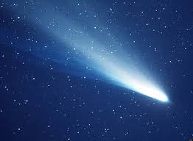
What is mythology?
myths = stories
1
2
Creation myths explain how the world came to exist.
Myths are often ancient stories told to help explain how the world came to be. All cultures have myths.
3
4
National myths explain how a nation or country was founded.
Myth vs. History – tension between fact and fiction

Slide 3
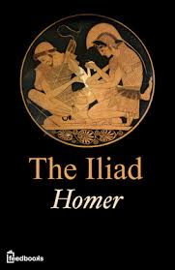


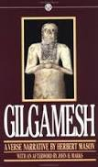






What is epic poetry?
An epic is a genre (or kind) of literature.
Epics are BIG:
  they take place across a broad expanse of land,
  often over the course of many years,
  and they deal with lofty, significant themes and questions.
Epics often include:
  heroes
  divine intervention (from the gods)
  the values of the culture in which the epic was created
Some famous epics you will encounter in your study of literature:

Slide 4

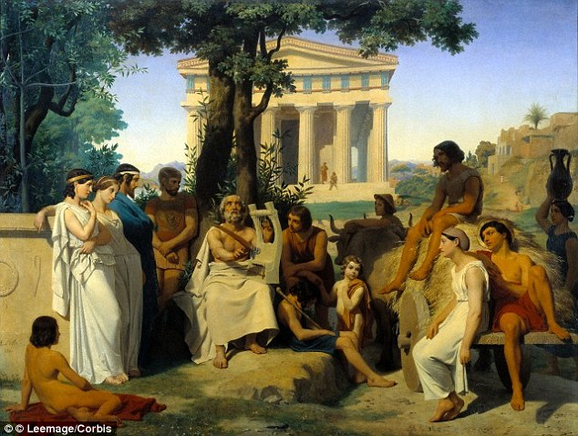
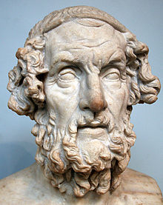
Who was Homer?
Some people theorize that Homer was…
blind.
a woman.
not a real person at all.
But we don’t really know much about his (or her!) life at all.
Bards were musicians and poets whose job was to entertain. They often travelled to palaces and taverns across the country and were given food and shelter for their work. Bards traded stories with one another in the course of their travels.
The author we call “Homer” didn’t come up with the ideas for the Iliad and the Odyssey – he just compiled them and wrote them down, in around 800 BCE..

Slide 5
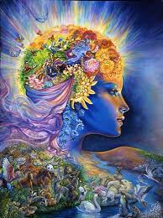
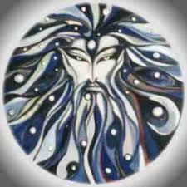
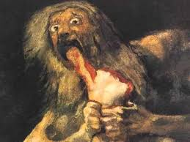
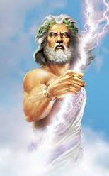
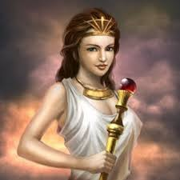
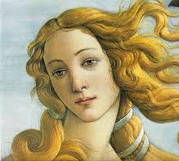
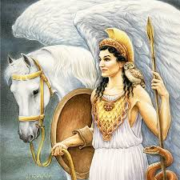
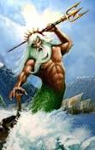
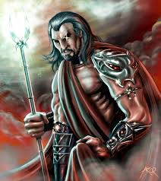
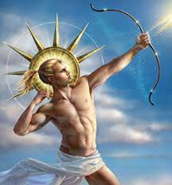
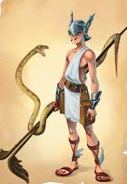
Generations of Greek Gods
1st Generation
The Creators
Gaia
(Mother Earth)
Ouranous
(Father Sky)
The king of the Titans, Kronos, devoured each of his children with his sister/wife, Rhea, so that they would never grow up to usurp his power. When Rhea gave birth to Zeus, she gave Kronos a rock to swallow instead of the baby. Zeus grew up, defeated his father, and released his siblings from Kronos’ stomach.
2nd Generation
The Titans
The Titans
3rd Generation
The Olympians
Zeus
(King of the Gods and Sky)
Hera
(Queen of the Gods)
Aphrodite
(Goddess of Love and Beauty)
Athena
(Goddess of War and Wisdom)
Poseidon
(God of the Sea)
Hades
(God of the Underworld)
Apollo
(God of Light)
Hermes
(Messenger God)

Slide 6
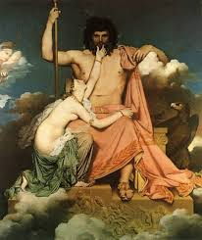
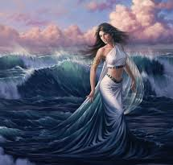
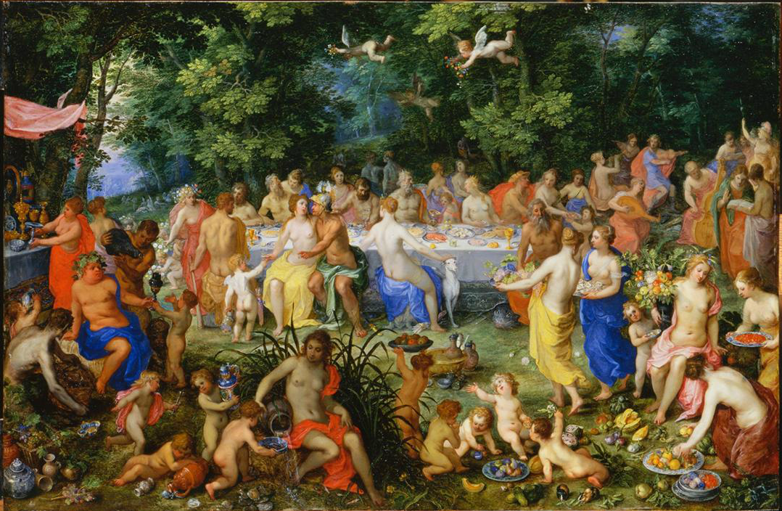
The Wedding of Thetis
Zeus was a bit of a – ahem – ladies’ man, and he had children with many women besides his wife. However, he received a prophecy that if he had a child with the sea nymph Thetis, that child would grow up to take his throne, just as he had taken the throne from his own father, Kronos.
In fact, any son born to Thetis was prophesized to be great, so Zeus decided to marry her off to a mortal – King Peleus – to reduce the risk to himself. Thetis wasn’t happy about the arranged marriage, so to placate her, Zeus offered to throw her the most astonishing wedding ever on Mount Olympus.
The wedding was amazing. But Zeus, understandably, had left one person off the guest list – Eris, Goddess of Discord. Eris resented the exclusion, and in revenge she rolled a golden apple into the crowd, where it landed at the feet of three goddesses – Hera, Athena, and Aphrodite, each of whom thought the apple was intended for her.

Slide 7
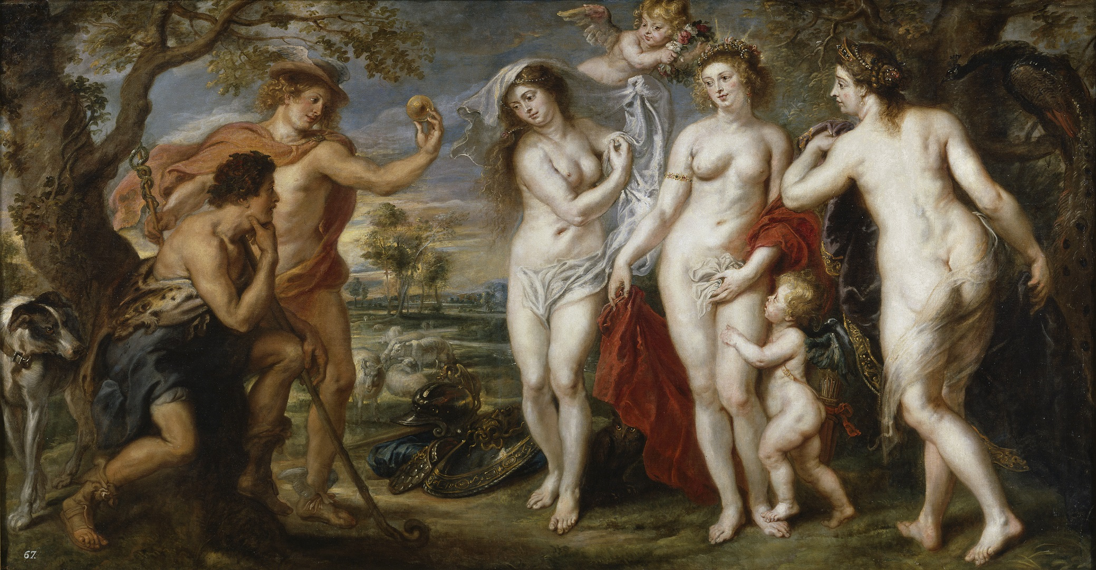
The Judgment of Paris
To arbitrate the matter, the goddesses chose a judge for a beauty contest – Paris, a prince from the royal family of Troy. However, each goddess secretly attempts a bribe; Hera promises to make Paris the most powerful man alive, Athena promises to make him the smartest man alive, and Aphrodite promises to give him the love of the most beautiful woman alive. Paris chooses Aphrodite.

Slide 8
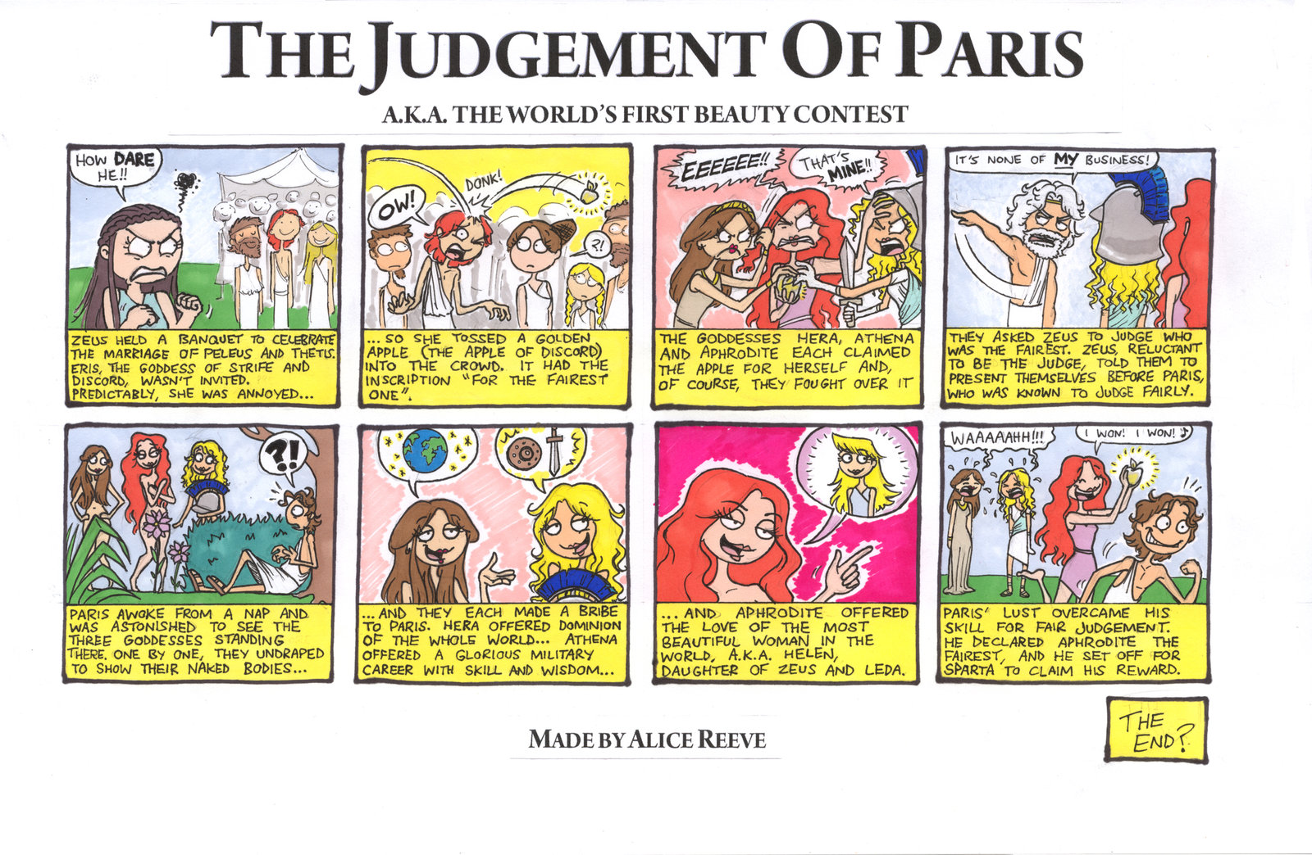
(in comic form)

Slide 9
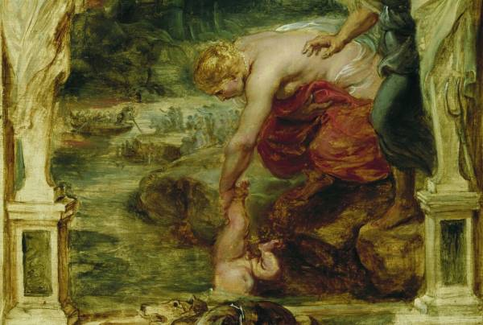
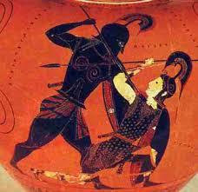
The Birth of Achilles
Achilles grows up to be the strongest man of his generation. His mother gives him a prophesy – he can either live a long and happy life without fame, or a short a glorious one, after which his name will be remembered forever.
Shortly after the wedding, Thetis gives birth to a son named Achilles. She wants to make him immortal (like herself), so she dips him in the River Styx in the Underworld. His only vulnerable point is the heel where she held him.

Slide 10
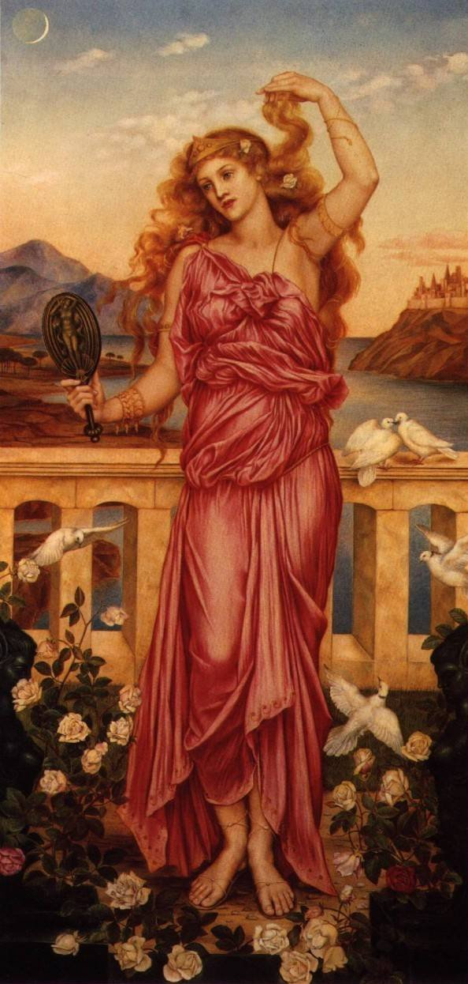
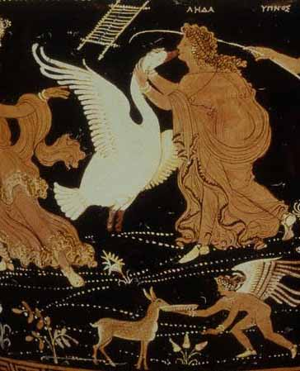
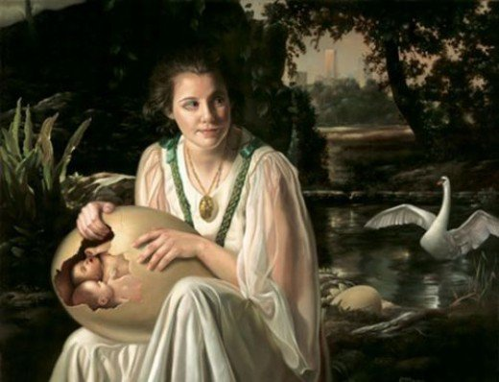
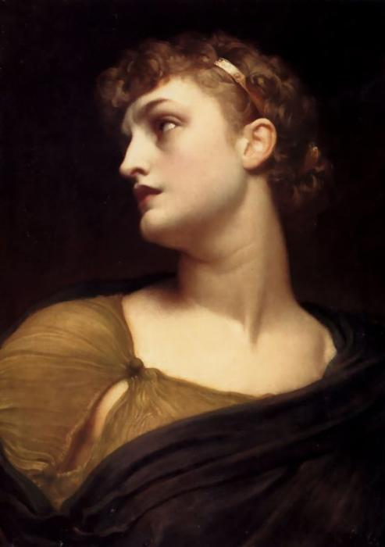
The Births of Helen and Clytemnestra
Helen
Zeus fell in love with a Queen named Leda, but Leda was already married and wanted to remain faithful to her husband. Zeus turned himself into a swan and seduced her.
Nine months later, Leda gave birth to an egg. Inside were two baby girls; Helen was Leda’s daughter with Zeus, and Clytemnestra was Leda’s daughter with her husband, King Tyndareus.
Clytemnestra

Slide 11
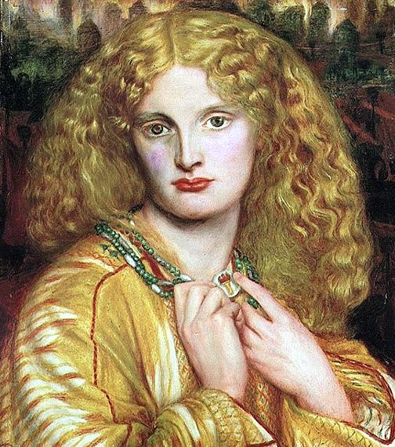
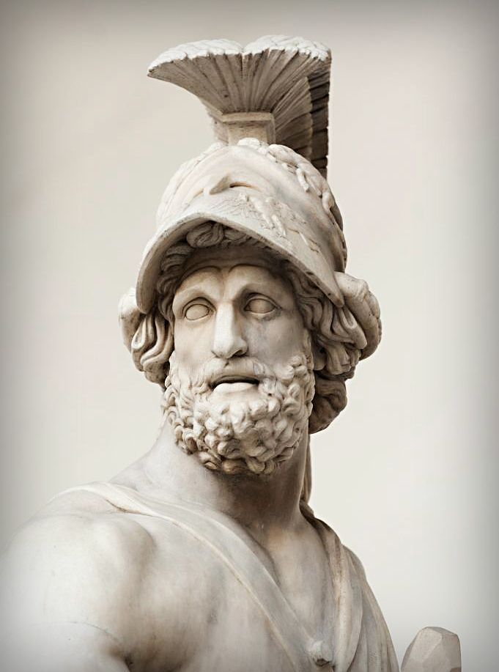
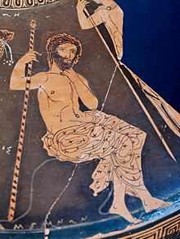
The Marriages of Helen and Clytemnestra
Clytemnestra married Menelaus’ brother, Agamemnon, King of Mycenae
By the time she was a teenager, Helen was the most beautiful woman in the world, and suitors from all over Greece – including a young prince named Odysseus – were clambering to marry her.
Helen’s stepfather, King Tyndareus, was worried that fighting would break out once a husband was chosen, so he made all of the suitors swear to abide by the decision and protect Helen from anyone who was not her rightful husband. He then chose Menelaus, King of Sparta.

Slide 12
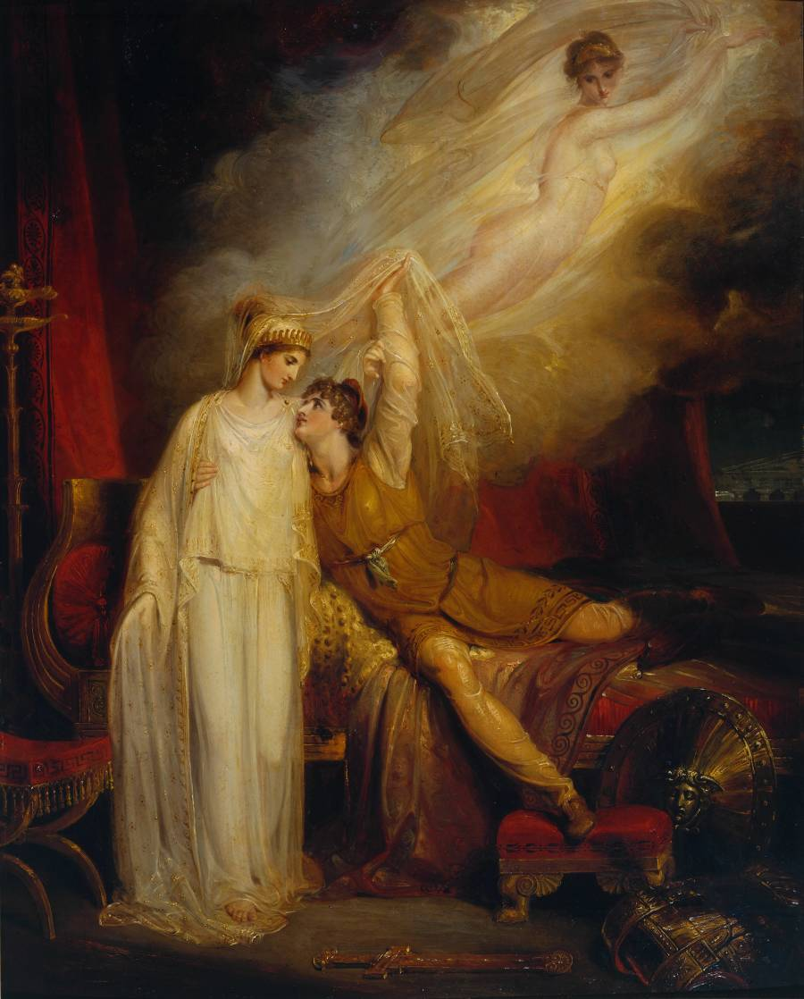
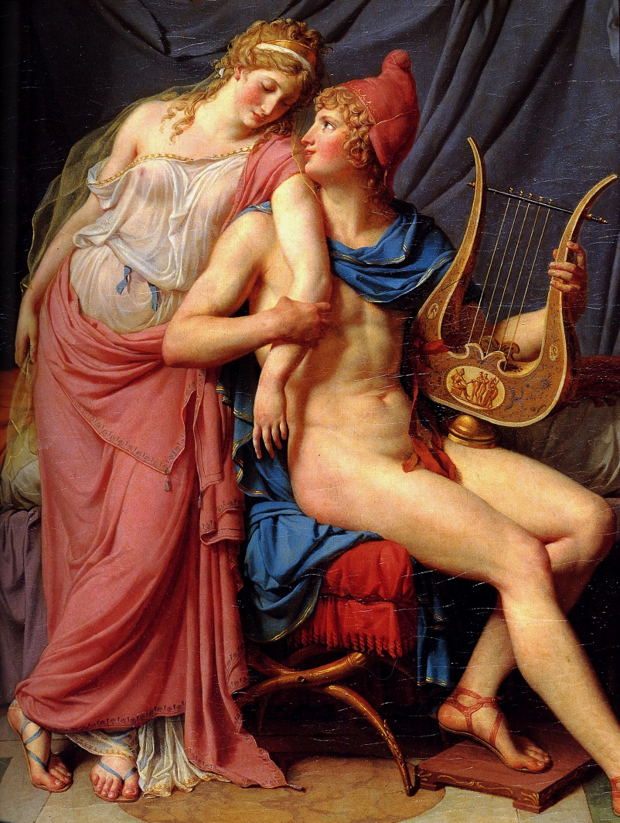
The Abduction of Helen
Paris, Prince of Troy, sails to Sparta, where King Menelaus treats him as an honored guest. Aphrodite is true to her word and makes Helen fall in love with Paris as they are feasting together. Paris takes Helen and they sneak off in a ship together to head back to Troy.

Slide 13
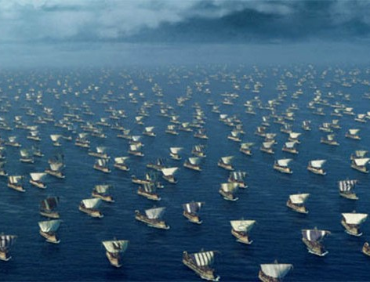
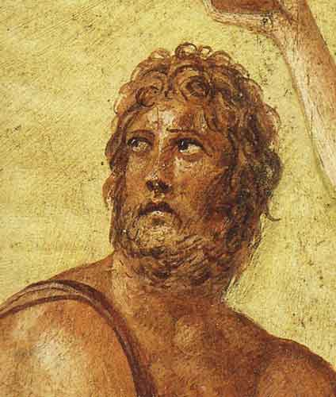
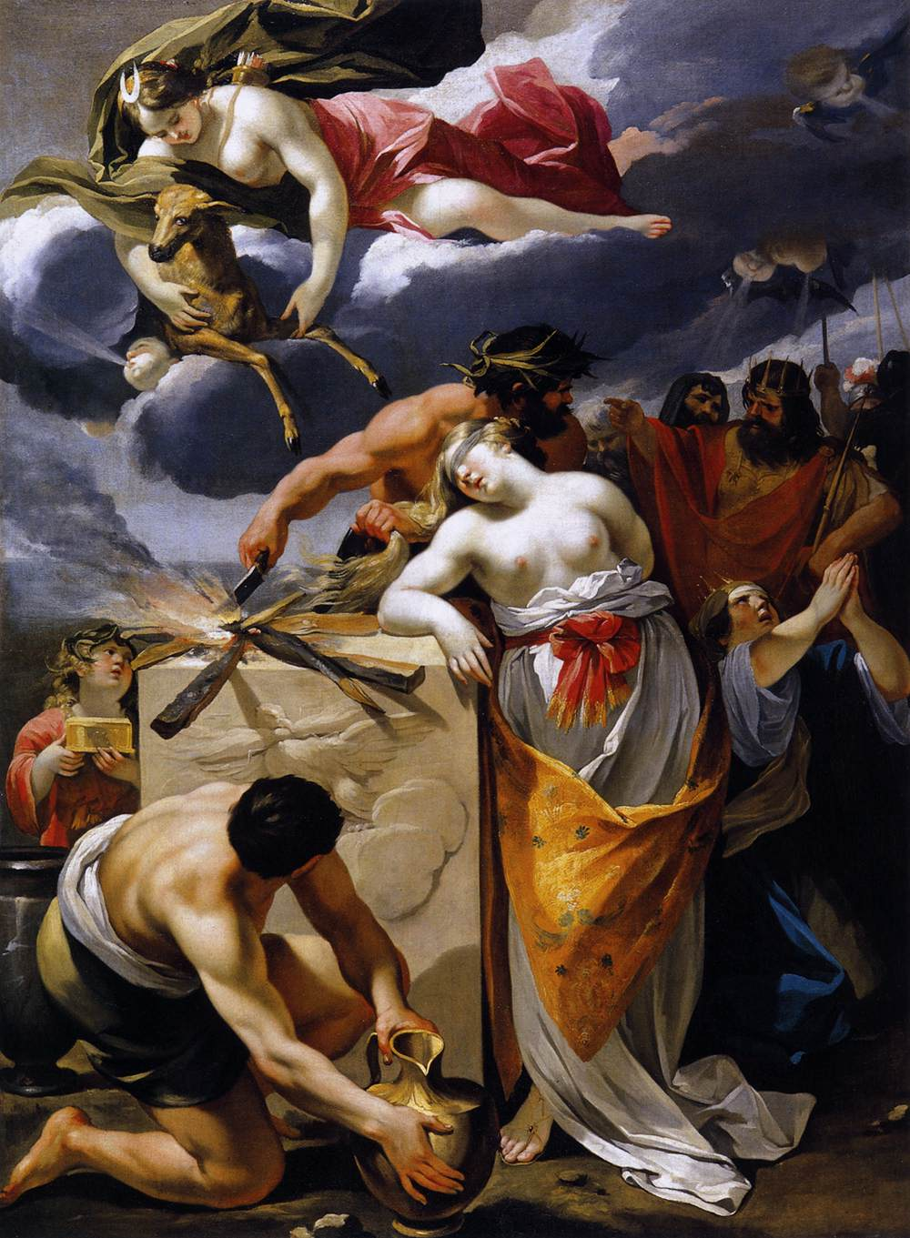
The Face That Launched a Thousand Ships
Because all of the princes throughout Greece had sworn to protect Helen’s marriage when they were courting her, they were now obligated to help Menelaus go to Troy to take her back. Agamemnon took charges of the men as the general of all the Greeks.
Odysseus, at this point, was happily married to Helen and Clytemnestra’s cousin, Penelope. He had a one-year-old son named Telemachus. When Agamemnon asked him to join, Odysseus pretended to be crazy, but Agamemnon wasn’t fooled.
The Greeks get ready to sail, but there are no winds. Agamemnon receives a prophecy that to begin the journey, he must sacrifice his daughter with Clytemnestra, Iphigenia. He kills her, the winds start, and Clytemnestra is very unhappy.

Slide 14
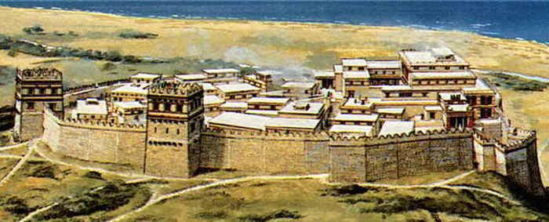
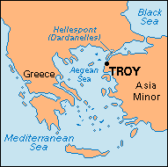
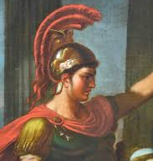
Arrival at Troy
However, Troy is protected by enormous, magical walls that cannot be broached.
The Greeks sail east to Troy.
The greatest warrior on the Trojan side is named Hector, the older brother of Paris.

Slide 15
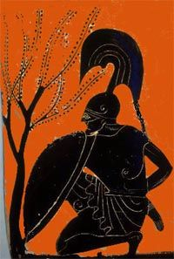
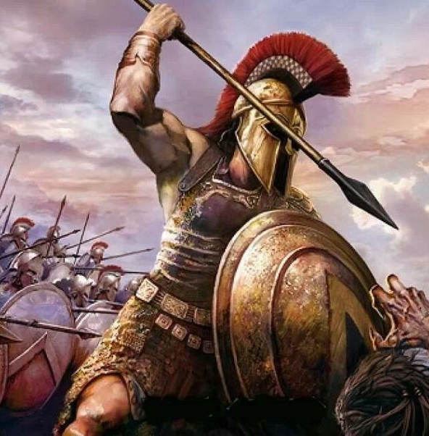
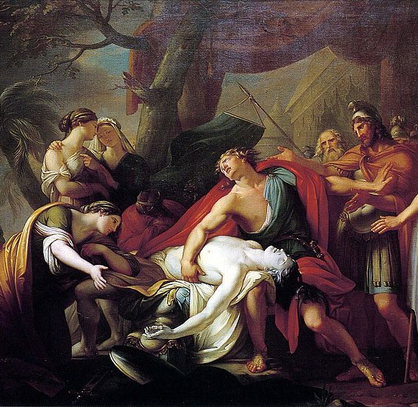
The War Stalls
After 10 years, Achilles stops fighting because he feels that Agamemnon is not giving him enough honor. Without him, the Greek army struggles.
Achilles’ friend (and possibly lover) Patroclus takes Achilles’ armor and goes out into battle. Hector, thinking he’s Achilles, kills Patroclus.
Achilles goes mad with grief when he hears that Patroclus is dead, and swears to kill Hector.

Slide 16
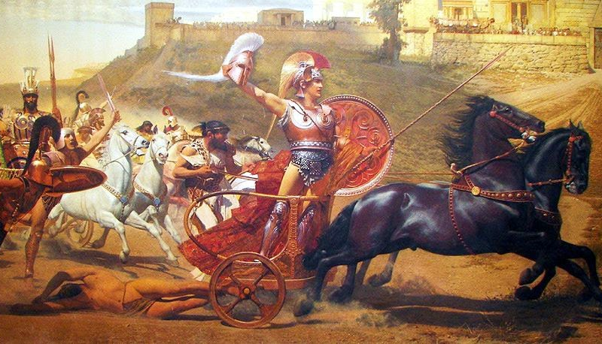
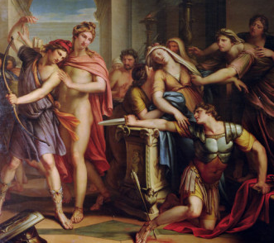
The Deaths of Hector and Achilles
Achilles kills Hector and drags his naked body behind his chariot around the walls of Troy for twelve days. Eventually Priam, King of Troy and Hector’s father, comes to Achilles and begs him to let him give Hector an honorable burial, and Achilles relents.
Paris shoots an arrow, guided by Apollo, at Achilles and it pierces him in his heel – his only weak point. Thus, Achilles perishes.

Slide 17
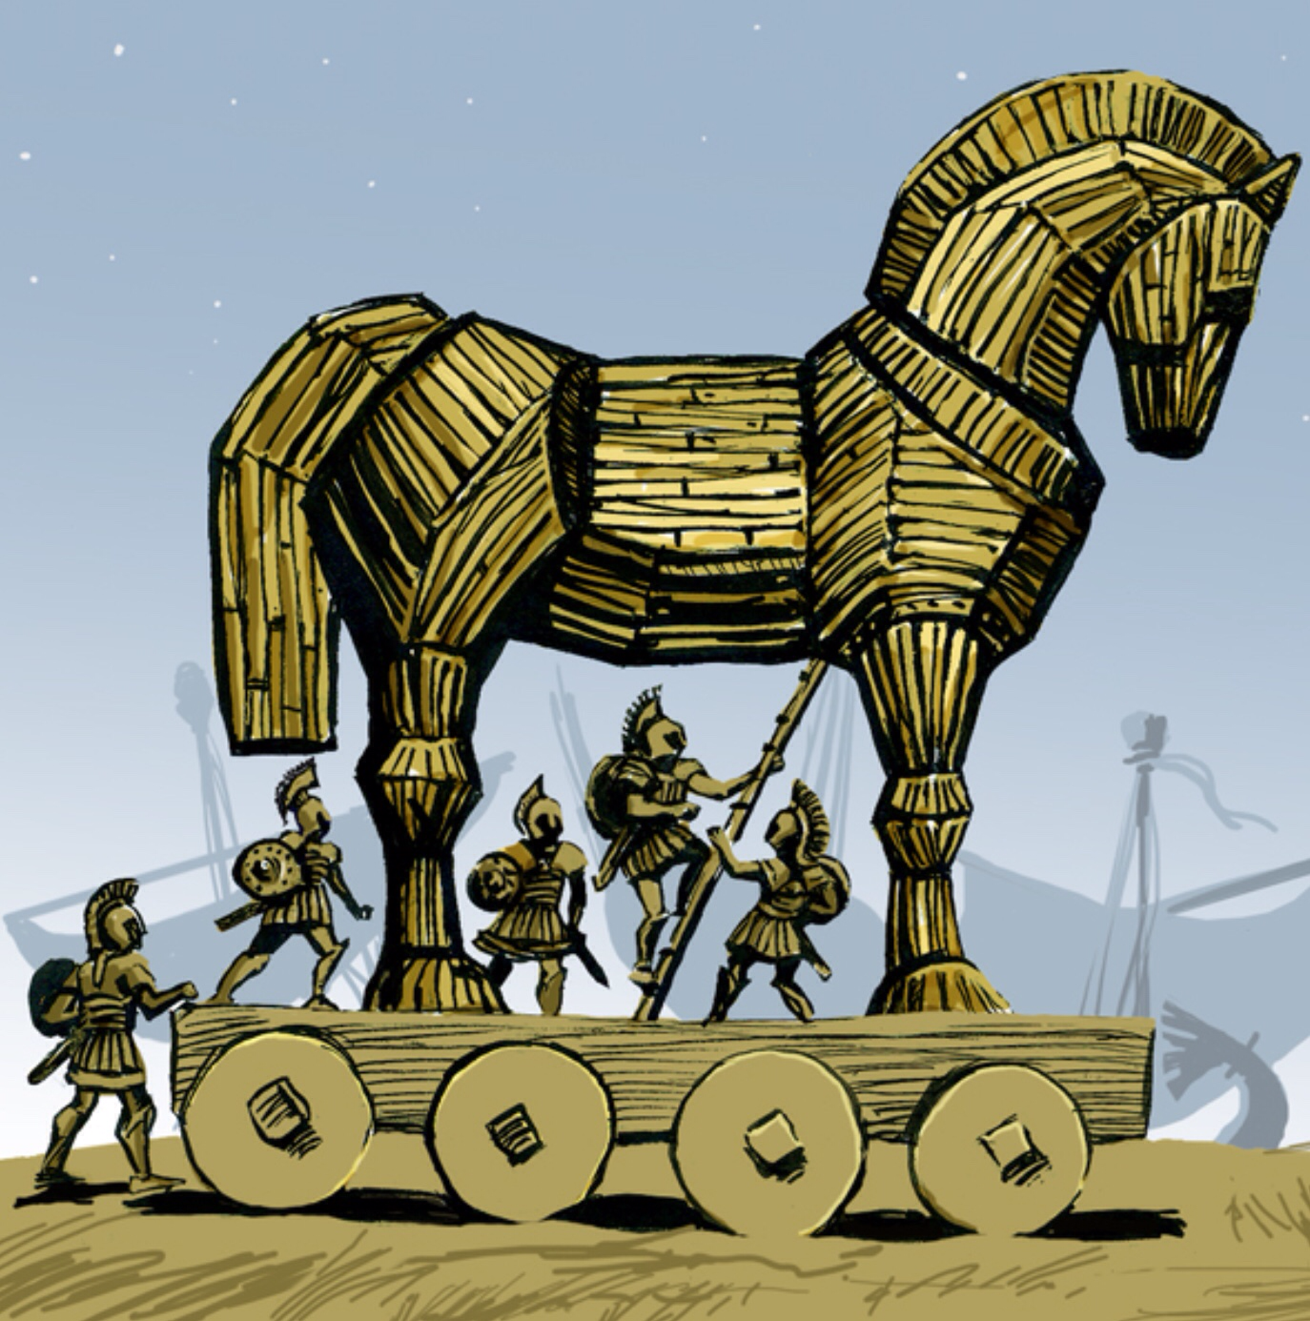

The Trojan Horse
After 10 years, the war is still at a stalemate. Odysseus has a tricky idea to end it, once and for all; the Greeks construct a giant statue of a horse (the symbol of Troy) and take their ships a mile away, so that it looks as if they have given up the siege.
However, there are Greek soldiers hiding inside the horse, and after the Trojans bring them inside the walls, they wreak havoc on the city by destroying the temples, slaughtering children, and enslaving the women. Troy is utterly destroyed.

Slide 18




The Returns
Helen returns with Menelaus; he forgives her, and she is once again Queen of Sparta. She grows older and her beauty fades.
Most of the surviving Greeks, however, were cursed for their cruelty in Troy and had difficult returns home. While in Troy, Agamemnon captured a Trojan princess named Cassandra and brought her back to Mycenae as his concubine. While he was away, his wife, Clytemnestra, had taken a lover. Upon his return, Clytemnestra slaughtered Agamemnon.

Slide 19



Historical Troy
For hundred of years, people assumed that the Trojan War was entirely fictional. However, in the middle of the 1800’s, archeologists discovered the remains of the city of Troy in what is today Turkey.
The remains of the walls of Troy.
Artifacts from the war.
Agamemnon’s death mask.

Slide 20
The Most Important Points to Remember
The most significant attributes of Achilles, the greatest of the Greek heroes, were his 1) strength, 2) courage, and 3) desire for glory.
Odysseus is a trickster.
Both Helen and Clytemnestra were unfaithful to their husbands (although many would argue that they had good cause).

Slide 21
Exit Ticket
“All is fair in love and war.”
Do you agree or disagree with this statement? Use examples from the story of the Trojan War to justify your opinion.

