Slide 1
Subjunctive Mood

Slide 2
What is a Mood?
In grammar, a “mood” can be thought of as describing the kind of job a sentence accomplishes. Other moods you might know include the imperative (giving a command – “Finish your homework.”), the interrogative (asking a question – “Have you finished your homework?”), and the indicative (describing something – “Edgar finishes his homework.”).

Slide 3
The Purpose of the Subjunctive
The “subjunctive” is a way of expressing thoughts about a situation that doesn’t actually exist – a “counterfactual condition.” It’s like talking about what might be going on in a parallel universe.
For example, has someone ever prefaced some advice they want to give you with the phrase, “If I was you…?” That’s actually not correct. What they literally are expressing when they say that is, “If, in the past, I have been the person whom you are…”

Slide 4
The Most Important Thing You Need to Know About the Subjunctive
Past Indicative Conjugation
Subjunctive Conjugation
I was
you were
he/she/it was
we were
they were
(if) I were
(if) you were
(if) he/she/it were
(if) we were
(if) they were

Slide 5
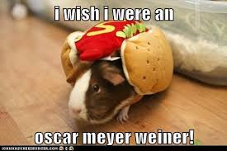
not was!

Slide 6
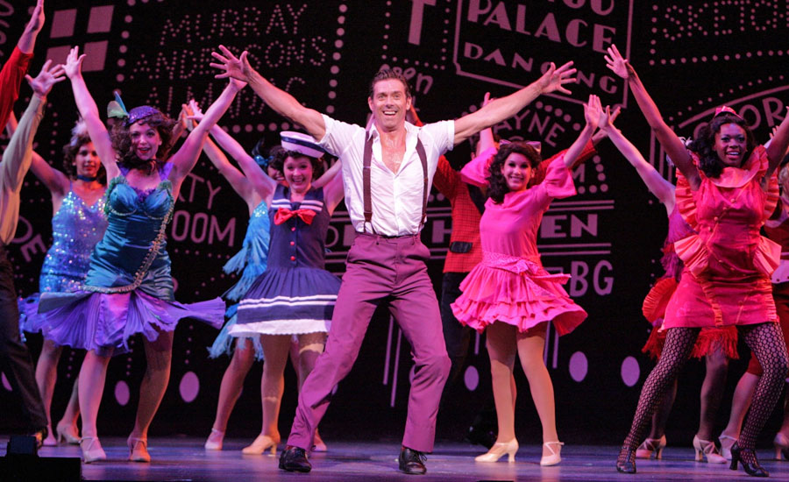
And Now… The Subjunctive as Expressed Through Musical Theater!

Slide 7
Example from Fiddler on the Roof
http://www.youtube.com/watch?v=RBHZFYpQ6nc

Slide 8
Example from Guys and Dolls
http://www.youtube.com/watch?v=aLooMzB_lgc

Slide 9
Practice Writing You Own Subjunctive Sentences!
I wish I were a fifty-one year grandma because then people would love me.
Annika wishes she were a chicken in her neighbors’ backyard because she loves being close to her neighbors.
The students wish they were not in school.
If I were a witch then I would fly on a broom across Europe.
If you were a dog I would name you Dylan.
If Ariana were a blue hippo, she would be hungry-hungry all the time.
If we were quinoa then no one would eat us, except for Annika the chicken.

