Slide 1
Independent and Dependent Clauses and Dinosaurs

Slide 2
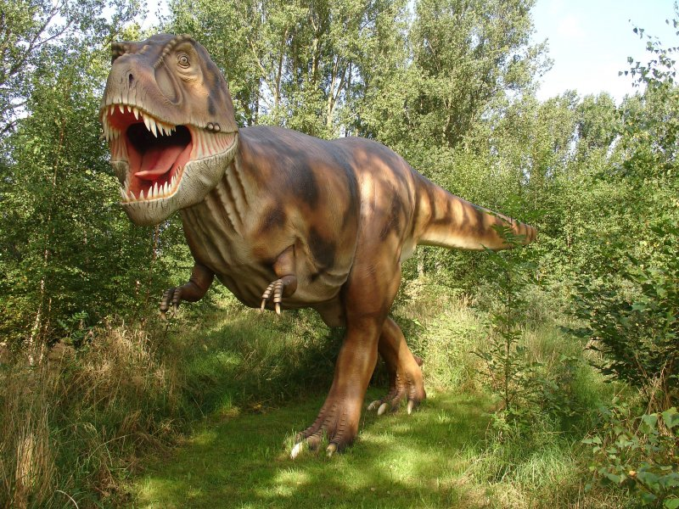
A CLAUSE: a series of words that contains a subject and verb relationship
A PHRASE: a series of words that does not contain a subject and verb relationship*
Let’s play… CLAUSE OR PHRASE?!!!!!
thundering through the prehistoric forest
though his arms were puny
T-Rex devours his enemies
to escape from his razor teeth
ripped to shreds
King of the Lizards
wherever T-Rex goes
he roars
*Remember the different kinds of phrases we have studied: appositive, infinitive, gerund, participial, and prepositional.

Slide 3



Slide 5
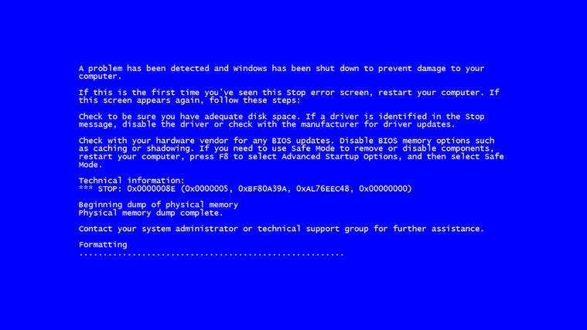

Slide 6
error!
We’ve encountered a rip in the fabric of space-time!

Slide 7
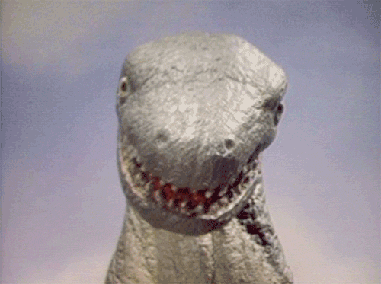

Slide 8
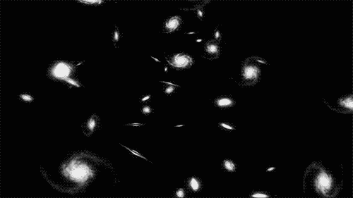

Slide 9
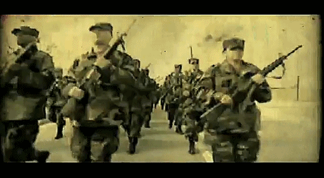

Slide 10


Slide 11
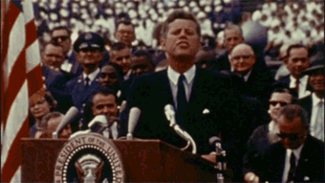

Slide 12
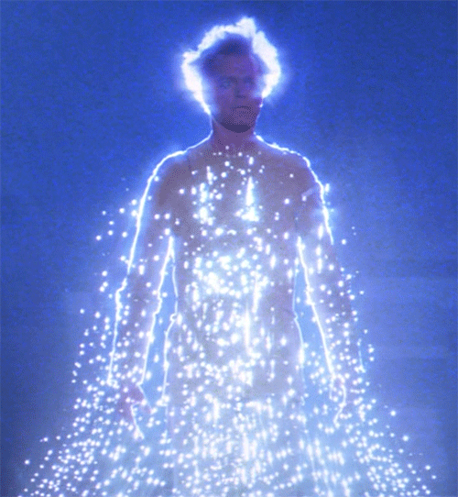

Slide 13


Slide 14
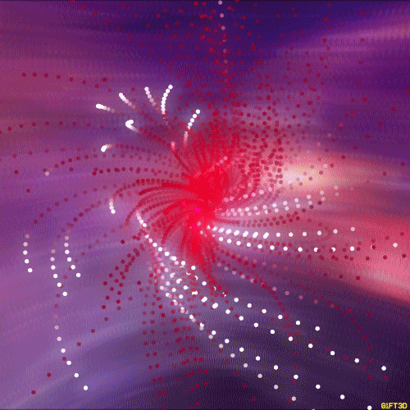

Slide 15
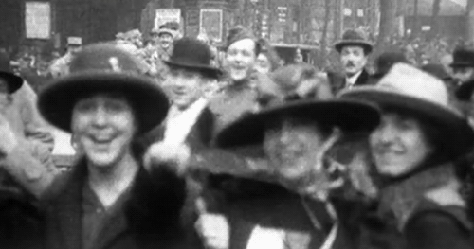

Slide 16


Slide 17
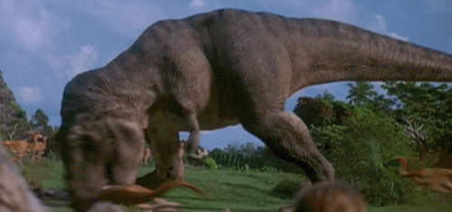

Slide 18


Slide 19
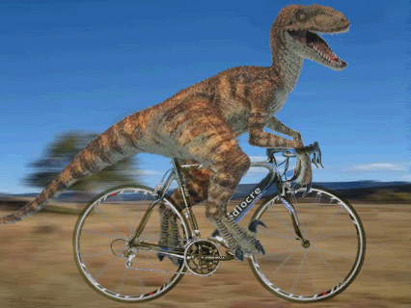

Slide 20
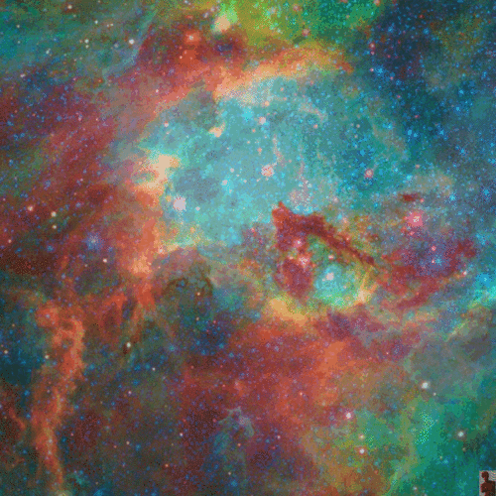

Slide 21
OH NO! We’ve gone back in time to the era of the dinosaurs, and the only thing that will save us is our knowledge of grammar!

Slide 22
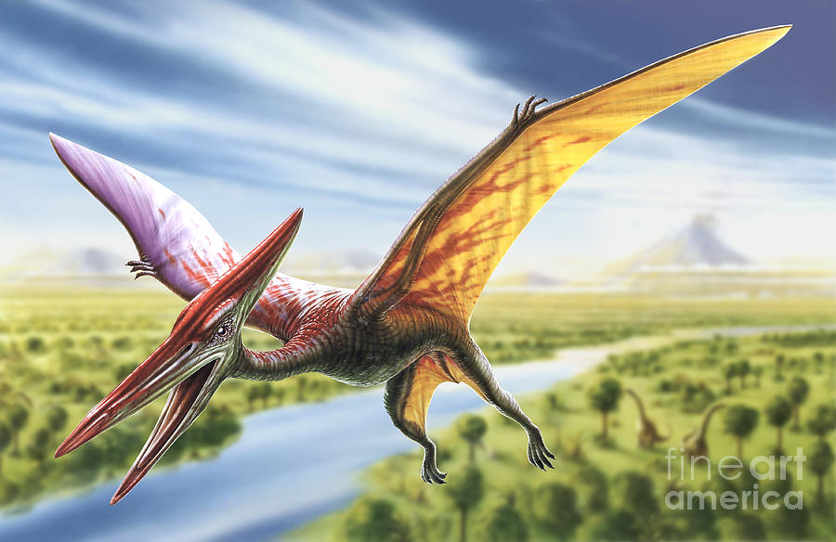
Independent clauses (otherwise known as “main clauses”) express complete thoughts.
COMPLETE THOUGHT
INCOMPLETE THOUGHT
the pterodactyl swoops down from the sky
as he lets out an ear-piercing shriek
you run in terror
before you can find shelter
CHALLENGE!
Is the following clause independent?
his great beak opens wide
Independent
Not Independent

Slide 23
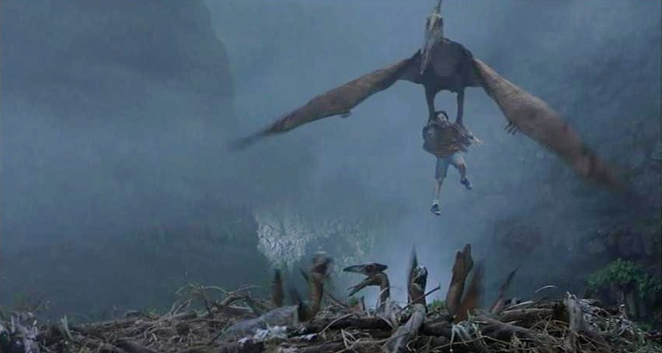
The pterodactyl bites the back of your shirt and swoops you up into the air. She carries you back to her nest, where she feeds you to her you babies.
Try again!

Slide 24
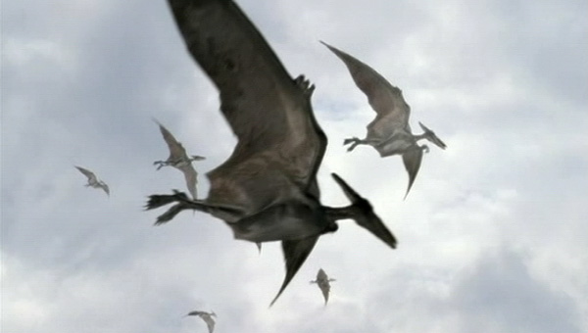
At the last moment, you duck and the pterodactyl swoops harmlessly overhead.
Continue!

Slide 25
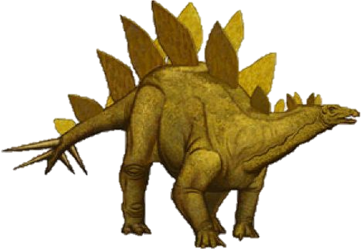
A complete sentence must have at least one independent clause, otherwise it is a sentence fragment.
EXAMPLES OF SENTENCE FRAGMENTS
because he eats only vegetables
after his spiked tail whips down beside you
fearing for your life
BUT WAIT! Sometimes sentence fragments can be a stylistic choice on the part of the author. Consider:
A swish, a slash. The heavy tail crashes down just inches from your skull. A spatter of blood from where it grazed you. Running, panting. Instant death.
Sentence fragments can: 1) create images, 2) emphasize important words, and 3) mimic natural language.

Slide 26
Think fast!
Is it ever okay to use a sentence fragment?
Never!!!
Sometimes...

Slide 27
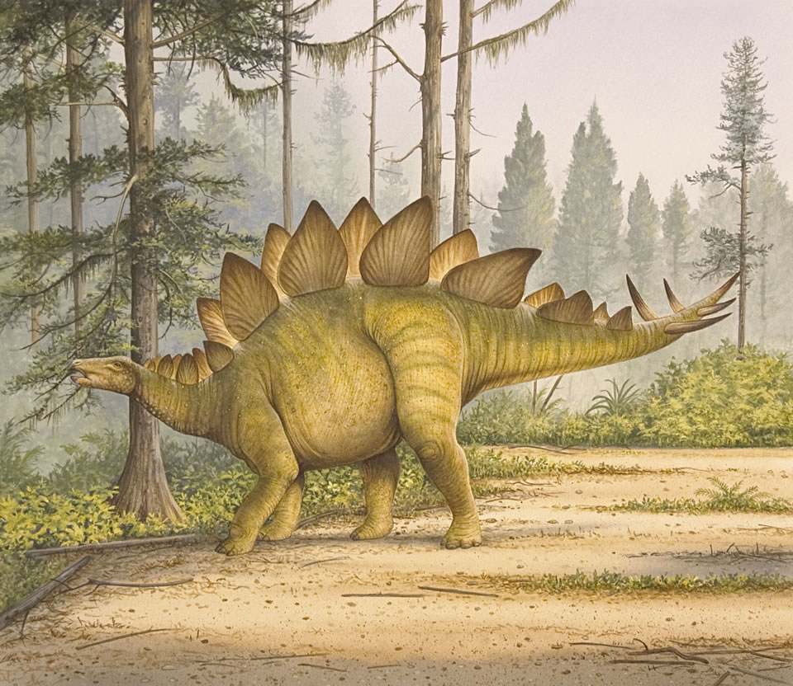
Incorrect. It is acceptable in certain situations to use sentence fragments if the author chooses to do so with a purpose.
Stegosaurus becomes carnivorous and decides to eat you!
try again

Slide 28
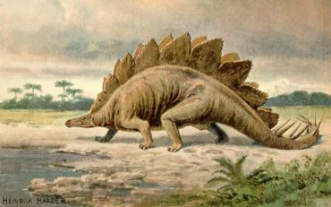
Correct! Using sentence fragments is acceptable under SOME circumstances, particularly in creative writing (sentence fragments should be avoided in formal or academic writing). The point is that you have to know the rule to be able to break it.
Stegosaurus decides you are boring and goes to drink water.
continue

Slide 29
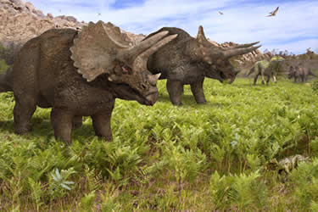
Dependent clauses (otherwise known as “subordinate clauses”) do not express complete thoughts.
Dependent clauses often (not always) contain subordinate conjunctions*.
after although as because before even if even though if in order that | once provided that rather than since so that than that though unless | until when whenever where whereas wherever whether while why
after stumbling upon a pack of triceratops
Subordinate conjunctions indicate that the dependent clause is the less important part of the sentence.
unless you can run very fast
as their horns are sharp like blades
*list from www.chompchomp.com.

Slide 30
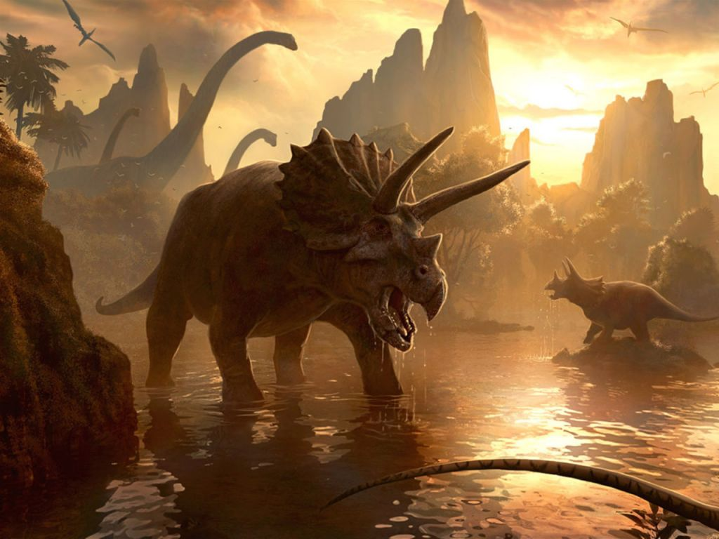
Dependent clauses are a great way to create tension and anticipation in the reader.
Because dependent clauses delay the action, the reader will naturally want to know more.
after stumbling upon a pack of triceratops
Wait, what happens after that?
unless you can run very fast
Wait, what will happen if you can’t?
as their horns are sharp like blades
Wait, why is it important that their horns are so sharp?

Slide 31
The formula for punctuating a sentence with an independent and a dependent clause…*
+
no comma needed
INDEPENDENT CLAUSE
DEPENDENT CLAUSE
You believe you have escaped
until you hear the breathing behind you.
+ ,
DEPENDENT CLAUSE
INDEPENDENT CLAUSE
comma needed
Until you hear the breathing behind you,
you believe you have escaped.
*some exceptions possible

Slide 32
Check yo-self!
Which sentence needs a comma?
After emerging from the jungle you spot the brontosaurus.
You spot the brontosaurus after emerging from the jungle.
This one.
That one.

Slide 33
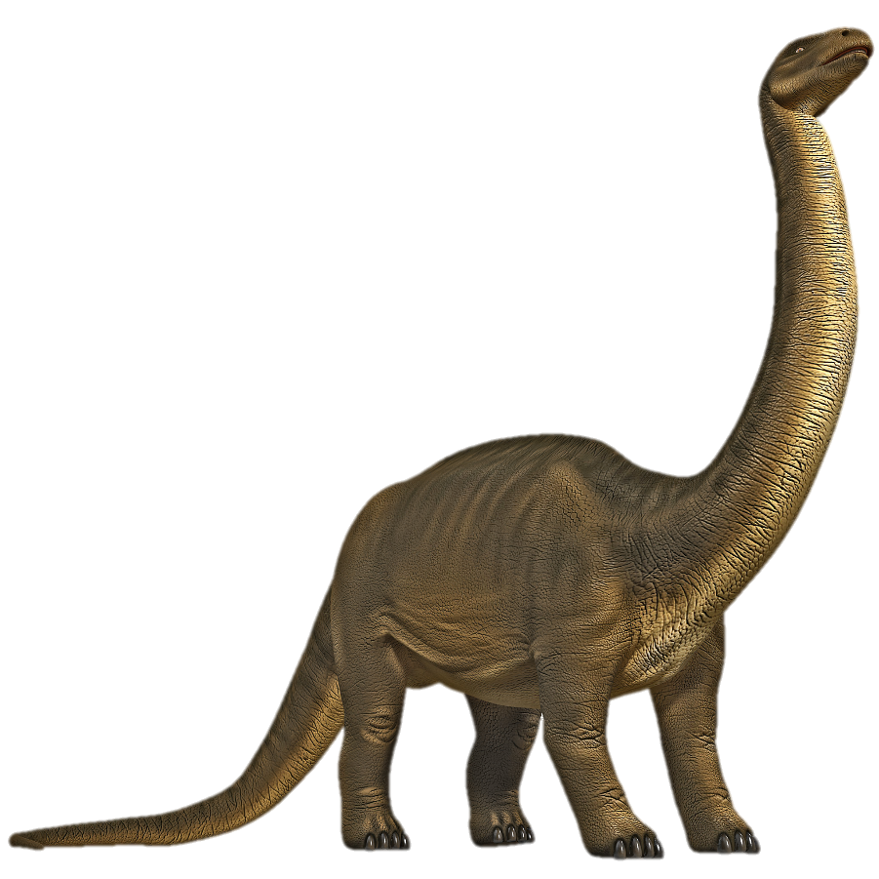
Nope; the brontosaurus smashes you under his mighty foot.
try again
you

Slide 34
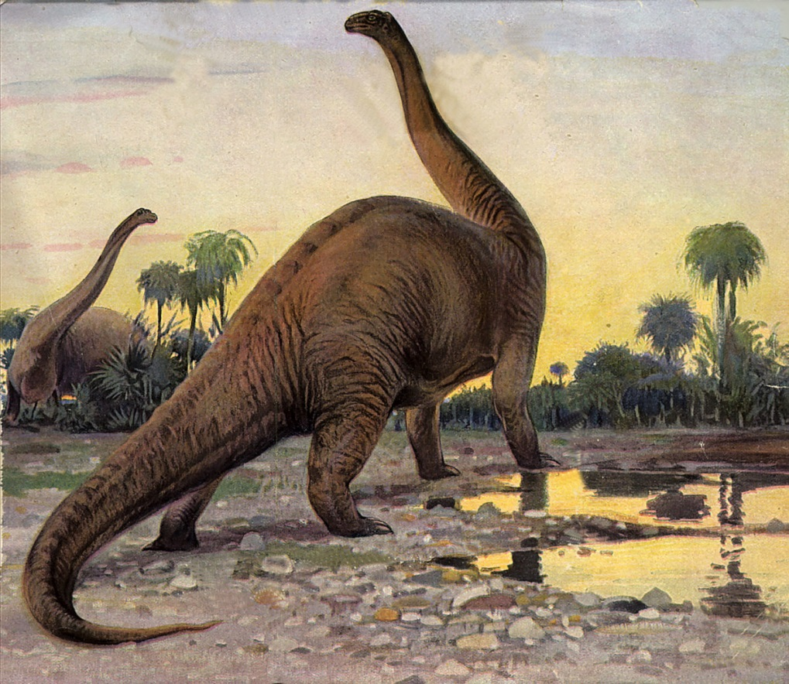
Correct – the brontosaurus gives you a gentle sniff and sends you on your way.
continue

Slide 35
A noun clause is a kind of dependent clause.
Three Things You Need to Know About Noun Clauses
Noun clauses are dependent clauses that function as nouns within the sentence.
Noun clauses often begin with one of the following words: who, what, when, where, why, how, or that.
To check if a clause is a noun clause, try replacing it with a noun in the sentence.
You believe that time travel is impossible.
(replace with: “Paul” or “the gossip”)
Apatosaurus knows where he can migrate when the weather gets cold.
(replace with: “German” or “advanced calculus”)
Examples:
Who you are does not matter to T-Rex; he only cares about how you taste.
(replace with: “Classical music” and “80’s rap and hip-hop”)

Slide 36
An adjective clause (often also called a “relative clause”) is a kind of dependent clause.
Two Things You Need to Know About Adjective Clauses
Adjective clauses describe or modify another noun or pronoun.
Adjective clauses are introduced by relative pronouns – who, whoever, whom, whomever, whose, which, and that – or by relative adverbs – when, where, and why.
The dinosaur that is deadliest is the velociraptor.
Examples:
They often attack in packs, which are made up of three to five members.
You should fear the velociraptor, whose cry signals certain death.

Slide 37
An adverb clause is a kind of dependent clause.
Two Things You Need to Know About Adverb Clauses
Adverb clauses describe or modify a verb, adjective, or adverb.
Adverb clauses can be introduced by either relative adverbs (when, where, and why) or subordinate conjunctions.
How do you run?
You run until you think your legs will fall off.
Before you can reach safety, the dinosaur catches you.
When does he catch you?
Examples:
So that you can live, you climb the tree to escape him.
Why do you climb?

Slide 38
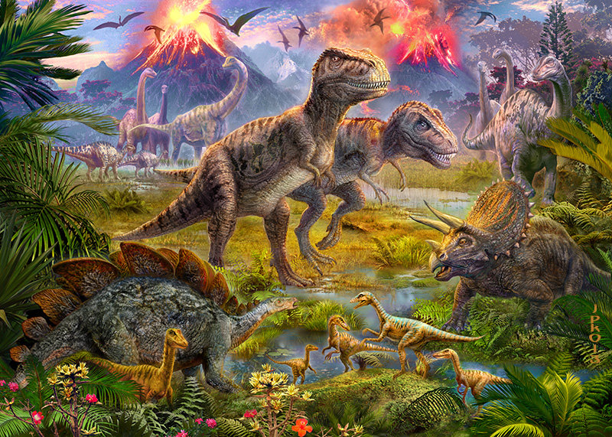
Congratulations! You have survived!

