Slide 1
Shakespeare: An Introduction
Bellaire High School
Pre-AP English 1

Slide 2
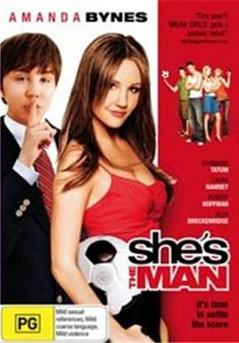
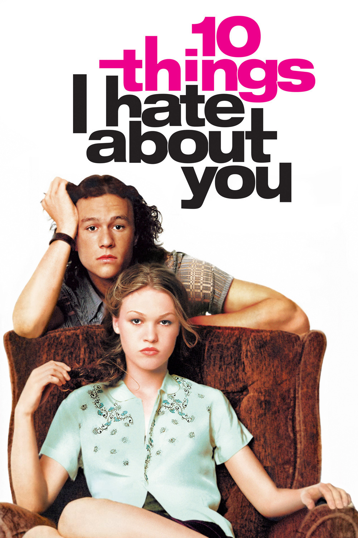

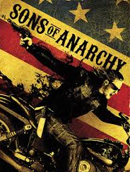
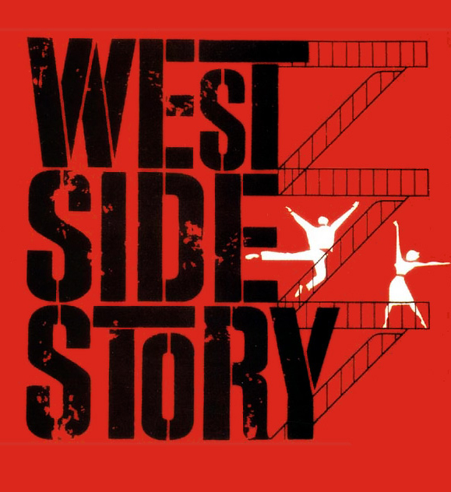
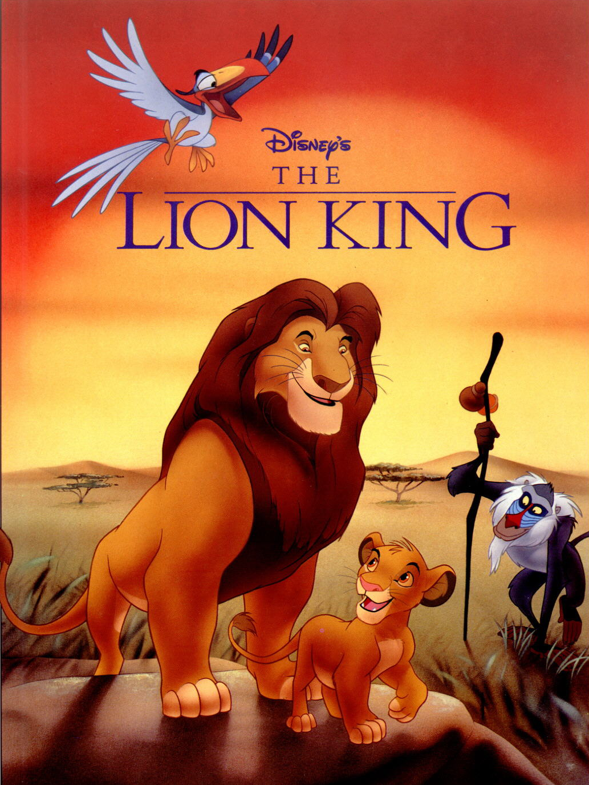
What’s the big deal about Shakespeare?
1. His stories explore universal, archetypal themes that people still grapple with today.
  Shakespeare’s friend Ben Jonson wrote in his eulogy for Shakespeare, “He was not of an age, but for all time.”
  His stories have been adapted into lots of contemporary works.

Slide 3
What’s the big deal about Shakespeare?
2. Shakespeare crafted language in a revolutionary and lasting way. We still use many of his expressions and metaphors today.
“jealousy is a green-eyed monster”
“brave new world”
“heart of gold”
“faint-hearted”
“kill with kindness”
“love is blind”
“break the ice”
“good riddance”
“wild goose chase”
“‘Knock knock!’”
“‘Who’s there?’”
“dead as a doornail”
“for goodness’ sake”

Slide 4
What was Shakespeare’s world like?
Shakespeare was born in 1564 in Stratford-upon-Avon, a village about 100 miles from London. His father was a glove-maker and city councilman, and his mother was from a wealthy land-owning family.
As a boy, Shakespeare would have attended public school, where the focus of his education would have been on learning Latin and reading classical (Greek and Roman) literature.

Slide 5
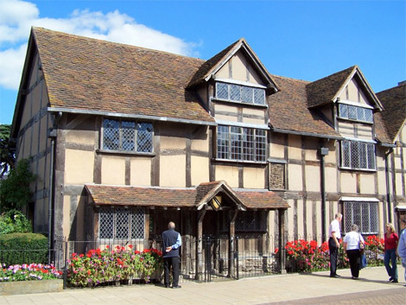
The house where Shakespeare was born.

Slide 6
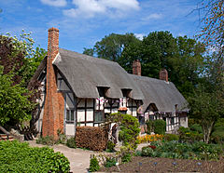
What was Shakespeare’s world like?
At the age of 18, Shakespeare married a woman from his village – Anne Hathaway, who was 26 at the time. They married very quickly, and six months after their wedding, their first child was born.
After being married for around 10 years, Shakespeare left Stratford to work in the world of theater in London – first as an actor, and then as a playwright.

Slide 7
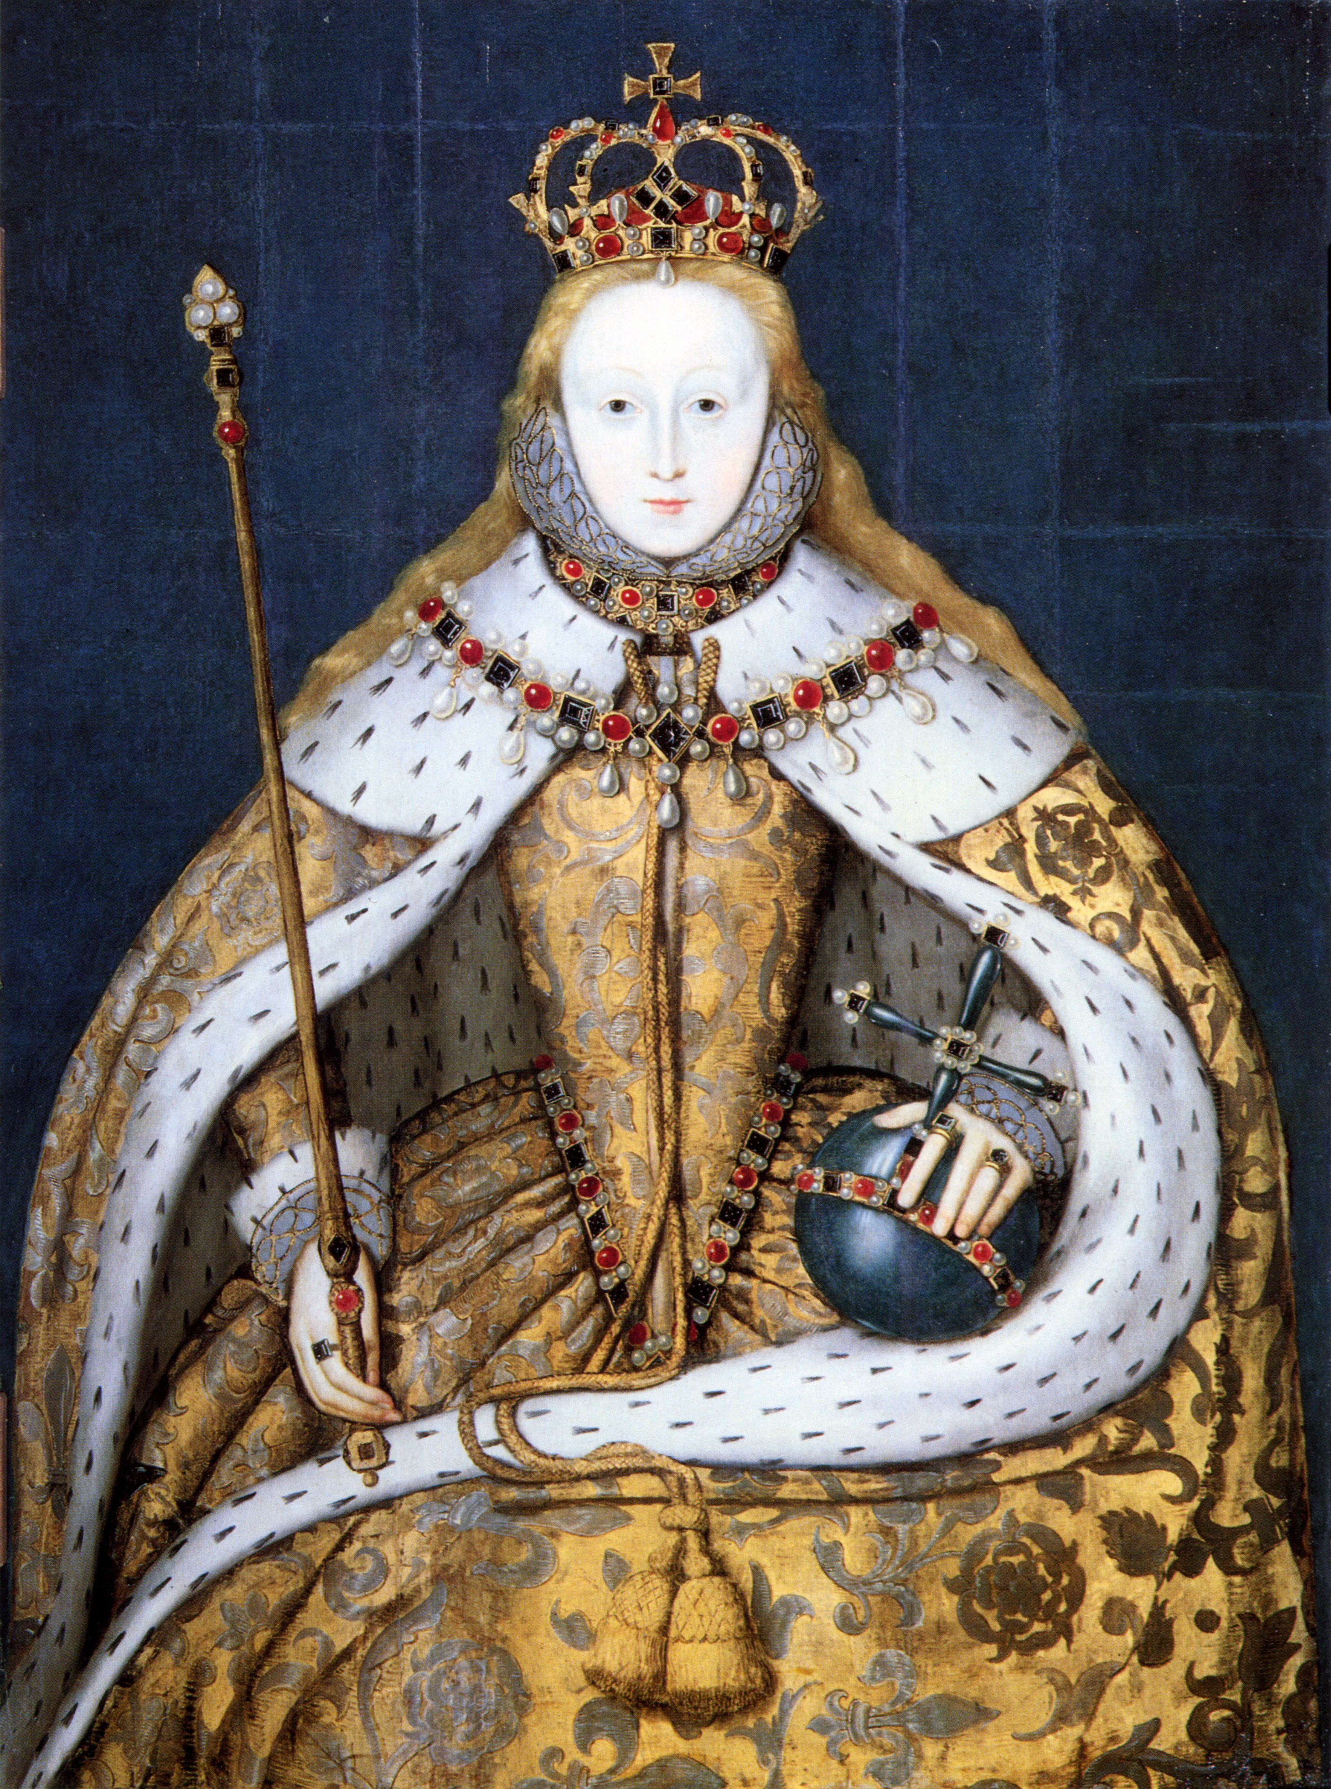
The era in which Shakespeare lived is call “Elizabethan.”
Queen Elizabeth I was the English monarch from 1558 until 1603. She was a powerful and charismatic ruler who defined that age through her ideas and ambitions.
Elizabeth made England a Protestant (as opposed to Catholic) nation.
Elizabeth negotiated trade agreements that ushered in an era of material prosperity.
The nobility and aristocracy still controlled much of daily life.

Slide 8
Theater in the Elizabethan Era
The theater and actors were considered to be lower-class.
Puritans (a fundamentalist branch of Protestants at the time) thought that theater was sinful and demanded that London theaters operate on the edge of the city.
This meant that all sorts of vices often were a part of the theater neighborhoods – gambling, taverns, bear-baiting, prostitution, pickpockets, etc.

Slide 9
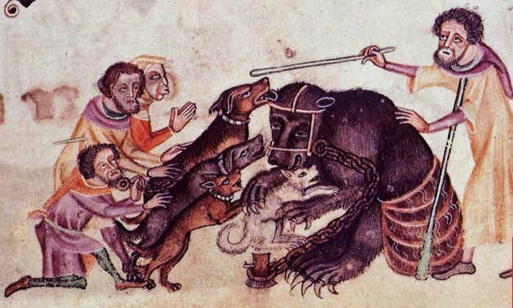
In bear-baiting, a chained bear would have to take on a pack of dogs – onlookers would bet on the outcome.

Slide 10
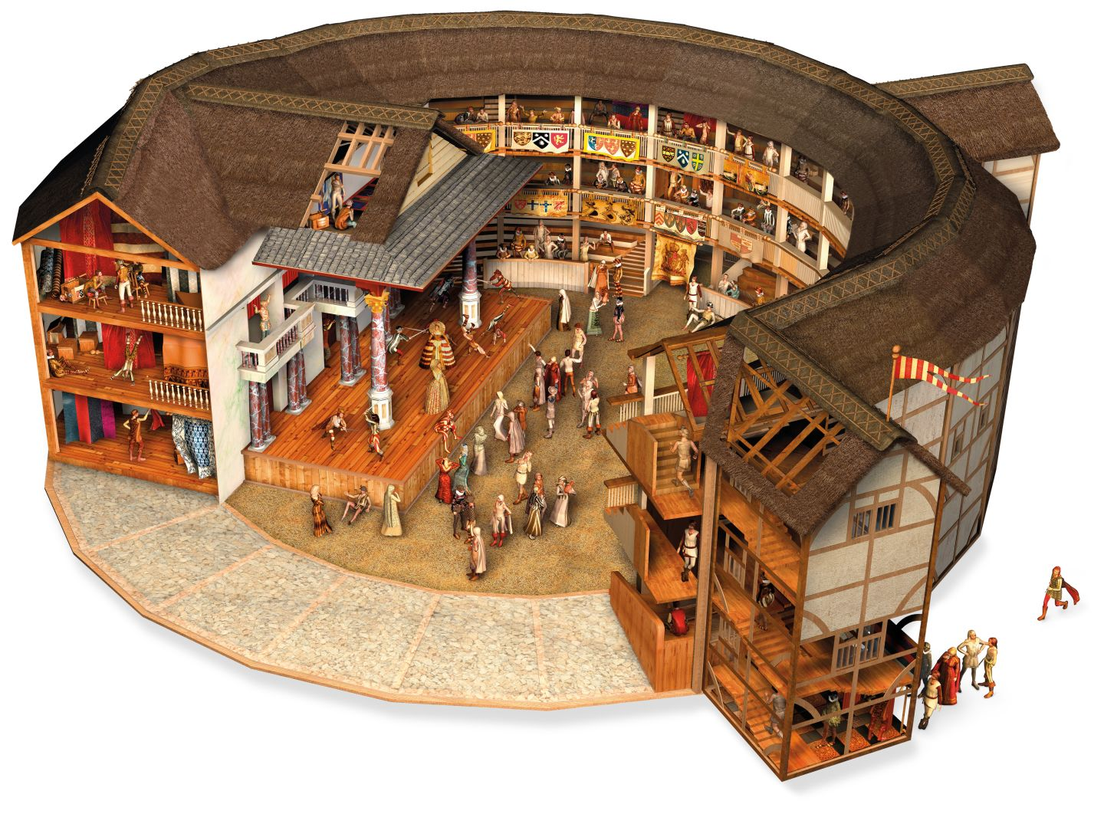
Architecture of The Globe Theatre
STADIUM SEATS –
for the wealthier members of the audience
THE TIRING ROOM – where actors could enter, exit, and change costumes
AN APRON STAGE –
a stage that juts forward so that the play is performed in the middle of the audience
TRAPDOOR and BALCONY –
to aid in developing the story
THE YARD –
where poor people (“GROUNDLINGS” could pay a penny to watch the show

Slide 11
The Globe Theatre
Plays in Shakespeare’s time had little in the way of scenery or special effects – therefore the language in the script had to have a lot of imagery to help the audience imagine.
Actors would have costumes and props to help tell the story.
Women in Shakespeare’s time were not allowed to act. This meant that all female roles were played by boys. Many of Shakespeare’s comedies included storylines about girls dressing as boys – so the audience would actually watch boys pretending to be girls pretending to be boys.

Slide 12
The Globe Theatre
Because theater was looked down upon, the nobility only watched plays when the actors came to their homes to perform. The only people who actually attended the theater were the lower and middle classes.
To keep these people entertained, Shakespeare had to include lots of sex and violence in his plays.
Since the plays were performed (instead of read, which is how we usually study them today), people were sensitive to the sound of the language – rhyme, meter, and puns.

Slide 13
Theater in Shakespeare’s time was a business.
Theaters relied upon ticket sales, which again meant that the plays had to appeal to a popular audience.
Acting troupes were often sponsored by wealthy, noble patrons who gave them financial support. As a result, troupes had to be careful not to offend their benefactors. After Queen Elizabeth’s death, Shakespeare was sponsored by King James I and included political themes in his works that James would have appreciated.

Slide 14
Scenes from Film
Anonymous - 6:50 to 10:00
Shakespeare in Love – 0:45 to 6:45

Slide 15
Language in Shakespeare’s Plays
***“The page versus the stage”
Shakespeare used rhyme, meter, and puns in his works to create a pleasing and interesting sound to the performance.
  Meter is the “beat” of poetry.
  One of the basic units of meter is called the “iam,” which is a pair of syllables – the first unstressed, and the second stressed.
  Shakespeare wrote in “iambic pentameter” – lines of five (“penta”) iams.

Slide 16

Iambic Pentameter
Here is how to remember what iambic pentameter looks and sounds like:
- / - / - / - / - /
“I am a pirate with a wooden leg.”
“I AM a PIrate WITH a WOODen LEG.”

Slide 17
Genres of Shakespearean Plays
Shakespeare several different genres (kinds) of plays: comedies, tragedies, histories, and romances.
The two major genres are comedy and tragedy.
  “The altar or the grave” (In a comedy, a couple winds up married at the end; in a tragedy, they die.)

Slide 18
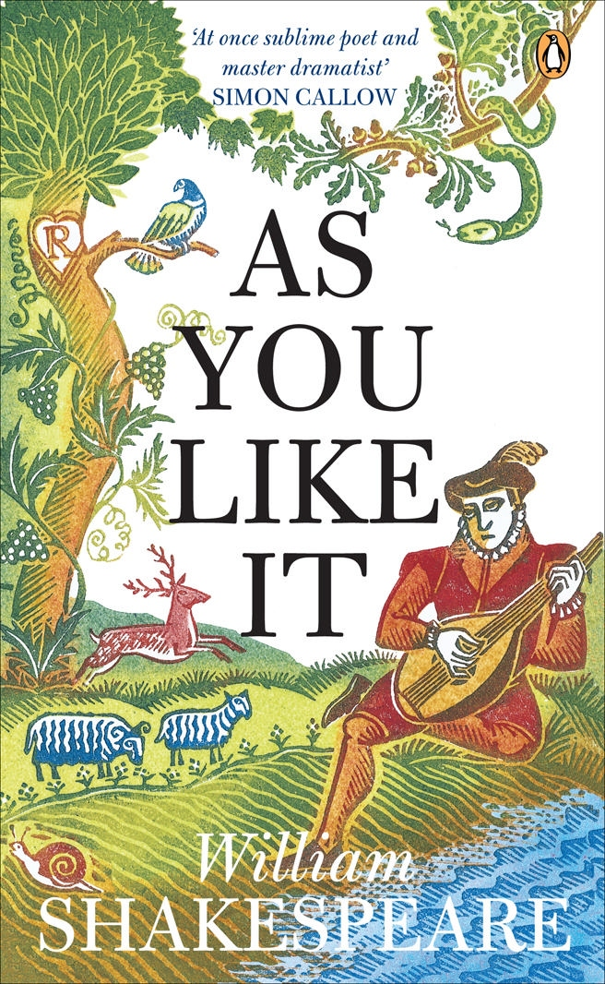
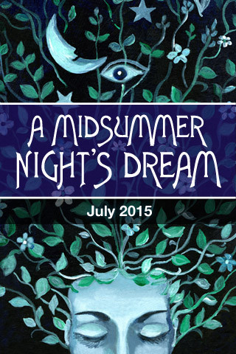
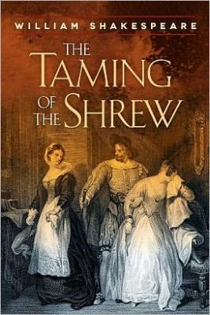
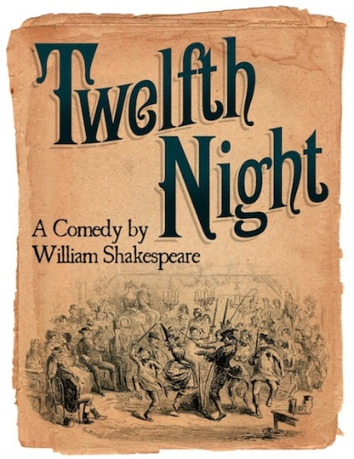
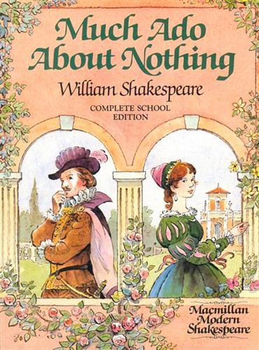
Shakespearean Comedies
Frequent characteristics of Shakespearean comedies:
  Mistaken identity
  Cross-dressing
  Marriage at the end

Slide 19

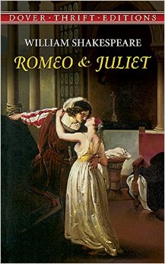
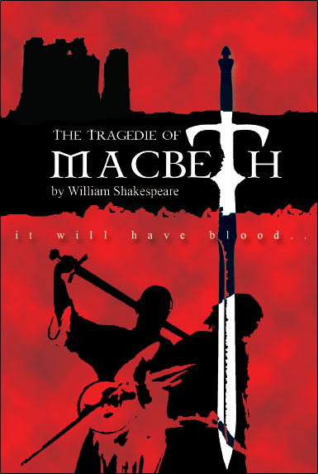
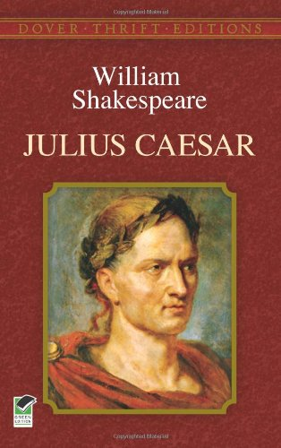
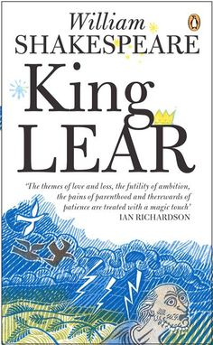
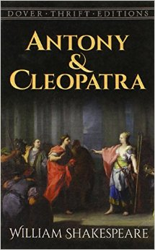
Shakespearean Tragedies
Shakespearean tragedies often include the following elements:
  A flawed protagonist
  A reversal of fortune
  Death at the end (often of the main character)

Slide 20

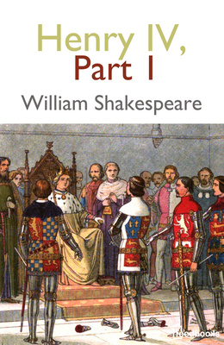
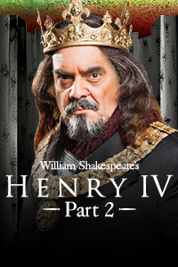
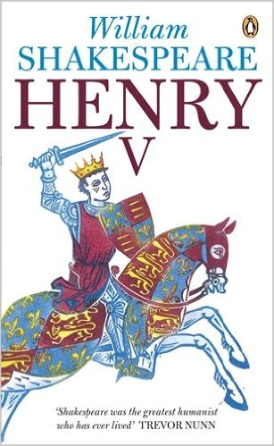

Shakespearean Histories
Shakespeare’s history plays deal with English history and the fight for the monarchy.

