Slide 1
The PIE Method for Building Paragraphs
Bellaire High School, English 1

Slide 2
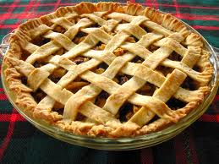
Pie.
Possibly the most delicious of all desserts. Definitely a brilliant strategy for composing paragraphs.

Slide 3
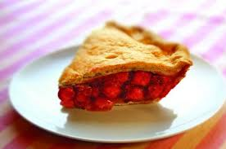
The structure of pie and the structure of PIE are the same!
Point
Illustration
Explanation
Pies are held together by three layers.

Slide 4
An Important Dichotomy Before We Begin
Concrete
Abstract
If something is concrete, it’s like… well… concrete. It’s physical, tangible, immediate, accessible, and part of the real world. You can point to it.
  A watch is concrete.
  A kiss is concrete.
  A quote from a text is concrete.
Something that is abstract exists within the realm of ideas. It could be true, but it’s not something that you can hold or to which you can point.
Time is abstract.
Love is abstract.
An interpretation of a text is abstract.

Slide 5
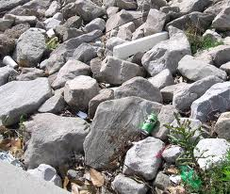
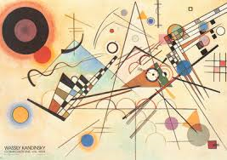
Concrete vs. Abstract

Slide 6
Ingredient #1: Point
The POINT of your paragraph is what you are trying to prove.
Your POINT should be semi-abstract – that is, it should operate on an idea level.
Synonyms for Point:
Purpose
Opinion
Idea
Thesis/sub-thesis
Argument
Claim
Assertion

Slide 7
Let’s play “Point/Not-a-Point!”

Slide 8
#1- Point/Not a Point?
Pie is delicious.
Point!

Slide 9
#2 - Point/Not a Point?
Pie.
Not a Point!

Slide 10
#3 - Point/Not a Point?
Half of all Americans say that pie is their favorite dessert.
Not a Point!

Slide 11
#4 - Point/Not a Point?
In the musical “Sweeney Todd: Demon Barber of Fleet Street,” the use of pies in the plot is ironic because this wholesome and traditional food is actually filled with the meat from Sweeney Todd’s murder victims.
Point!

Slide 12
#5 - Point/Not a Point?
Pie was invented by the Ancient Greeks.
Not a Point!

Slide 13
#6, #7, #8
#6 – Write a point about pie.
#7 – Write a point about cake.
#8 – Write a point about ice cream.

Slide 14
Ingredient #2: Illustration
Illustrations are CONCRETE examples that demonstrate the truth of your point. They are the substance the shows that your abstract assertion has some basis in reality.
Synonyms for Illustration:
Evidence
Data
Examples
Information
Kinds of Illustration:
Facts
Anecdotes
Definitions
Personal Experience
Description
QUOTES!

Slide 15
Examples of Illustrations
Point: Pie is the most delicious of all desserts.
When I was in Fargo, North Dakota, Thursday was known as Pie Day – people would take a mid-morning break and eat all kinds of pie.
(Anecdote)
Sales of frozen pies increased 6% over the last year, according to the American Baking Institute.
(Statistic)
“Give me liberty or give me pie!”
-Thomas Jefferson
(Quote)
It is acceptable to top your pie with ice cream.
(Fact)
Pie has both sweet (the filling) and savory (the crust) components.
(Analysis)

Slide 16
If you are thinking that there is a lot of overlap between the kinds of evidence and the tools of rhetoric (logical fallacies), you would be correct.
You are so smart!

Slide 17
#9 and #10 – Write two of your own illustrations supporting your point about pie.

Slide 18
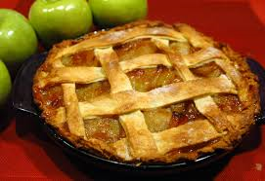
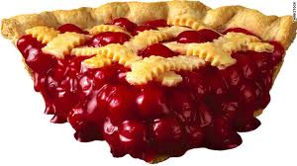
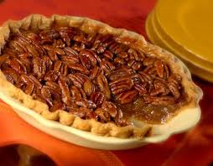
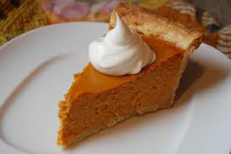
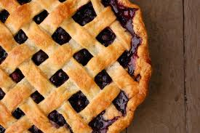
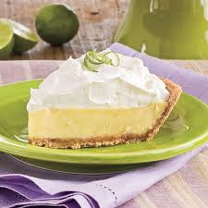
Kinds (“Flavors”) of Illustrations
History
News
Sports/Entertainment
Personal Life
Literature
School

Slide 19
Examples of Flavors of Illustrations*
History – Genghis Khan’s Mongol army subsisted entirely on pies for the duration of their campaign to take over the lands now known as Kazakhstan.
News – The 2011 revolutions known as the “Arab Spring” began largely because the people of those nations were aggrieved that their leaders were hording all of the pies for themselves.
Sports/Entertainment – Kim Kardashian is mostly famous for her accomplished pie-baking skills.
School – Bellaire’s English 1 STAAR scores improved when students were allowed to eat pie while taking the test.
Personal Life – My friend got married a few months ago, and instead of a cake there was WEDDING PIE!**
Literature – The Ninth Circle of Hell in Dante’s “Inferno” was characterized by an absence of pie.
*It is possible that some of these are not true.
**This one is true.

Slide 20
#11, #12, and #13
Choose three of the six “flavors” of illustrations (history, news, sports/entertainment, school, personal experience, and literature). Write the flavor, and the come up with an illustration relating to the point “Pie is delicious.” Your illustrations do not need to have a high degree of veracity (for this assignment only – you should usually make sure that you are supporting your claims with true evidence, but we don’t have time for you to do research on pie right now).

Slide 21
Ingredient #3: Explanation
Explanations are how you demonstrate that your illustrations prove your point. They relate the evidence back to your original assertion, guiding the reader through your logical steps.
Synonyms for Explanation:
Analysis
Interpretation
Commentary
Justification
Rationalization
Connection

Slide 22
Examples of Explanation (in pink) - 1
We live in an era of trendy desserts. At the beginning of the millennium the cupcake craze burst forth on the scene, and after that it was cakeballs. Today, macaroon shops are popping up on every corner, and there are four-hour waits for a concoction called the “cronut.” But there is one confection that will never go out of style because it is truly the most delicious of all desserts: pie. (POINT)
As any schoolchild can tell you, Genghis Khan’s Mongol army subsisted entirely on pies for the duration of their campaign to take over the lands now known as Kazakhstan. (ILLUSTRATION) The hearty pastry allowed these great warriors to defeat their enemies, and so today it remains filling and satisfying in a way that more dainty treats (I’m looking at you, cupcakes) simply are not.

Slide 23
Examples of Explanation (in pink) - 2
At my friend’s marriage ceremony a few months, instead of a cake the bride opted to serve guests wedding pie. (ILLUSTRATION) She could have had the largest, most decadent, most ostentatious cake money could buy, but instead she opted for what was clearly the superior choice of dessert – pie. The casual nature of the dessert put guests at ease and helped everyone to feel like a part of her new family.
And in one of the most famous references to pie in Western literature, Dante writes that the deepest level of Hell in his inferno was one in which man was entirely disconnected from pie. (ILLUSTRATION) It is a universal truth that the harshest life a person can know is that without pie. At this deepest level of Hell, souls munch discontentedly on sticks of celery, repenting their choices that led them away from the most glorious of all desserts, too late recognizing that a life without pie is worthless. That Dante was able to describe this hopelessness hundreds of years ago is a testament to pie’s deep relationship to our essential humanity.

Slide 24
#14 and #15 - Write a PIE paragraph using your point about pie and two of your illustrations. Underline your explanations which demonstrate the relationship between your point and illustrations.

Slide 25
QUICK QUIZ!
Draw three columns on your sheet of paper. Label them POINT, ILLUSTRATION, and EXPLANATION.
Organize these synonyms into the columns to which they belong:
Analysis Argument Assertion Claim
Commentary Connection Data Evidence
Examples Idea Information Interpretation
Justification Opinion Purpose Rationalization
Thesis/sub-thesis

Slide 26
QUICK QUIZ, PART II
Also on your sheet of paper, explain what “concrete” and “abstract” are.

