Slide 1
Prepositional Phrases and Chinese Mythology

Slide 2
What is a phrase?
Examples:
phrase
clause
In ancient times, the sky was supported above the earth by four pillars.
A phrase is a group of words that does NOT contain a subject-verb* relationship.
Phrases are different from clauses, which are groups of words that DO contain a subject-verb relationship.
phrase
phrase
clause
phrase
But after the gods got into an argument, the pillars cracked and the sky fell.
clause
clause
*Remember that a subject is not the same thing as a noun!

Slide 3

What is a phrase?
Examples:
Nuwa, a powerful goddess, fixed the sky with beautiful stones.
phrase
Phrases can be parts of clauses (that is, contained within them).
phrase
All of this together makes up a single clause.

Slide 4
Let’s play… Phrase or Clause?
Example:
Phrase or Clause:
subject
verb
Nuwa gathered the four legs
clause
of a giant turtle.
phrase
verb
subject
She used them
clause
to hold up the sky.
phrase

Slide 5
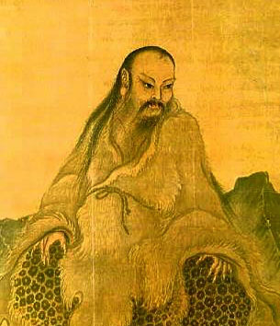
Review: Prepositions
Practice: Identify the prepositions.
Remember that prepositions’ function is to describe relationships – often relationships in time, space, or subject matter.
Fuxi was the husband (and brother!) of Nuwa. With his wife, Fuxi created the first human beings from clay. Fuxi is famous across China for inventing hunting, fishing, and cooking. According to legend, he lived for 197 years.
Fuxi

Slide 6
The Formula for a Prepositional Phrase
prepositional phrase
=
preposition
+
noun/pronoun*
+
modifiers
modifier
noun
preposition
According to Chinese legends,
the god Shennong had a transparent body.
the prepositional phrase
preposition
modifier
noun
He could see inside his stomach
to understand how medicinal plants work.
the prepositional phrase
*There are actually some other options for what can go here – we’ll talk about them later.

Slide 7
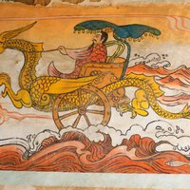
The Object of the
Preposition
Examples:
The Yellow Emperor had four faces to allow him to see in four directions.
noun
modifier
preposition
Remember that a subject is the actor in a sentence, while an object is the thing receiving the action.
The object of the preposition in a sentence, then, is the thing indicated by the preposition.
Remember the formula…
prepositional phrase = preposition + noun/pronoun + modifiers
The object of the preposition is the noun within the prepositional phrase.
the object of the preposition
prepositional phrase
noun
modifier
preposition
He had a chariot pulled by a dragon.
the object of the preposition
prepositional phrase

