Slide 1
Appositives and Norse Myths

Slide 2
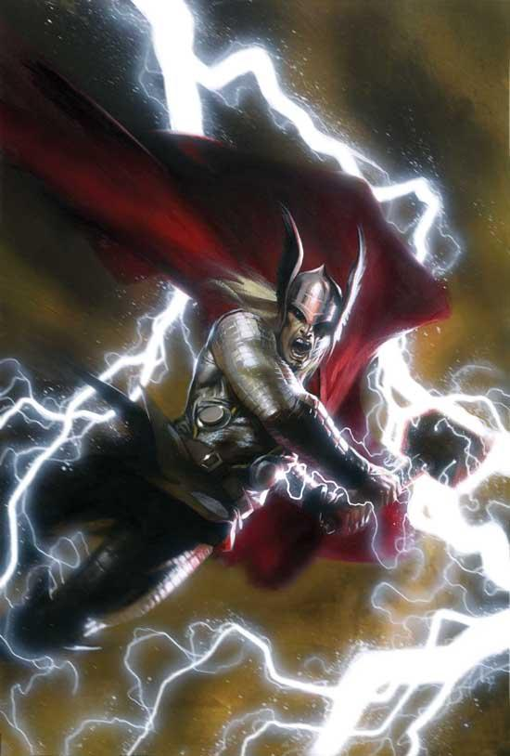
Definition of an Appositive
An appositive is a noun or noun phrase that renames another noun or noun phrase.
Example:
The thunder god Thor protects Asgard, the home of the gods.
“Thor” renames “the thunder god.”
“The home of the gods” renames “Asgard.”

Slide 3
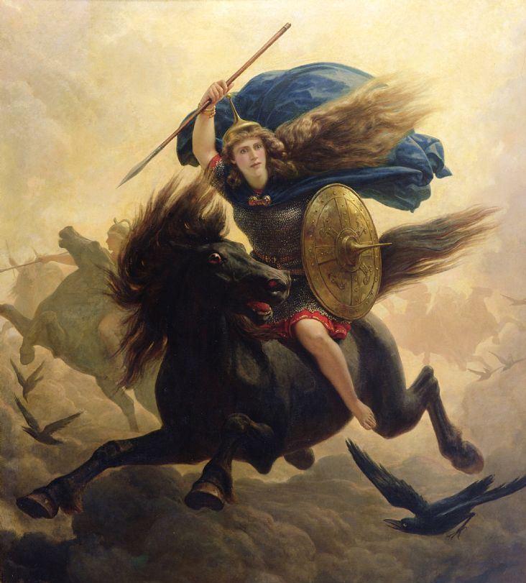
Practice – Identify the Appositive
Valkyries, goddesses of the battlefield, would choose souls to bring to Valhalla, the Norse version of Heaven.
“Goddesses of the battlefield” renames “Valkyries.”
“The Norse version of Heaven” renames “Valhalla.”

Slide 4
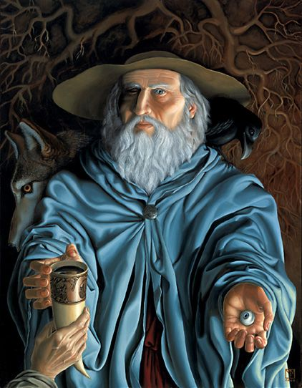
Practice – Identify the Appositive
A lover of wisdom, Odin sacrificed one of his eyes to have a sip from the well of knowledge.
“A lover of wisdom” renames “Odin” (even though it comes before “Odin”).

Slide 5
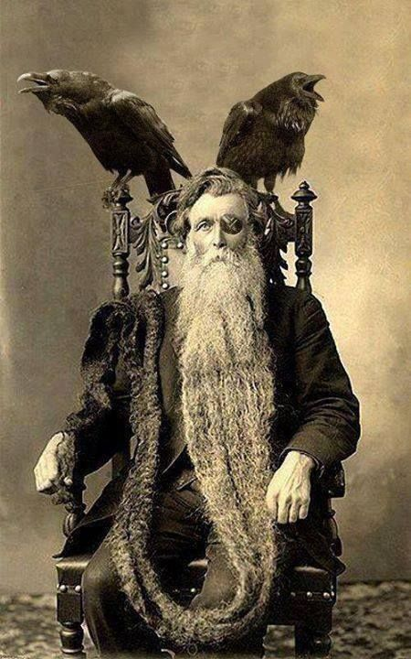
Practice – Identify the Appositive
Odin sends his pet ravens, Huginn and Muninn, to travel the world and bring him information about people.
“Huginn and Muninn” renames “his pet ravens.”

Slide 6
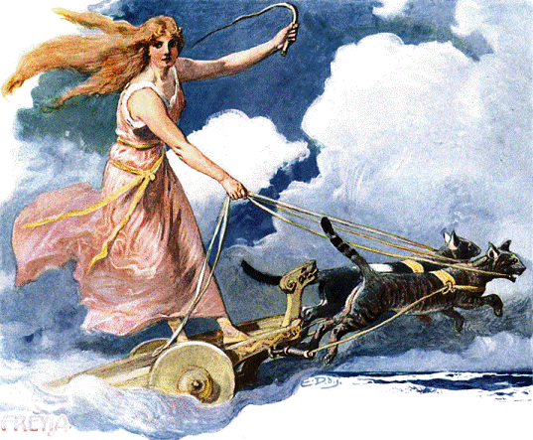
Practice – Identify the Appositive
Odin’s wife Freya, the goddess of love, rides a chariot pulled by two cats.
Both “Freya” and “the goddess of love” rename “Odin’s wife.”

Slide 7
Be careful when identifying appositives.
Appositives do NOT use verbs to rename.
Appositives
Not Appositives
Odin’s son Baldr was killed by a spear of mistletoe.
Norse mythology is my favorite!
verb
The famous composer Richard Wagner wrote four operas about Norse mythology.
Wagner’s operas were called The Ring Cycle.
verb
If the sentence uses a verb to rename, it is NOT an appositive; it’s something called a predicate nominative, which we will discuss later.

Slide 8
Using Commas with Appositives
If an appositive is essential to understanding the sentence, do NOT use commas to separate it.
If the sentence would make sense even if you removed the appositive, separate the appositive using commas.
Baldr’s mother, Freya, made all the objects in the kingdom swear not to hurt him – except for mistletoe.
Odin’s son Baldr had a dream that he would die.
Odin has two sons – if we took out “Baldr,” the sentence would not have the same meaning because we could not know which one it was talking about. Therefore, we do not separate “Baldr” from the rest of the sentence with commas.
Baldr only has one mother – Freya – so if we take out her name, we still know what the sentence means. Therefore, we offset “Freya” from the rest of the sentence with commas.

Slide 9
Using Commas with Appositives - 2
If an appositive is essential to understanding the sentence, do NOT use commas to separate it.
If the sentence would make sense even if you removed the appositive, separate the appositive using commas.
Since Baldr was practically invincible, the gods made a game of throwing things at him. Loki, the trickster god, made a spear out of mistletoe and got Hodr, Baldr’s brother, to throw it at Baldr and kill him.
Freya thought that the plant mistletoe was too insignificant to pose a risk, so she did not ask it to promise not to hurt Baldr.
It is important to the story that out of all the plants in the world, it was mistletoe in particular that did not make a promise. If we took it out of the sentence, we would lose something important.
Although the appositive in this sentence give us more information, the sentence is not ambiguous without them and still communicates the same message.

Slide 10
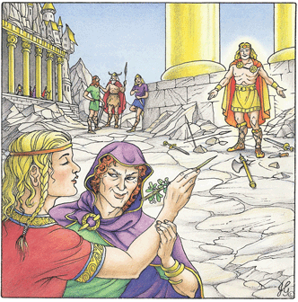
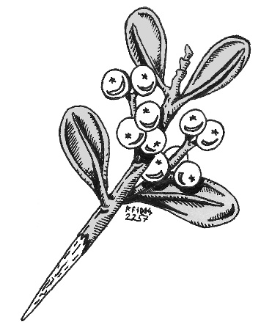

Slide 11
Why use Appositives?
Appositives allow skillful writers to communicate more in fewer words.
consider
Fenrir was the son of Loki. Fenrir was also a wolf. He was very strong and the other gods were afraid of him. They tried to trick him into wearing a set of unbreakable chains by telling him that it was a contest of strength. Fenrir was suspicious and he demanded that someone put their hand in his mouth while he wore them. There was a god named Tyr. Tyr was a selfless and noble god. Tyr volunteered to place his hand in Fenrir’s mouth. The other gods put the chains on Fenrir, and when he realized it was a trap, he chomped down on Tyr’s hand. (107 words)
versus
Loki’s son Fenrir, a wolf, was feared by all the other gods. They tried to trick him into wearing a set of unbreakable chains by telling him that it was a contest of strength. Fenrir was suspicious and he demanded that someone put their hand in his mouth while he wore them. Tyr, a noble and selfless god, volunteered to place his hand in Fenrir’s mouth. The other gods put the chains on Fenrir, and when he realized it was a trap, he chomped down on Tyr’s hand. (88 words)

Slide 12
