Slide 1
Parts of Speech:
Verbs and the Hero’s Journey

Slide 2
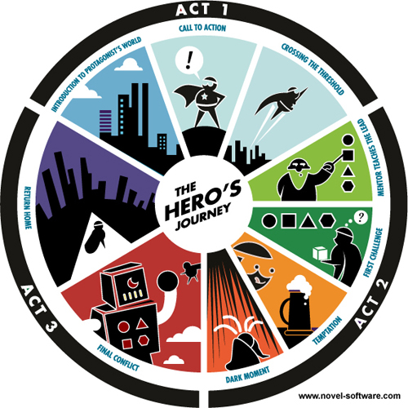
The Hero’s Journey is a pattern that many stories – from ancient myths to modern-day television – follow.

Slide 3
Definition
Hero’s Journey:
Stage 1 – The Ordinary World
Verbs communicate action, occurrence, or a state of being.
The hero lives in a peaceful or boring world.
action
The hero becomes great because of challenges and adventures.
occurrence
The hero is someone who might not seem special at the beginning.
state of being

Slide 4
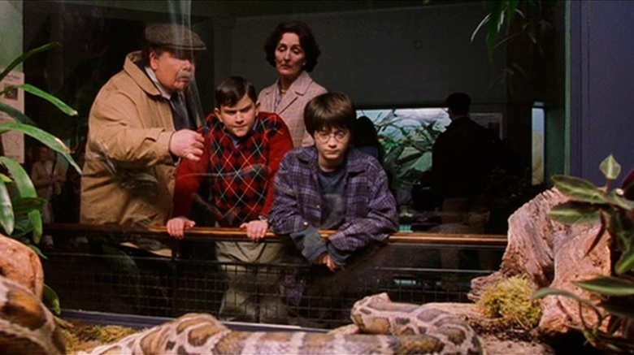
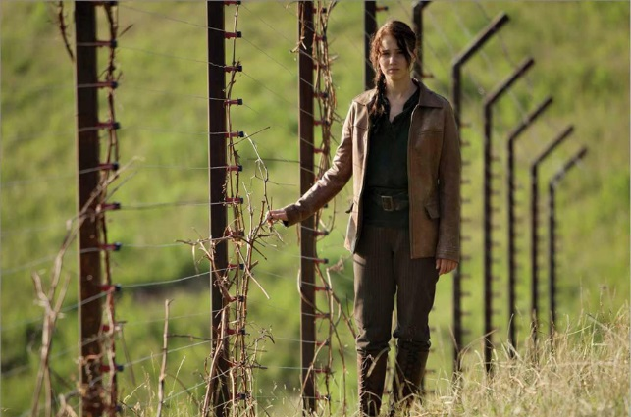

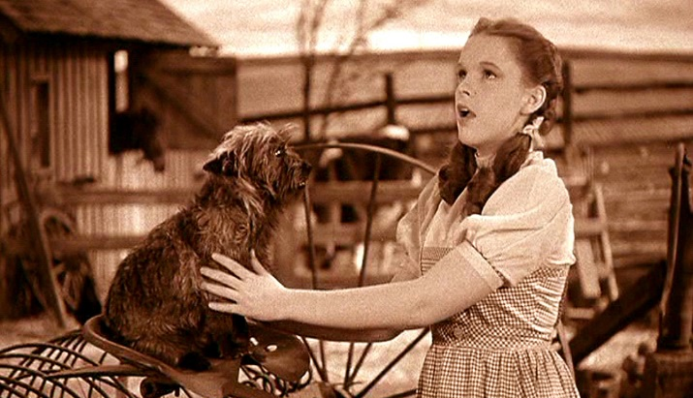
Hero’s Journey: Stage 1 – The Ordinary World
Identify the verb in the following examples:
The Dursley family is cruel to Harry Potter.
Katniss feels hopeless in District 12.
Frodo lives a peaceful life in the Shire.
Dorothy dreams of an exciting life outside of Kansas.

Slide 5
Conjugation
Hero’s Journey:
Stage 2 – The Call to Adventure
Verbs change form depending on the person and number of the associated noun.
The hero receives a message or a sign that tells him or her to go on a quest.
The verb “to receive” is conjugated as “receives” because its noun is in third person, singular.
 | singular | plural
first person | I live | we live
second person | you live | you (y’all) live
third person | he/she/it lives | they live
Many verbs only change form in the third person singular, in which an “s” or “es” is added to the base.

Slide 6

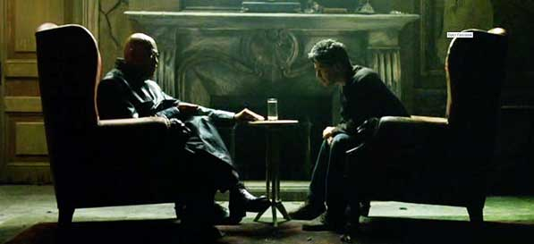
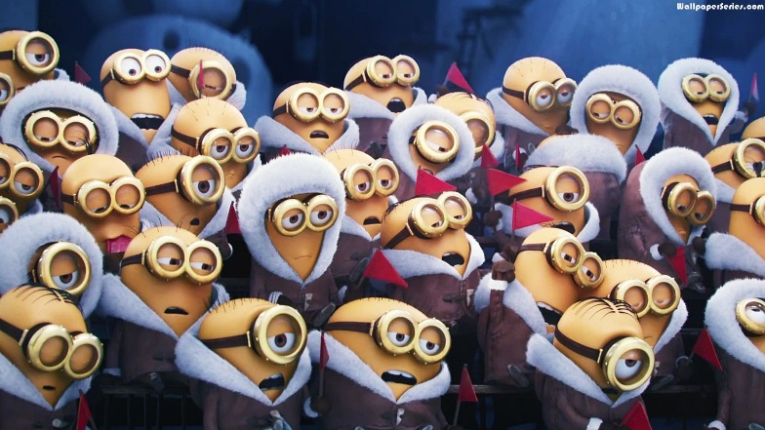
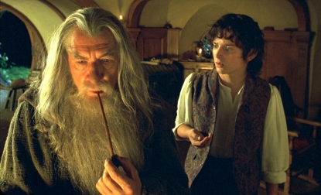
Hero’s Journey: Stage 2 – The Call to Adventure
Is the underlined verb conjugated correctly in the following examples? (This is called “subject-verb agreement.”)
Harry Potter gets a mountain of letters inviting him to attend school at Hogwarts.
Morpheus tell Neo that the world he lives in isn’t real.
Gandalf ask Frodo to destroy the ring of power.
The Minions feels sad without a leader.

Slide 7
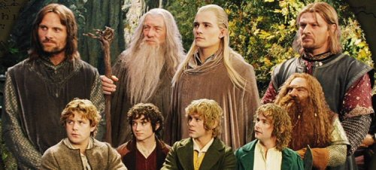
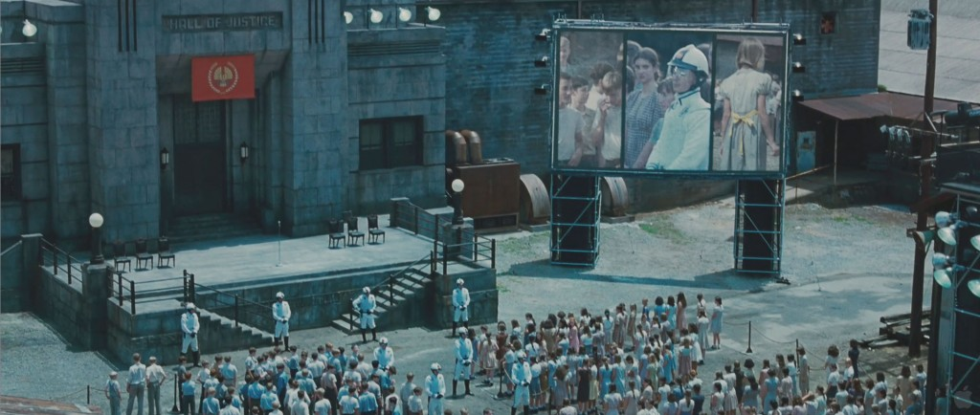
Collective Nouns and Subject-Verb Agreement
Remember – collective nouns are units made up of multiple things or people (the class, the group, the family, the flock, the company, etc.). Deciding whether to use the singular or the plural form of the verb for a collective noun can be tricky.
If the members of the collective noun are all acting together, use the singular form of the verb.
If the members of the collective noun are acting separately, use the plural form of the verb.
They each hope individually, so the verb is plural.
They all promise together, so the verb is singular.
The Fellowship of the Ring promises to help Frodo in his quest.
The crowd in District 12 hope not to be reaped.

Slide 8
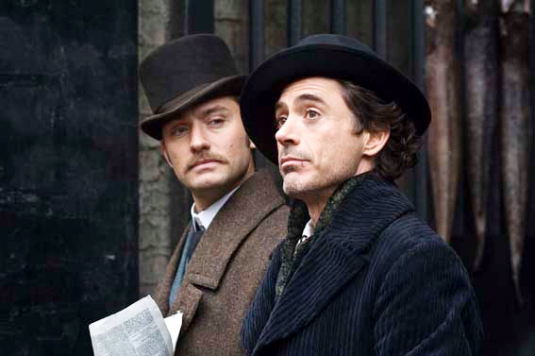
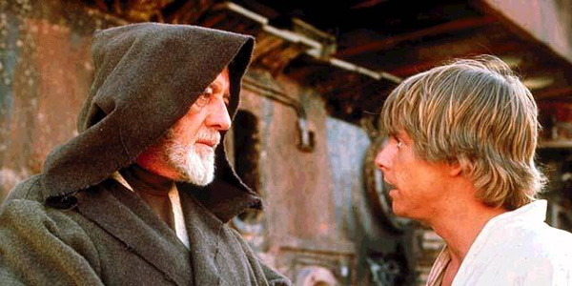
Compound Subjects and Verb Agreement
We’ll talk about subjects later, but for now, know that they are usually nouns. Compound subjects with two or more nouns take the plural form of the verb.
Sherlock Holmes and Dr. Watson receive a letter asking them to solve a mystery.
Obi-Wan Kenobi and Princess Leia beg Luke Skywalker to fight against the Empire.
You could write the sentence as…
You could write the sentence as…
They receive a letter asking them to solve a mystery.
They beg Luke Skywalker to fight against the Empire.
third person plural
third person plural

Slide 9
Tense (time)
Hero’s Journey:
Stage 3 – Refusal of the Call
Verbs also change form depending on the time in which they take place.
The hero refused the request to go on an adventure.
The verb “to refuse” is conjugated as “refused” to indicate that the action took place in the past.
(for the first person singular)
But eventually, the hero will accept that the adventure is his or her destiny.
past simple | present simple | future simple
I lived | I live | I will live
The verb “to accept” is conjugated as “will accept” to indicate that the action will take place in the future.
For many verbs, you add “d” or “ed” to the stem to put it in past simple; you add the word “will” before the stem to put it in future simple..

Slide 10
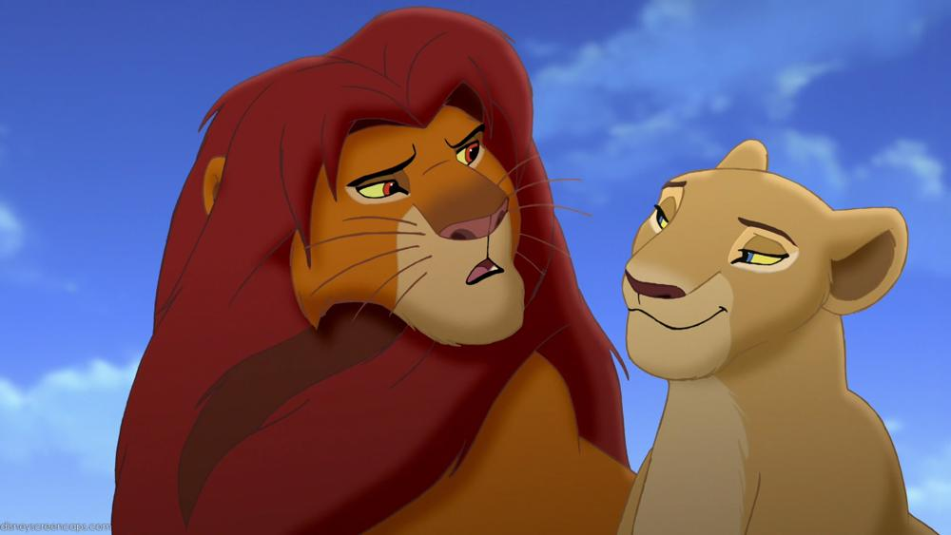
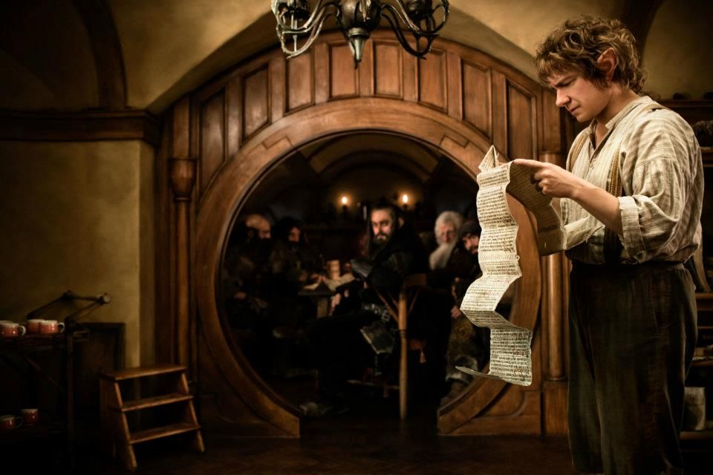
Hero’s Journey: Stage 3 – Refusal of the Call
What does the form of the underlined verb say about the time during which the action takes place?
Nala asked Simba to return to the Pride Lands to fight Scar, but Simba said “no.”
Bilbo will tell the dwarves to leave him alone after they eat all of his food.

Slide 11
Aspect (progression of time)
Hero’s Journey:
Stage 4 – Meeting with the Mentor
Verbs also change form depending on how they are happening during the time they take place.
When the hero is starting the quest, a mentor appears to offer training, advice, and tools.
(for the first person singular)
The present continuous form of the verb “is starting” indicates that is takes place over a period of time; “is starting” communicates a different message from “starts.”
 | past | present | future
simple | I walked. | I walk. | I will walk.
continuous/ progressive | I was walking. | I am walking. | I will be walking.
perfect | I had walked. | I have walked. | I will have walked.
After the mentor has helped the hero, the hero is ready to face great challenges.
simple: limited information about the progression of time
continuous/progressive: happening over a span of time
perfect: happens at a specific point in time (that point can be long or short)
The present perfect form of the verb “has helped” indicates that this action is a specific point or stage of the journey.

Slide 12
Explanation of Verb Tenses and Aspects*
 | past | present | future
simple | I loved existing or happening in the past | I love existing or happening now | I will love existing or happening in the future
continuous/ progressive | I was loving existing or happening over a period of time in the past | I am loving existing or happening over a period of time now | I will be loving existing or happening over a period of time in the future
perfect | I had loved existing or happening before a specific time in the past | I have loved existing or happening sometime before now | I will have loved existing or happening before a specific time in the future
*adapted from The Holt High School Handbook 2 (1995)

Slide 13
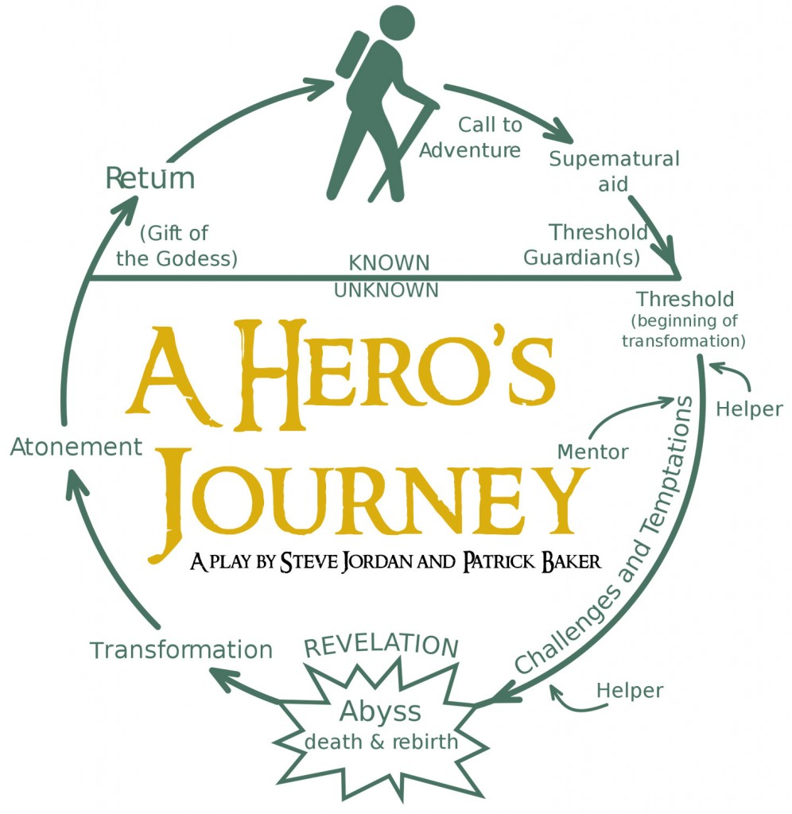
is starting (continuous/progressive)
has helped (perfect)

Slide 14
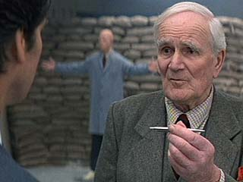

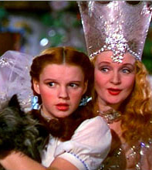
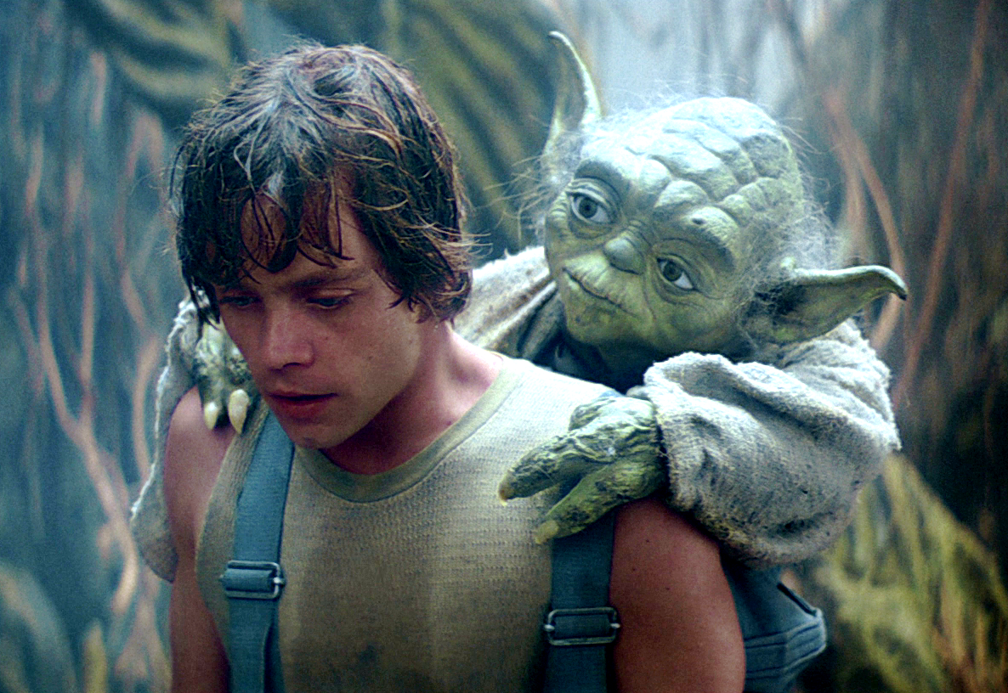
Hero’s Journey: Stage 4 – Meeting with the Mentor
Is the underlined verb in past, present, or future tense? Is it in simple, continuous/progressive, or perfect aspect? How does its form determine its meaning?
Q from James Bond is teaching James how to use a poisoned pen.
Glinda the Good Witch appeared after Dorothy’s house had killed the Wicked Witch of the East.
Although he gives Luke Skywalker lots of wise advice, Yoda will have died before Luke defeats Darth Vader.

Slide 15
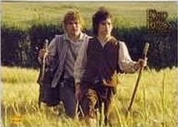
Consistency of Tense
Hero’s Journey: Stage 5 – Crossing the Threshold
Writers should make sure that all of the verbs in a particular work are in the same tense, to avoid reader confusion.
After stumbling along for some way along the stream, they came quite suddenly out of the gloom. As if through a gate they saw the sunlight before them. Coming to the opening they found that they had made their way down through a cleft in a high sleep bank, almost a cliff [.…]
The four hobbits stepped over the wide stone threshold, and stood still, blinking. They were in a long low room, filled with the light of lamps swinging from the beams of the roof; and on the table of dark polished wood stood many candles, tall and yellow, burning brightly.
- Lord of the Rings: The Fellowship of the Ring
Notice how all of the verbs are in past tense.

Slide 16
The Emphatic Form
Hero’s Journey:
Stage 6 – Tests, Allies, and Enemies
The emphatic form is created by adding the correct conjugation of “to do” to the subject-verb relationship.
Although the hero might be brave and strong, he or she does need help – often in the form of a sidekick.
The addition of “does” emphasizes the word “need.”
 | singular | plural
first person | I do love | we do love
second person | you do love | you (y’all) do love
third person | he/she/it does love | they do love
In spite of the fact that the minor obstacles the hero encounters make life more challenging, they do serve the purpose of teaching the hero important lessons.
Note #1: The order of the words can be inverted to create a question: “Do you love me?” – “You do love me!”
Note #2: The meaning of “do” is different when it is used for emphasis than when it is the verb itself: “I do basketball.”
The addition to “do” emphasizes the fact that the obstacles are helpful.

Slide 17
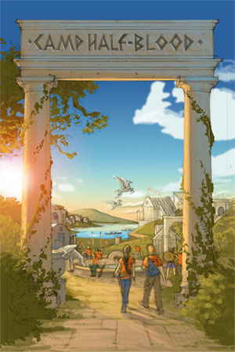
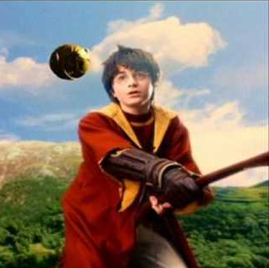
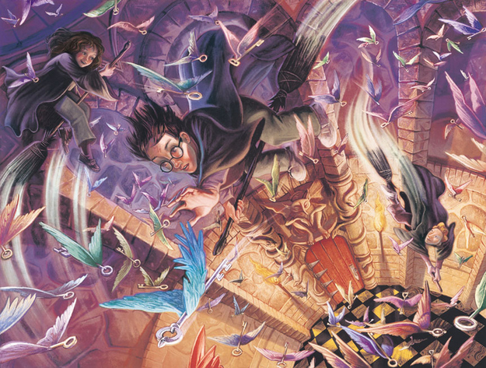
Hero’s Journey: Stage 6 – Tests, Allies, and Enemies
Explain how the addition of the word “do” or “does” changes the meaning of the sentence.
Although Camp Half-Blood is a lot of fun, campers do work hard to train for combat.
Does Harry use the skills he learned on the Quidditch field to defeat Professor Quirrel?

Slide 18
Auxiliary (Helping) Verbs
Hero’s Journey:
Stage 7 – Temptation and the Goddess
When a verb is formed by using two or more verbs, the non-action verb is called an “auxiliary” or “helping” verb.
The hero is going on his or her quest when he or she encounters temptation (often in the form of a woman).
The hero should resist the temptation.
A goddess or a strong woman might appear to inspire the hero.
Auxiliary verbs include any form of the verbs to be, to do, and to have, as well as the words can, could, may, might, must, ought to, shall, should, will, would.
At the end of the journey, if the hero has listened to the goddess, he or she will be successful.

Slide 19
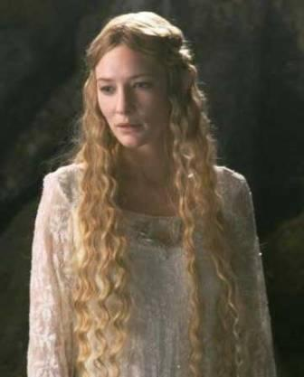

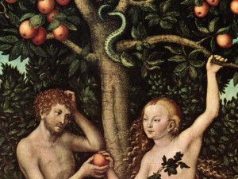
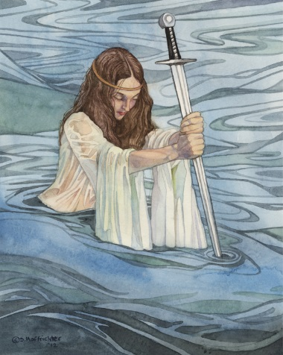
Hero’s Journey: Stage 7 – Temptation and the Goddess
Identify the auxiliary verbs in the following sentences.
Although the Elf Queen Galadriel considers taking Frodo’s ring, she does decide to help him.
After Megara has betrayed Hercules, she feels remorse.
In the picture above, the Lady of the Lake is giving King Arthur his famous sword.
Adam ought to resist when Eve offers him an apple.

Slide 20
Linking Verbs
Hero’s Journey:
Stage 8 – The Abyss/the Underworld/the Innermost Cave/the Darkest Place
Linking verbs do not express action. Instead, they link a noun to more information about that noun.
The hero feels scared when he or she approaches a literal or metaphorical cave.
Common linking verbs include forms of the following:
to be
to become
to appear
to seem
to look, sound, smell, taste, feel
to grow
to remain
to prove
to stay
The verb “feels” links “hero” and “scared.”
But the hero is able to face that fear.
The verb “is” links “hero” and “able.”
The hero proves courageous and grows stronger as a result of confronting such a great challenge.
The verb “proves” links “hero” and “courageous”; the verb “grows” links “hero” and “stronger.”

Slide 21
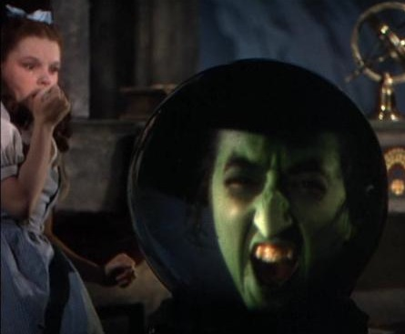
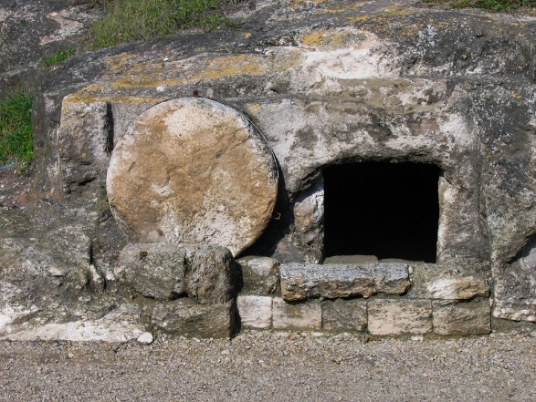
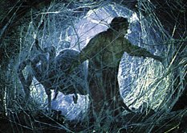
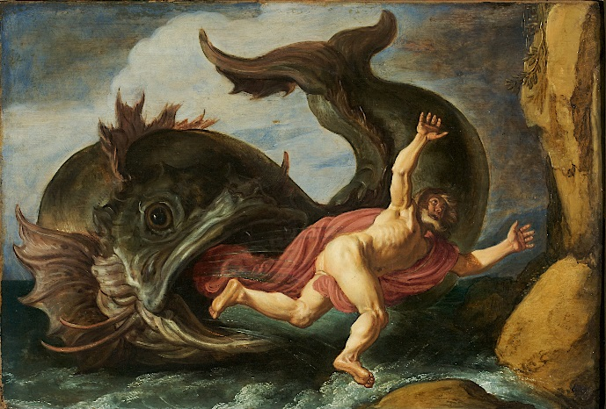
Hero’s Journey: Stage 8 – The Abyss/the Underworld/the Innermost Cave/the Darkest Place
Identify the linking verbs in the following sentences.
Dorothy is terrified after the flying monkeys bring her to the witch’s castle.
Jesus appears dead and his body is brought to a cave.
Frodo becomes sick after a giant spider chases him through her cave and bites him.
Jonah remains faithful, even after he is swallowed by a whale.

Slide 22
Transitive and Intransitive Verbs
Hero’s Journey:
Stage 9 – The Ordeal
The hero confronts the greatest challenge of all.
Transitive verbs transfer action from a subject to an object (we’ll talk more about this later). Intransitive verbs do not transfer action.
Does the hero confront a thing? Yes (“the greatest challenges of all”); the verb is transitive.
The Ordeal is extremely difficult.
Examples of Transitive Verbs:
I eat cookies.
You read books.
She loves dinosaurs.
Examples of Intransitive Verbs:
laugh
fall
happen
agree
live
sleep
etc.
Does the hero “is” a thing? No; that wouldn’t make any sense. Therefore the verb is intransitive.

Slide 23
Infinitives
Hero’s Journey:
Stage 10 – The Reward
We will talk more about infinitives later, but for now, you need to know that an infinitive is the word “to” plus the present-simple-singular-first-person form of the verb.*
The hero often receives a great reward to honor his or her triumph.
The hero might need to take the reward away from the enemy.
Examples of Infinitives:
to walk
to read
to watch
to meditate
to make
Although the reward may be a physical object, it may also be intangible (happiness or love, for example) that the hero needed to go on an adventure to appreciate.
*Note – be careful not to confuse the use of the word “to” in an infinitive with the word “to” used in a preposition – for example, “We go to Bellaire High School.”

Slide 24
Participles and Gerunds
Hero’s Journey:
Stage 11 – The Road Back
Participles and gerunds are forms of a verb. (We will talk much more extensively about participles and gerunds later.) For now, you need to know that there are present participles (the verb + “ing”) and past participles (the verb + “ed” or “d”).
When the hero finishes defeating the enemy, he or she must return to the ordinary world.
After the quest is completed, the hero might have trouble returning to his or her old life.
verb | present participle/ gerund | past participle
learn | learning | learned
paint | painting | painted
study | studying | studied

Slide 25
Irregular Verbs
Hero’s Journey:
Stage 12 – Resurrection/Elixir
Many verbs are irregular, which means that they do not follow the rules for forming the simple past and the past participle. There is no way to learn these words other than memorization.
After he or she returns to the ordinary world, the hero will have brought back something – a treasure, wisdom, etc. – to make the world different and better.
Examples of Irregular Verbs:
The word “brought” is the past participle of “bring.” The verb is irregular because “bringed” would be incorrect.
simple present | simple past | past participle*
begin | began | begun
eat | ate | eaten
give | gave | given
At this stage of the journey, the hero is also often reborn – either literally, in a new body, or metaphorically, in a new frame of mind.
*The past participle is used to form the perfect aspect (past perfect, present perfect, and future perfect). For example:
I had begun my homework, but was interrupted.
I have already eaten, so I am not hungry.
I have given my present to my friend for his birthday.
The word “reborn” is the past participle of “rebear” (as in, a child). The verb is irregular because “rebeared” would be incorrect.

