Slide 1
Pronouns and Puns
a grammar adventure!

Slide 2
A pronoun is a word that replaces or stands in for a noun (or another pronoun).
“He” renames the “guy.”
Did you hear about the guy whose whole left side was cut off? He is all right now.
If a pronoun ever encounters an antinoun, the universe as we know it will cease to exist.
The noun that a pronoun replaces is called the antecedent.

Slide 3
Before we go any further, we need to explain the difference between the subject and the object of a sentence.
The subject is the one performing the action.
The object is the one receiving the action.
subject
I love you.
object
In these two sentences, “I” and “me” refer to the same individual, but the word changes – that is because pronouns change depending on whether they are the subject of object of the sentence.
subject
You love me.
object

Slide 4
Pronoun Category #1: Personal Pronouns
There’s nothing punny on this page….
Personal pronouns help the reader of a sentence identify what kind of person (first, second, or third) is discussed in a sentence. The form of the pronoun changes depending on its function in the sentence.
 | Singular |  |  |  | Plural
Function in Sentence | Subject | Possessive | Possessive | Object | Subject | Possessive | Possessive | Object
First Person | I | my | mine | me | we | our | ours | us
Second Person | you | your | yours | you | you | your | yours | you
Third Person | he, she, it | his, hers, its | his, hers, its | him, her, it | they | their | theirs | them

Slide 5
Let’s practice!
Consult your chart to fill in the missing personal pronouns based on their function in the sentence.
It
I am reading a book about anti-gravity. ___ is impossible to put down.
The pronoun in this sentence functions as a third person, singular, ungendered subject.
they
I don't trust these stairs because ______ are always up to something.
The pronoun in this sentence functions as a third person, plural, ungendered subject.
his
My friend's bakery burned down last night. Now ____ business is toast.
The pronoun in this sentence functions as a third person, singular, masculine possessive.
I was struggling to understand how lightning works, and then it struck ____.
me
The pronoun in this sentence functions as a first person, singular object.

Slide 6
More practice!
Consult your chart to fill in the missing personal pronouns based on their function in the sentence.
When the cannibal showed up late to the luncheon, they gave _____ the cold shoulder.
him
The pronoun in this sentence functions as a third person, singular, masculine object.
she
her
Maggie was going to buy a book on phobias, but _____ was afraid it wouldn't help _____.
The first pronoun in this sentence functions as a third person, singular, feminine subject; the second pronoun functions as third person, singular, feminine object.
you
it
Did ____ hear about the guy who got hit in the head with a can of soda? He was lucky ___ was a soft drink.
The first pronoun in this sentence functions as a second person subject; the second pronoun functions as third person, singular, ungendered subject.
A prisoner's favorite punctuation mark is the period. It marks the end of ____ sentence.
his
The pronoun in this sentence functions as a third person, singular, masculine possessive.

Slide 7
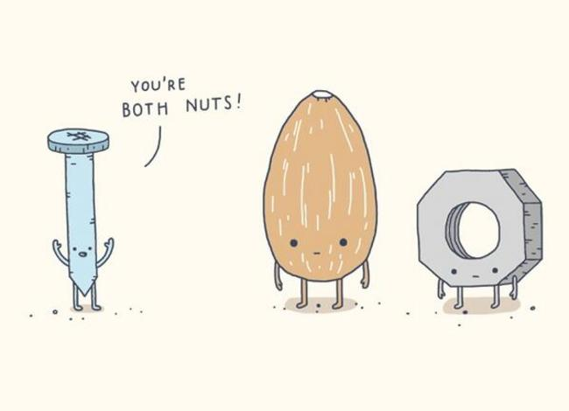

Slide 8
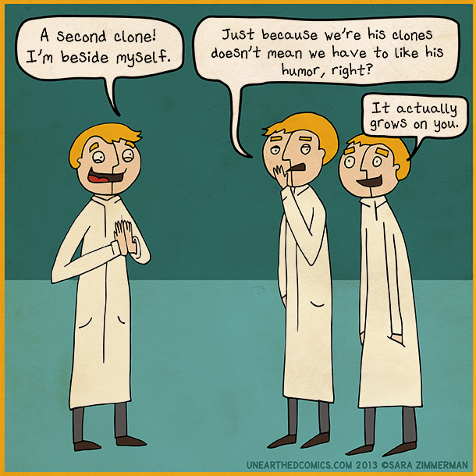
Pronoun Category #2: Reflexive/Compound Personal Pronouns
Reflexive pronouns are usually used as object pronouns when the subject and object of a sentence are the same entity (that is, when the subject’s action reflects back on itself).
 | Singular | Plural
First Person | myself | ourselves
Second Person | yourself | yourselves
Third Person | himself, herself, itself | themselves
Examples:
I wish myself a happy birthday, because no one else will.
You tell yourself everything will be all right.
He shot himself in the foot on accident.

Slide 9

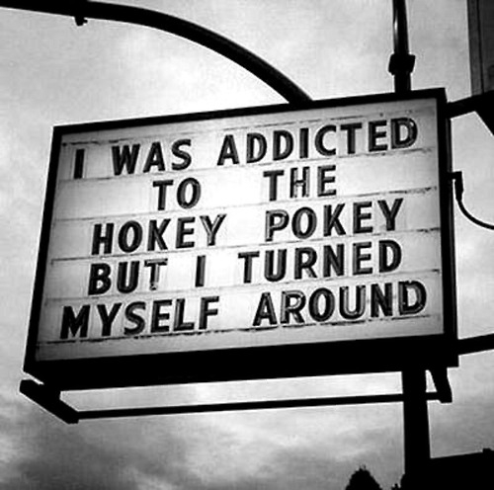
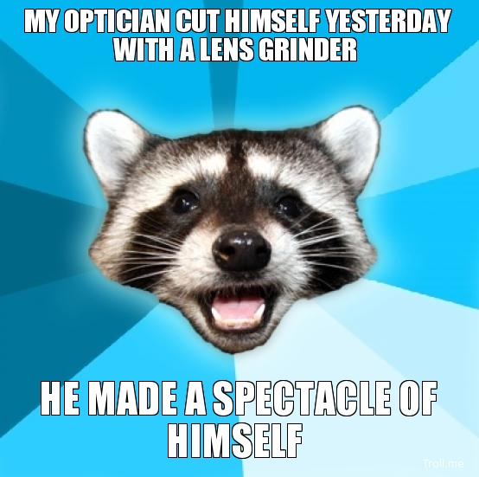

Slide 10
Pronoun Category #3: Interrogative Pronouns
Who took the cookie from the cookie jar?
Interrogative pronouns are placeholders for things whose identity we don’t know. They are used in questions.
“Who” is the subject of the sentence; we could replace it with “she” or “Hortensia.”
Whom do you love?
“Whom” is the object of the sentence; we could rewrite the sentence as, “Do you love Dagoberto?”
 | subject | object
person | who | whom
thing | what
person or thing | which
possessive | whose
What is your problem?
“What” is the subject of the sentence; we could rewrite the sentence as, “A personality disorder is your problem.”
Which witch is your favorite?
Ms. Chapman noticed that one of her students was not paying attention in class. She said to the student, “Name two pronouns.” The student said, “Who? Me?”
“Which” is an object pronoun; the sentence could be rewritten as “My favorite is that witch, the one with the sandwich.” (“That” is also a pronoun.)
Whose lasagna is the best?
“Whose lasagna” is the subject of the sentence, and could be replaced with “my lasagna.”

Slide 11
Pronoun Category #4: Relative Pronouns
Relative pronouns relate (that is, connect or link) a noun (or another pronoun) to a noun phrase, adjective phrase, or adverb phrase.

Slide 12
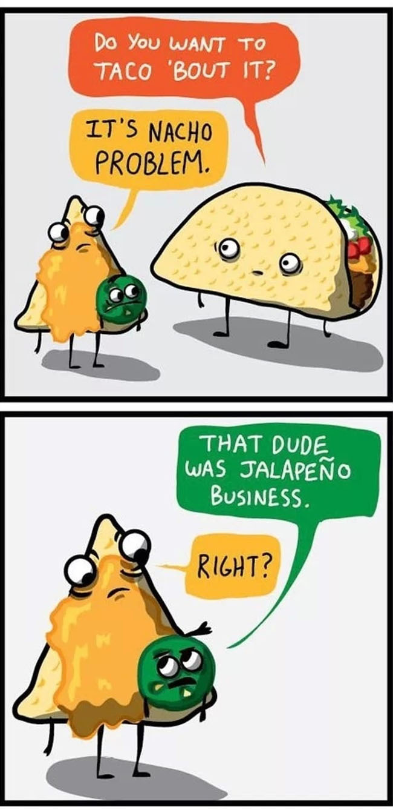

Slide 13
Puns from…
http://www.punoftheday.com/cgi-bin/disppuns.pl?ord=F
http://kickasshumor.com/all-time-best/18/funny-puns
http://bilinguish.com/2013/08/03/english-grammar-jokes/
http://distractify.com/jake-heppner/puns/

