Slide 1
Parts of Speech:
Prepositions and Heroic Archetypes

Slide 2
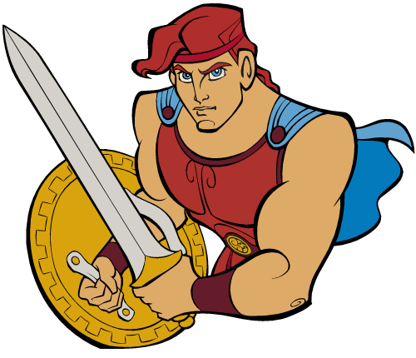
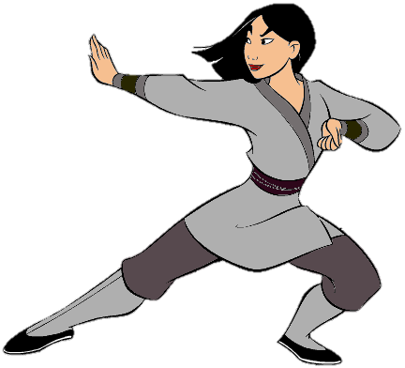
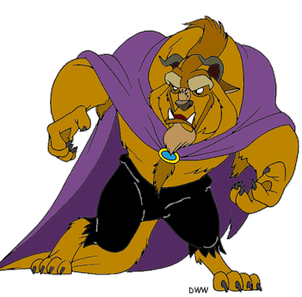
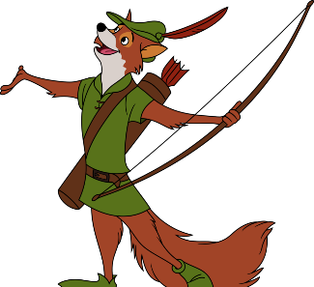
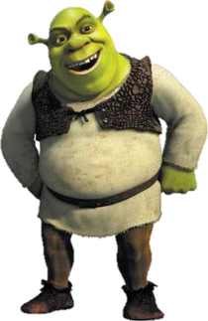
Before we begin… Heroic Archetypes
An archetype is a pattern in literature that extends across time and culture. Over the course of this year, we will examine several different kinds of heroic archetypes.
the Classical Hero
The classical hero comes to us from the mythology of Ancient Greece and Rome. He’s a “golden boy” – strong, brave, handsome, and good. Examples: Hercules and Superman
the Heroine
Although all of the heroic archetypes can be women, women as heroes often encounter challenges and possess strengths unique to their gender. Examples: Wonderwoman and Mulan
the Byronic/Romantic Hero
The Romantic or Byronic (named after English poet Lord Byron) hero is a dark, mysterious, complicated loner. (Also note that “Romantic” doesn’t mean “kissy-kissy, smooch-smooch” – it’s a philosophy that we’ll discuss in-depth later. Examples: Batman and Robin Hood
the Anti-Hero
An anti-hero is in many ways the opposite of the classical hero. He possesses many flaws and vices, and yet is spite of these is able to accomplish something great. Examples: Dexter Morgan and Shrek
the Tragic Hero
A tragic hero is a sympathetic figure who often has a fatal character flaw (such as too much pride). That flaw will lead to his or her downfall. Examples: Oedipus and Beast

Slide 3
Definition
The Classical Hero - Example
Prepositions describe relationships (often space and time).
Hercules is the son of Zeus.
The preposition “of” helps us understand Hercules’ relationship to Zeus.
Hercules was a servant to King Eurystheus for ten years.
The preposition “for” is a preposition of time.
After his death, Hercules became a god and ascended to Mount Olympus.
The preposition “to” is a preposition of place.

Slide 4
Common Prepositions
about
above
across
after
against
along
among
around
at
before
behind
below
beneath
beyond
by
during
near
of
off
over
past
through
toward
upon
with

Slide 5
The object of the preposition
The Heroine - Example
The object of the preposition is the thing the preposition connects to the subject. It usually comes after the preposition. (The subject is the actor or the focus of the sentence – we’ll talk more about this later.)
Mulan fights against the Hun army.
“The Hun Army” is the object of the preposition “against.”
Mulan must hide her gender from Li Shang.
“Li Shang” is the object of the preposition “from.”
Mushu the dragon teaches Mulan about being a man.
“Being a man” is the object of the preposition “about.”

Slide 6
Prepositional Phrases
The Tragic Hero - Example
A preposition + the object of that preposition + any modifiers = a prepositional phrase.
prepositional phrase
Belle is locked in the ancient castle.
prepositional phrase
prepositional phrase
She falls in love with the Beast.

Slide 7

Prepositions, Adverbs, and Conjunctions
The Romantic Hero - Example
Words that are prepositions can also sometimes function as adverbs or subordinating conjunctions.
  Remember that adverbs describe how, when, where, to what extent, how much, and how often a verb is done.
Robin Hood lives in Sherwood Forest.
The prepositional phrase “in Sherwood forest” also helps us understand something about HOW Robin Hood lives (a verb), so the phrase acts as an adverb.
After he stole the king’s treasure, Robin Hood was branded an outlaw.
In this sentence, “after” is both a preposition and a subordinating conjunction.

Slide 8
Ending a sentence with a preposition
The Anti-Hero - Example
Traditional wisdom holds that writers should not end a sentence with a preposition because it is unclear and confusing. You might have teachers who expect you to follow this rule, and you might have others who don’t care. Regardless, it’s important to be aware of the rule and be able to practice it, should the need arise.
Fairytale characters move to the swamp Shrek lives in.
REVISED
Fairytale characters move to the swamp in which Shrek lives.
The dragon was a fearsome creature to fight with.
REVISED
The dragon was a fearsome creature with whom to fight.

