Slide 1
Parts of Speech:
Nouns and Articles and Superheroes

Slide 2
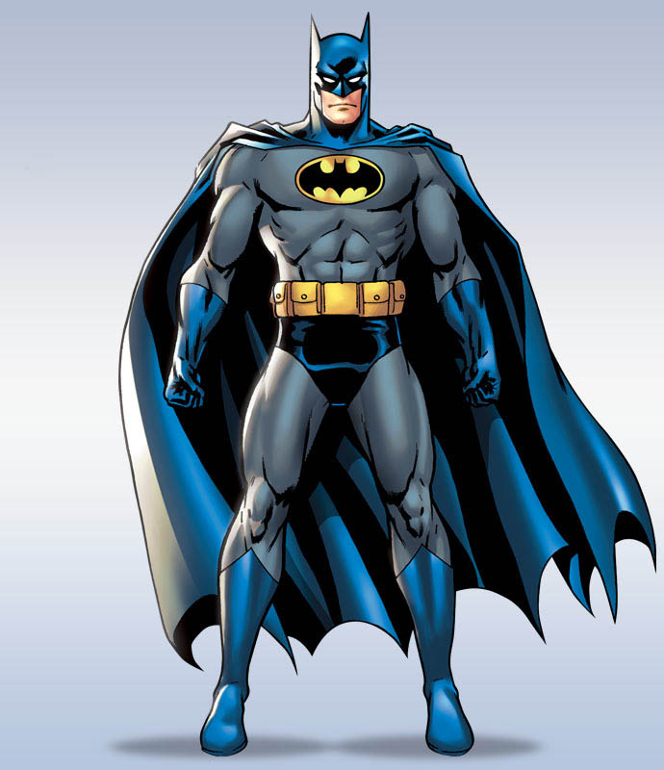

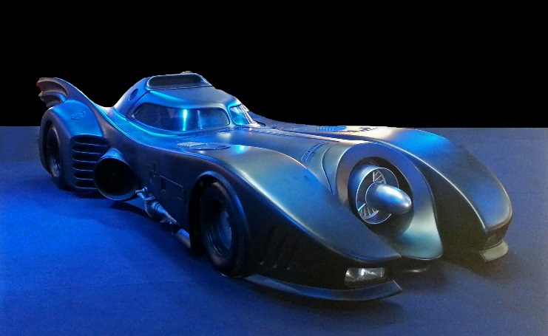

Time Warp Back to Elementary School: What is a noun?
You may remember your third grade teacher telling you that a noun is a person, place, thing, or idea. She was right!
Batman (person)
Gotham City (place)
Batmobile (thing)
justice (idea)

Slide 3

Nouns can do different jobs within a sentence.
Superman fights Lex Luthor.
(subject)
Lex Luthor tells Superman a secret.
(indirect object)
Lex Luthor fights Superman.
(direct object)
Clark Kent is Superman.
(subject complement)
Lex Luthor gives kryptonite to Superman.
(object of preposition)
If you don’t know what all of these parts of a sentence are, don’t worry! We will learn about them this year.

Slide 4

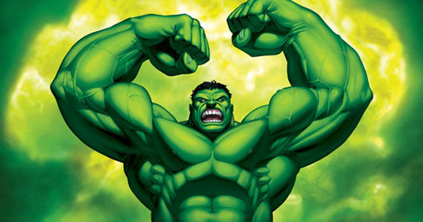
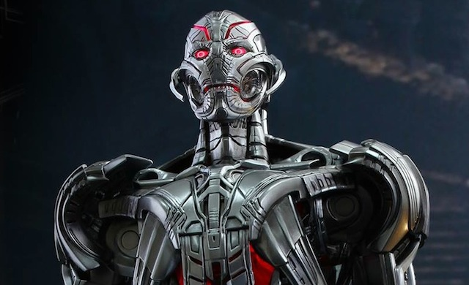
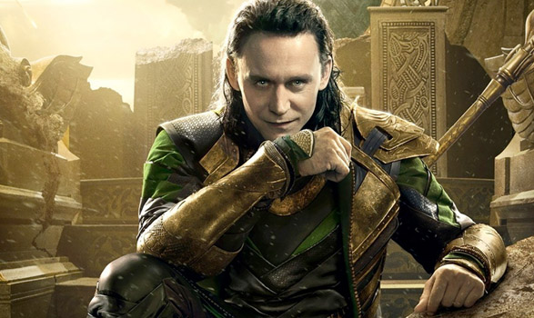
Nouns are often accompanied by another kind of word called an “article.”
Writers use articles to explain whether they are talking about one specific noun, or a nonspecific, general noun.
Examples of Articles:
“The” is called a definite article. It is used to talk about one particular person, place, or thing.
The Avengers
The Incredible Hulk
“A” and “an” are called indefinite articles. They are used to talk about a general person, place, or thing.
“An” is used instead of “a” for words that start with a vowel or vowel sound (some words beginning with “h”).
A robot
An enemy

Slide 5


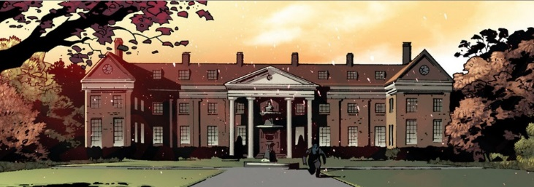

Proper versus Common Nouns
Proper nouns refer to a specific person, place, or thing.
Common nouns refer to a general person, place, or thing.
People believe Wolverine can save them.
People believe heroes can save them.
The students attend Xavier’s School for Gifted Youngsters.
The students attend school.
Proper nouns should be capitalized, while common nouns should be in lower-case (unless they are at the start of the sentence).

Slide 6

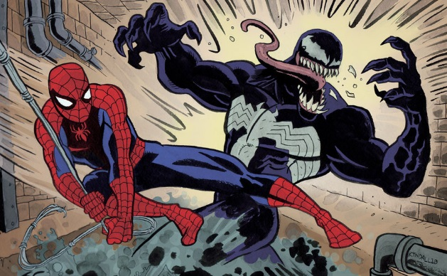

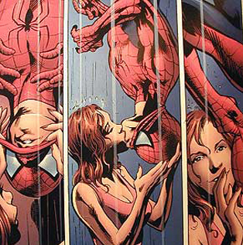
Count versus Non-count Nouns
Count nouns refer to nouns that you can count.
Non-count nouns refer to nouns that you cannot count.
Spiderman climbs buildings.
Spiderman fights evil.
Spiderman has spidey senses.
Spiderman kisses Mary Jane in the rain.

Slide 7
Count Nouns and Plurals
Count nouns turn into plurals when there is more than one. To make a noun plural, you usually add “s” to the end of the word. For some nouns that end in “y,” you change the “y” to “ies.” For some irregular words, you add “es” (often words that already end in “s,” “o,” “x,” “ch,” or “sh”), and for others, you change the form of the word entirely.
adding “s”
“y” to “ies”
adding “es”
other
singular
plural
singular
plural
singular
plural
singular
plural
villain
villains
enemy
enemies
hero
heroes
tooth
teeth
monster
monsters
city
cities
goddess
goddesses
person
people
Other Exceptions…
You won’t need to use these rules that often, but it’s good to know!
singular plural singular plural singular plural singular plural singular plural
-us -I -um -a - f/fe -ves -is -es -ix -ices
fungus fungi phylum phyla wolf wolves analysis analyses appendix appendices
cactus cacti curriculum curricula life lives thesis theses matrix matrices

Slide 8
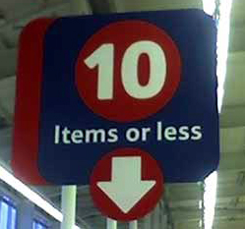

Count and Non-count Nouns and Quantity Adjectives
The word “fewer” is only used for count nouns; the word “less” is only used for non-count nouns.
WRONG! You can count the number of items in your cart.
The word “many” is only used for count nouns; the word “much” is only used for non-count nouns.
Although Tony Stark has many friends, he doesn’t have much happiness in his life.

Slide 9
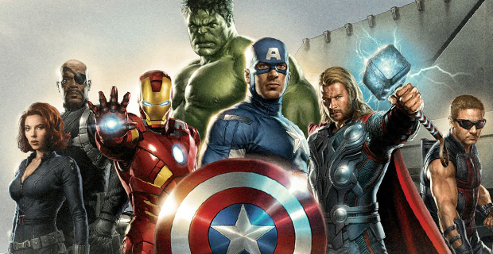
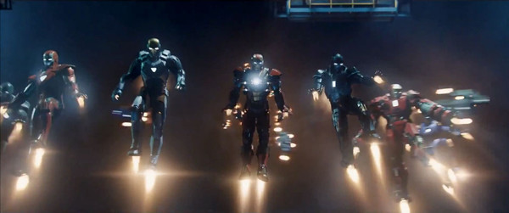

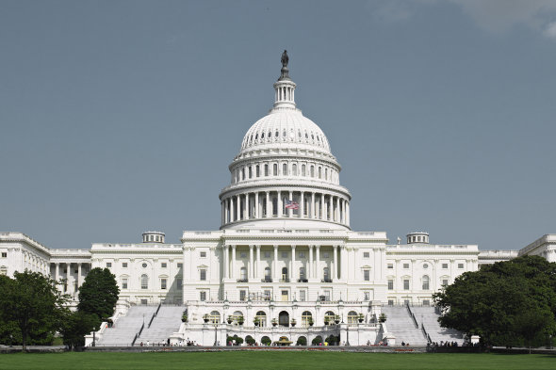
Collective Nouns
Collective nouns are words that refer to a group of things (or people, or animals, or places, etc.). Understanding collective nouns becomes important when deciding what form of a verb to use (we’ll talk about this later).
the team
the army
the public
the government

Slide 10
Concrete versus Abstract Nouns
Concrete nouns are things that you can perceive with your senses (things that you can see, hear, smell, taste, or touch). Abstract nouns are things that you cannot perceive with your senses – often ideas or concepts.
concrete
abstract
crime
muscle
justice
Batman
Arkham Asylum
insanity
criminal
strength
Concrete or abstract?

Slide 11


Gendered Nouns
In English, almost all of our nouns are neutral (that is, they do not have a gender). Some other languages (Spanish, French, Latin, etc.) assign gender to almost all of their nouns, even those that are not human. Here are some of the exceptions in English:
Today, most writing guidelines advise that writers should try to use gender-neutral language whenever possible, so as to be fair. Examples of gender-neutral language include:
congressperson instead of congressman or congresswoman
flight attendant instead of steward or stewardess
he or she instead of he (and his or her instead of his, as well as him or her instead of him)
humanity or humankind instead of mankind
masculine
feminine
hero
actor
aviator
waiter
father
heroine
actress
aviatrix
waitress
mother

