Slide 1
Interjections and Villains

Slide 2
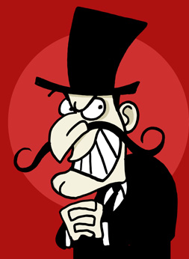
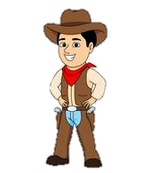
Definition
Ha! My evil plan has worked.
Interjections are words or phrases that communicate emotion.
Oh no!
Yes! Now I’m just going to detonate this explosive… Huh? Whoops!
Hurray!

Slide 3
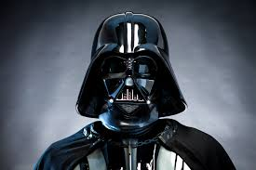
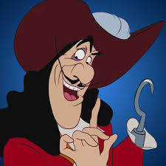
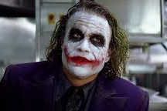
Categories of Interjections*
*This is by no means a comprehensive list; there are many more interjections.
Emotion – Surprise
wow
whoa
yikes
Onomatopoeic Interjections
shhh
pssst
mmm
Emotion - Uncertainty
um
uh
hmm
huh
well
Salutation
hey
hi
hello
bye
Whoa, the Death Star is enormous!
Agreement or Disagreement
yes
yeah
no
nope
Hey, is that a crocodile?
Emotion – Negative
eww
yuck
ugh
ouch
uh-oh
(curse words are also interjections)
Emotion – Celebration
woohoo
hurray
Hmm, that makeup is an interesting choice.

Slide 4
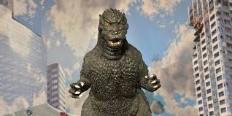
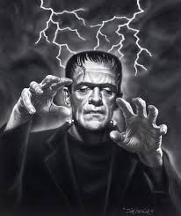
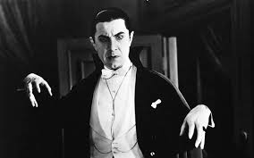
Punctuating Interjections
Interjections are often offset from the rest of the sentence using punctuation. If you want a hard stop for strong emphasis, you can make the interjection its own sentence with a period, exclamation mark, or question mark. Otherwise, you can just separate the interjection with a comma.
Aaaah! Godzilla is about to eat me!
Frankenstein just wants to be accepted. Aww…
Mmm, blood is delicious.

