Slide 1
Parts of Speech:
Conjunctions and Real-World Heroes

Slide 2
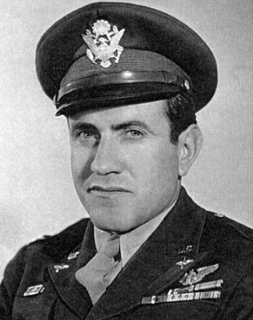

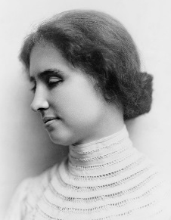
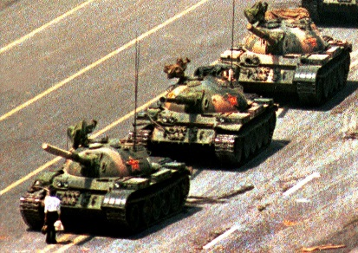
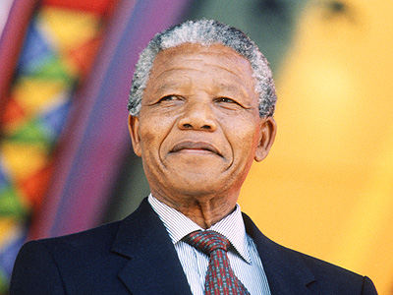
Before we begin… Real-Life Heroes
As we learn about conjunctions, we will use some of the following real-life heroes as examples.
Louie Zamperini transformed from a hooligan to an American Olympic track star to a war hero who survived not only a plane crash over the Pacific Ocean, but also the horrors of a Japanese prisoner-of-war camp.
Malala Yousafzai was a teenage women’s rights and education activist who was shot in the head by the Taliban in an attempt to silence her. She survived and continued her work.
Helen Keller overcame blindness and deafness and learned to communicate. She campaigned for political causes such as women’s suffrage and freedom of speech.
The Tank Man was an unknown Chinese protestor who stood up against a tank in a demonstration against the government’s oppression of its people.
Nelson Mandela spent his fighting for equality and democracy in South Africa. He spent 27 years in prison for his political beliefs before being released and elected President of the country.

Slide 3
Example –
Louie Zamperini
Definition
A conjunction is a word that joins two other words (or phrases, or clauses).
Louie Zamperini was always stealing food as a child, so he learned to run fast.
After he attended the Olympics, Zamperini joined the Air Force during World War II.
Louie Zamperini was not only an outstanding athlete but also a brave soldier.

Slide 4

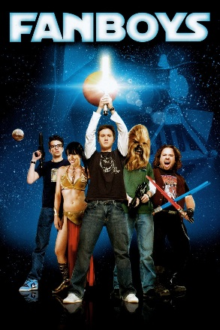
Example –
Malala Yousafzai
Coordinating Conjunctions
Coordinating conjunctions join two elements of equal value or significance.
You probably know the mnemonic device FANBOYS, which lists all of the coordinating conjunctions:
  FOR
  AND
  NOR
  BUT
  OR
  YET
  SO
Malala wanted to create schools for girls in Pakistan, for she believed education is the key to freedom.
The coordinating conjunction “for” connects two clauses.
Malala and her father opposed the Taliban.
The coordinating conjunction “and” connects two nouns to create a compound subject.
Terrorists attempted to assassinate Malala, yet she survived.
The coordinating conjunction “yet” connects two clauses – both have equal importance in the sentence.

Slide 5

Example –
The Tank Man
Punctuating Items in a Series
When you have three or more items in a series, you will need to separate them with commas after every item and a coordinating conjunction in front of the last item.
item, item, item, <and> item
This is called the “Oxford Comma.” A few people argue that it is unnecessary, but eliminating it can sometimes lead to confusion. For this class, I expect you to use the Oxford Comma.
The Tank Man literally stood up against tyranny, oppression, and injustice.
We don’t know his name, his story, or his fate.

Slide 6
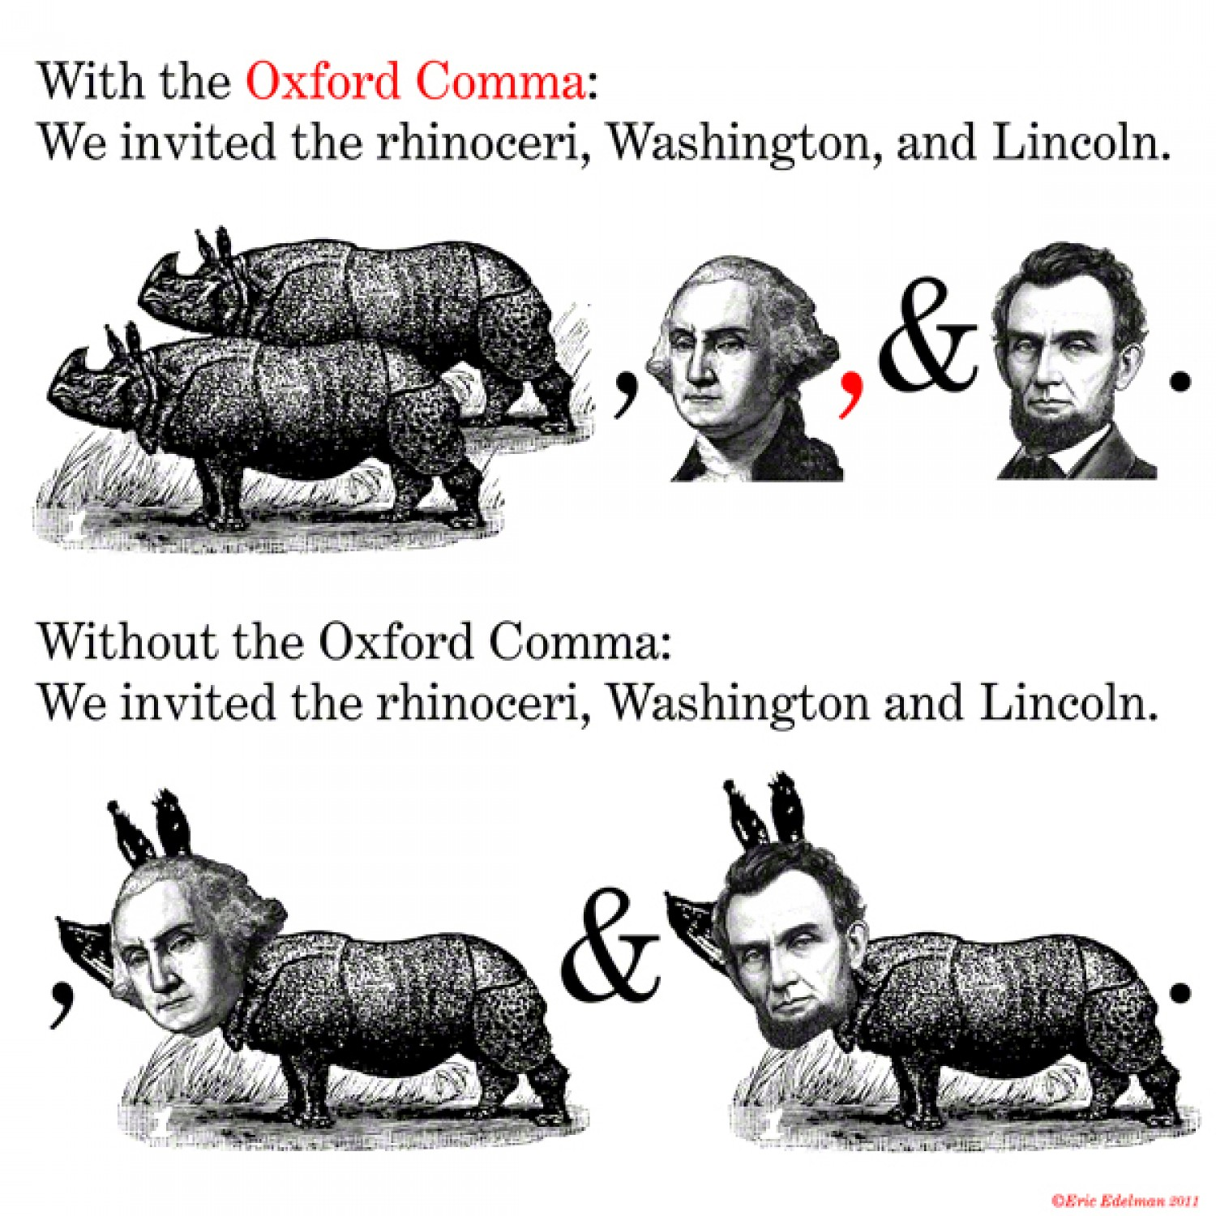
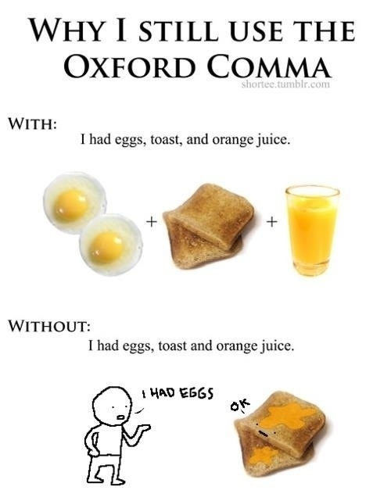

Slide 7
Example –
Nelson Mandela
Correlative Conjunctions
Correlative conjunctions are pairs of conjunctions:
  either…or
  neither…nor
  both…and
  not only…but also
Nelson Mandela grew up in South Africa during a time when black people could neither live freely nor vote to change things.
After decades of fighting against the system, Mandela not only secured freedom from prison but also was elected President in the first democratic elections in the country.

Slide 8


Example –
Helen Keller
Subordinating Conjunctions
A subordinating conjunction still connects two words (or phrases, or clauses), but it suggests that one of those elements in less important.
There are many more subordinating conjunctions than coordinating ones. You can remember them by thinking of the mnemonic device “a white bus.”*
A – after, although, as
W – when, whenever, where, wherever, while
H – how
I – if
T – than, though
E – even though, even if
B – because, before
U – unless, until
S – since, so that
Helen Keller lost her hearing and eyesight after contracting scarlet fever.
The use of the subordinating conjunction “after” tells us that the most important part of this sentence is that Helen lost her hearing and eyesight, not the type of disease that she caught.
Even though she couldn’t hear or see, Helen worked her entire life to secure rights for others.
The use of the subordinating conjunction “even though” indicates that the most important part of the sentence is about the success Helen was able to achieve, not her limitations.
*This isn’t a complete list of all subordinating conjunctions, but it covers many.

