Slide 1
Parts of Speech:
Adjectives, Adverbs, and Greek Heroes

Slide 2
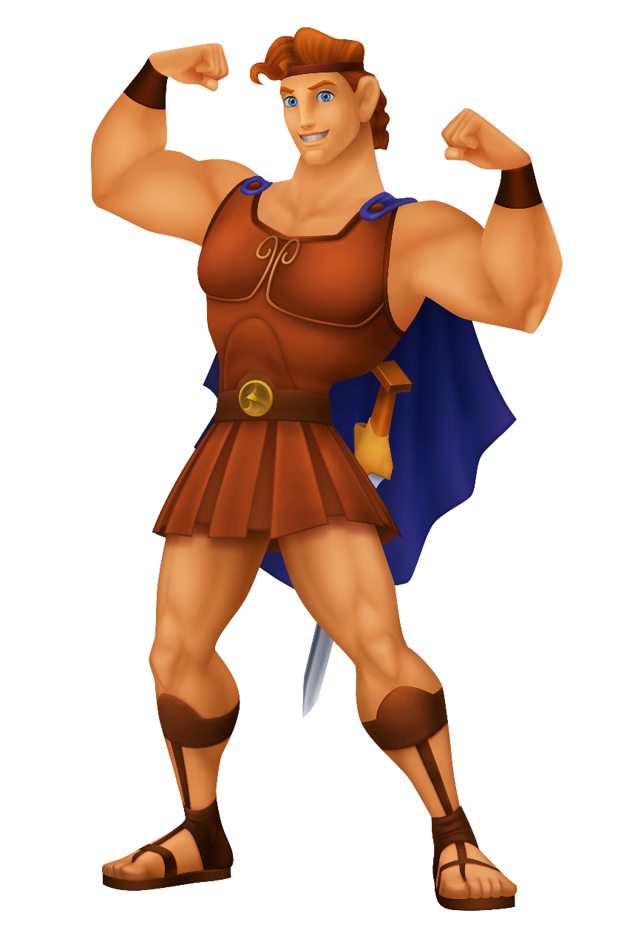
What is an adjective?
Heracles is considered by many to be the greatest Greek hero. He was a strong, brave, and just man.
Adjectives are words that modify (describe) a noun or pronoun. Adjectives answer the following questions:
What kind?
How many?
How much?
Which one?*
What kind?
Heracles is famous for completing the Twelve Labors, difficult challenges which included slaying a hydra with nine heads.
How many?
Heracles was a hero because he had more bravery than the average person.
How much?
We remember those stories about Heracles even today.
Which one?
*adapted from http://www.chompchomp.com/terms/adjective.htm and the Holt High School Handbook

Slide 3
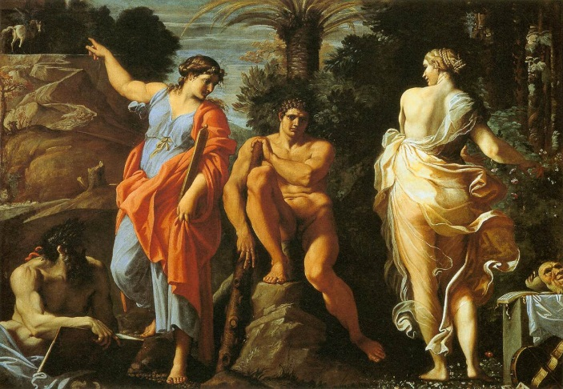
Adjectives and Commas
When you have multiple adjectives in a list, you sometimes need commas to separate them.
Coordinate adjectives occur in a list whose meaning stays the same, even when the adjectives are rearranged. You need to separate these with commas.
Noncoordinate adjectives occur when the list must retain its order to preserve its meaning. You do not need to separate these with commas.
The Choice of Heracles (1596), Carracci
When Heracles was a young man, he was given a choice between a happy, easy, forgettable life, or a difficult, painful, glorious life.
These two lists of adjectives could be rearranged; therefore they are coordinate and require commas.
Of Zeus’s many illegitimate children, Heracles is the one most people know about today.
It wouldn’t make sense for you to say “illegitimate, many”; therefore, the adjectives are noncoordinate and should not have commas.

Slide 4
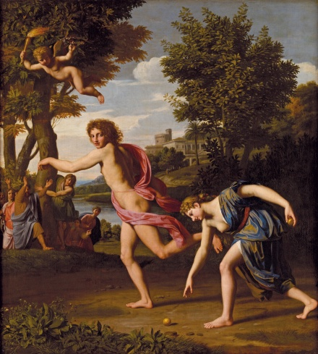
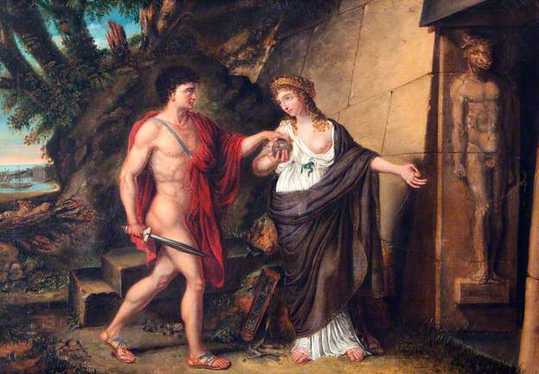
Comparative and Superlative Adjectives
Some adjectives also give us information about whether the noun being described is more or most in a certain category.
Atalanta was the fastest person, male or female, in Ancient Greece.
Hippomenes fell in love with Atalanta, and even though she was faster than he was, he tricked her by throwing golden apples in her path. She lost the race and had to marry him.
kind of adjective | comparative | superlative
one syllable | add “er,” “ier,” or “r” to the end of the word | add “est,” “iest,” or “st” to the end of the word
two syllables | add “er,” “ier,” or “r” to the end of the word (usually) | add “est,” “iest,” or “st” to the end of the word (usually)
three syllables | add “more” in front of the word | add “most” in front of the word
The Race Between Atalanta and Hippomenes (1680), Columbel
Although Theseus is most famous for defeating the Minotaur, it was actually the Princess Ariadne who came up with the idea for him to escape the labyrinth using a ball of twine.
Ariadne was more intelligent than many other Greek princesses.
Exceptions
adjective | comparative | superlative
good | better | best
bad | worse | worst
little | less | least
much | more | most
far | farther/further | farthest/furthest*
*Farther/farthest refer to literal distance (“It is farther to Dallas that to Austin.”), which further/furthest refer to non-literal distance (“Studying will take you further in life than watching TV.”
Theseus and Ariadne at the Entrance of the Labyrinth (1812), Westall

Slide 5
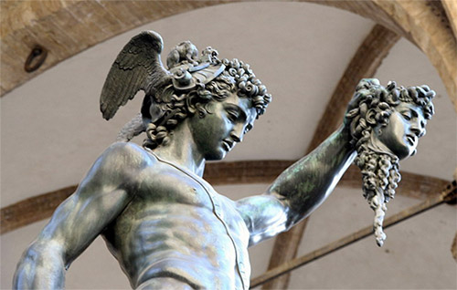
Adjectives and Writing
In general, writers should attempt to use more precise, specific nouns instead of general nouns along with adjectives.
This allows writers to communicate their message more efficiently.
Perseus with the Head of Medusa (1545), Cellini
Perseus decided to go on a difficult journey to defeat Medusa. Medusa was a scary woman who had serpents for hair. People who looked into her eyes would be turned into stone. Perseus defeated Medusa by holding up a shiny metal shield so that she turned herself into a statue.
quest
Perseus decided to go on a difficult journey to defeat Medusa. Medusa was a scary woman who had serpents for hair. People who looked into her eyes would be turned into stone. Perseus defeated Medusa by holding up a shiny metal shield so that she turned herself into a statue.
monster
reflective

Slide 6
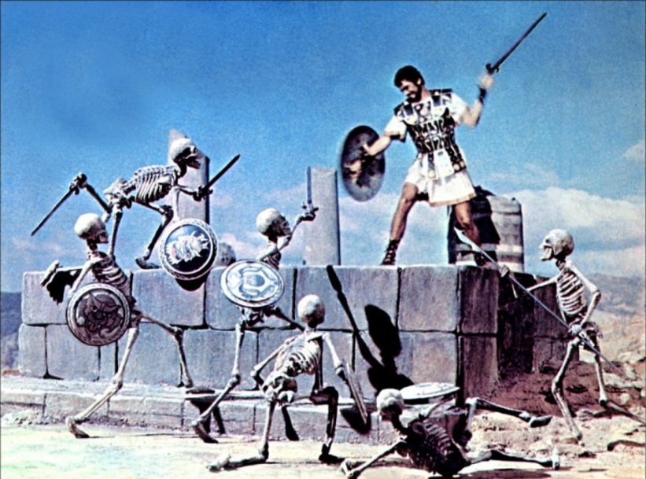
What is an adverb?
Adverbs are words used to modify a verb, an adjective, or another adverb.
Jason was a prince in Ancient Greece who had to go on an adventure to prove that he was worthy of being king of his homeland.
He fearlessly sailed between two great clashing rocks to reach a distant land.
“fearlessly” modifies a verb (“sailed”)
He slaughtered the Harpies, a trio of very vicious, bird-like monsters who tormented people.
“very” modifies an adjective (“vicious”)
The myths about Jason are still widely known in our world today, in large part because of the films and TV shows that depict his adventures.
Jason and the Argonauts (1963), Columbia Pictures
“still” modifies another adverb (“widely,” which modifies “known”)

Slide 7
Kinds of Adverbs
Adverbs of manner describe how something is done.
What kind of adverb is used in the following sentences?
Examples: angrily, quickly, skillfully (often words that end in “-ly”)
Adverbs of time describe when something is done.
Examples: afterwards, already, always, early, finally, immediately, now, recently, soon, still, then, today, tomorrow, yesterday, yet
adverb of manner
adverb of time
adverb of place
adverb of degree
adverb of frequency
Adverbs of place describe where something is done.
1. Theseus never thought he would be trapped in a labyrinth with a man-eating beast.
Examples: above, below, here, outside, there, under
Adverbs of degree describe to what extent or how much something is done.
2. The maze seemed completely impossible to escape.
Examples: a (little) bit, a lot, absolutely, almost, completely, enough, entirely, extremely, fairly, highly, nearly, perfectly, pretty, quite, rather, really, slightly, so, somewhat, too, totally, utterly, very
3. But Ariadne had craftily suggested that he mark his path with a ball of string.
Adverbs of frequency describe how often something is done.
4. When he stepped inside the maze, Theseus unwound the string.
Examples: again, almost, always, ever, frequently, generally, hardly, never, occasionally, often, rarely, seldom, sometimes, twice, usually
5. After he finally killed the Minotaur, he was able to find his way out again.

Slide 8
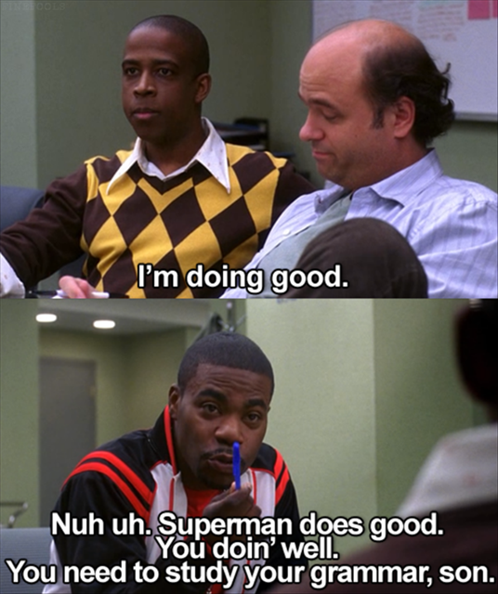
Do not use an adjective in place of an adverb.
really
It must have been real difficult for Atlas to hold the entire world on his shoulders.
well
Because Heracles did good on his Twelve Labors, he was released from servitude.
quickly
Atalanta ran quick to try to win the race.

Slide 9
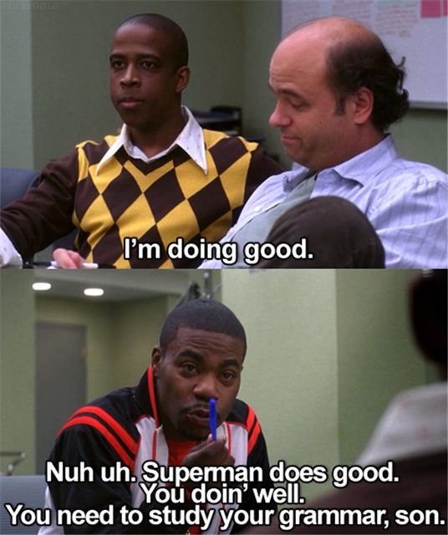
Why is this incorrect?

Slide 10
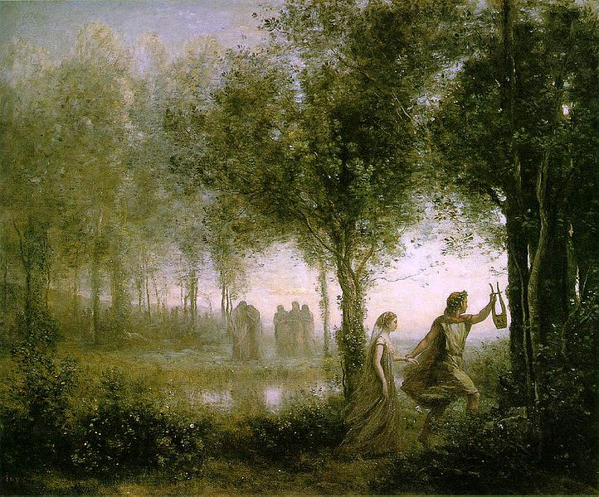
Adverbs and Writing
The same rule for writing with adjectives applies to adverbs: if you have a choice of a vague verb coupled with an adverb and a more precise verb, choose the more precise verb. This will help your writing to be clear and concise.
Orpheus Leading Eurydice from the Underworld (1861), Corot
Orpheus was a very good musician. One day, his bride, Eurydice, was killed unjustly by a satyr. He cried a lot. He went to the Underworld to sincerely ask Hades to let him take Eurydice back….
an excellent
Orpheus was a very good musician. One day, his bride, Eurydice, was killed unjustly by a satyr. He cried a lot. He went to the Underworld to sincerely ask Hades to let him take Eurydice back….
murdered
beg

