Slide 1
Subjects and Predicates and Evil Kittens

Slide 2
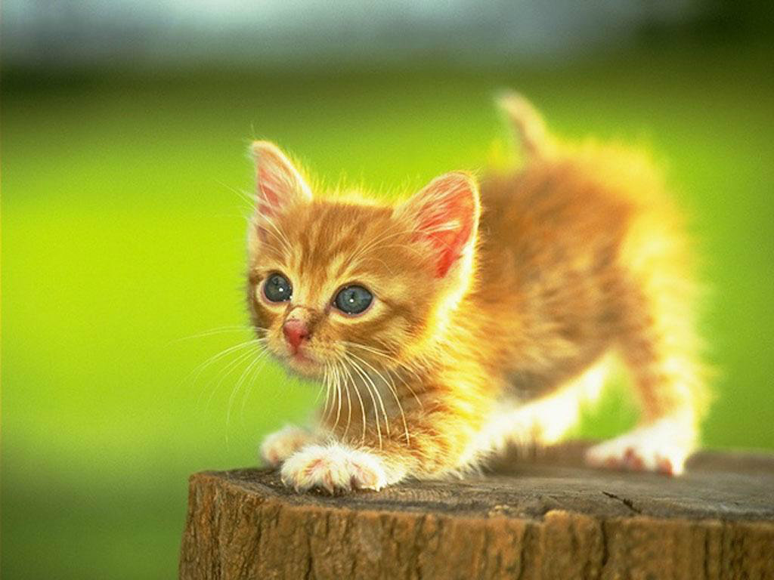
Buttercup hates all of humanity.
The subject: the actor, the doer, the main focus of the sentence, the person from whose perspective the sentence is told
The predicate: the action, the thing being done

Slide 3

Lapping at the blood on her paws, Muffin smiled.
Be careful: subjects do not always come at the beginning of a sentence.

Slide 4
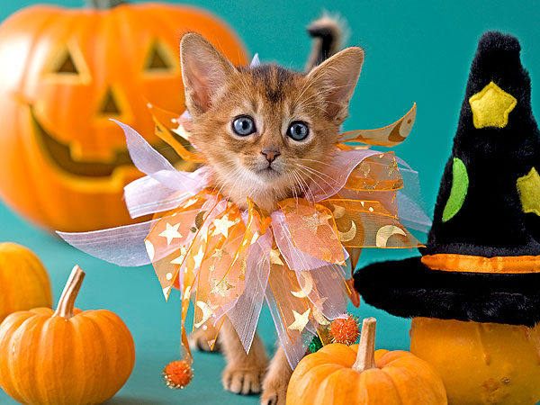
For the indignity that he had suffered, Pumpkin would make the humans pay dearly.
Be careful: subjects do not always come at the beginning of a sentence.

Slide 5

At night, Oreo sharpens his claws.
Be careful: subjects do not always come at the beginning of a sentence.

Slide 6

Deep in Tigger’s heart is a dark and terrible secret.
Be careful: subjects do not always come at the beginning of a sentence.
predicate
subject
Confusing? Consider how you could flip the parts of the sentence and rewrite it.
A dark and terrible secret is deep in Tigger’s heart.
subject
predicate

Slide 7
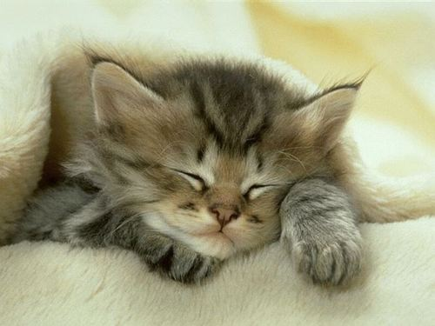
The tiny, fluffy kitten pretended to sleep.
The simple subject is the noun itself; the complete subject is the noun plus all of its modifiers (adjectives, participles, etc.).

Slide 8
Side Note: The term “subjective”
According to Dictionary.com, the definition of subjective is:
1. existing in the mind; belonging to the thinking subject rather than to the object of thought (opposed to objective ).
2. pertaining to or characteristic of an individual; personal; individual:
a subjective evaluation.
3. placing excessive emphasis on one's own moods, attitudes, opinions, etc.; unduly egocentric.
The issue of humankind’s value is subjective; while people probably think that they are the most intelligent, important species on the planet, kittens despise humanity and wait for the day that felines will reign over all.

Slide 9
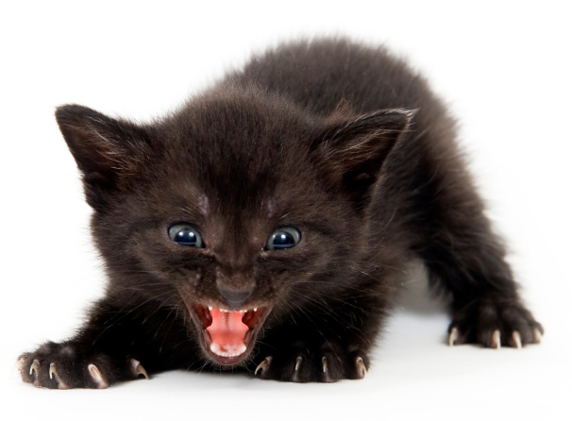
Fear me! And listen to all the different kinds of predicates there are!

Slide 10
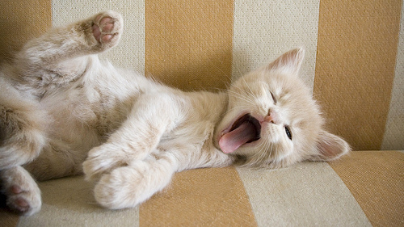
Toby yawned, stretched, and contemplated election rigging in Southeast Asia.
A compound predicate includes two or more actions (verbs and their modifiers) for one subject.

Slide 11
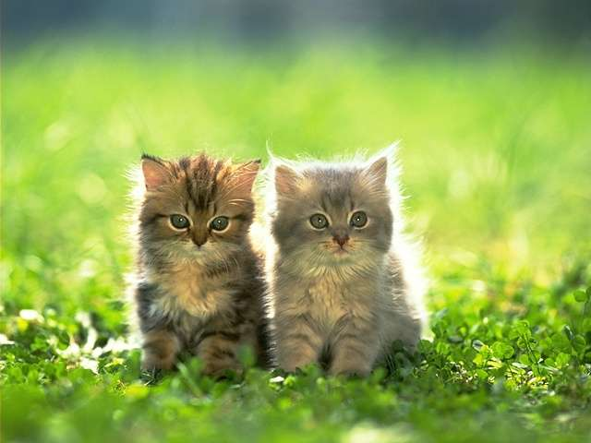
Rusty and Felix are the leaders of an international terrorist organization.
The predicate nominative follows a linking verb (usually a form of the verb “to be,” but also “becomes,” “appears,” “stays,” “remains,” and others) and renames the subject.
So the predicate nominative essentially renames the subject.

Slide 12
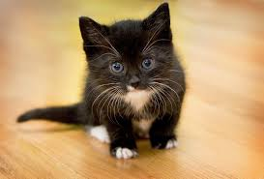
Tuxedo felt furious.
The predicate adjective follows a linking verb (usually a form of the verb “to be” or a sense verb like “feels,” “looks,” “seems,” “sounds,” etc.) and describes the subject.

Slide 13
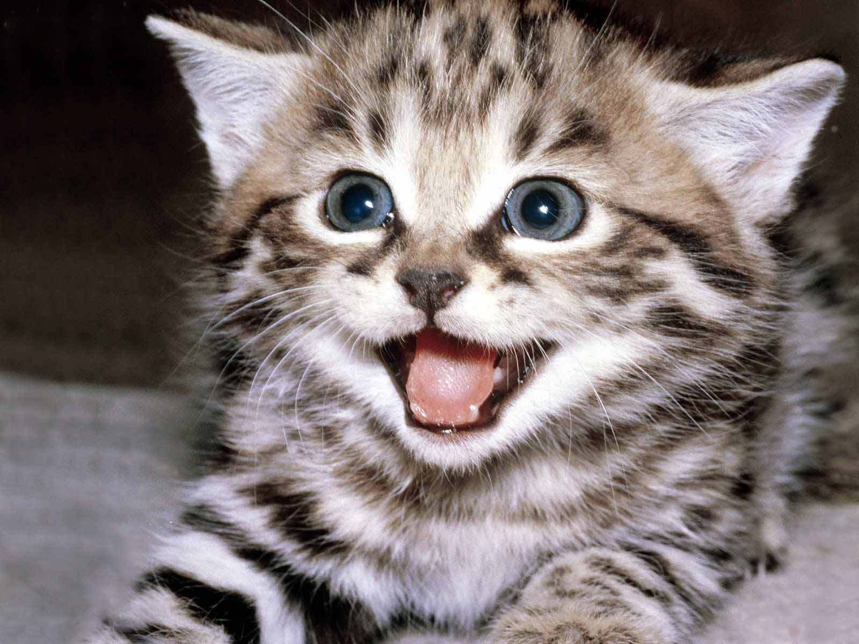
Snickers was delighted to hear about the spread of Ebola.
The predicate adjective follows a linking verb (usually a form of the verb “to be” or a sense verb like “feels,” “looks,” “seems,” “sounds,” etc.) and describes the subject.

