Slide 1
Direct Objects,
Indirect Objects, and
Disgruntled Disney Princesses

Slide 2
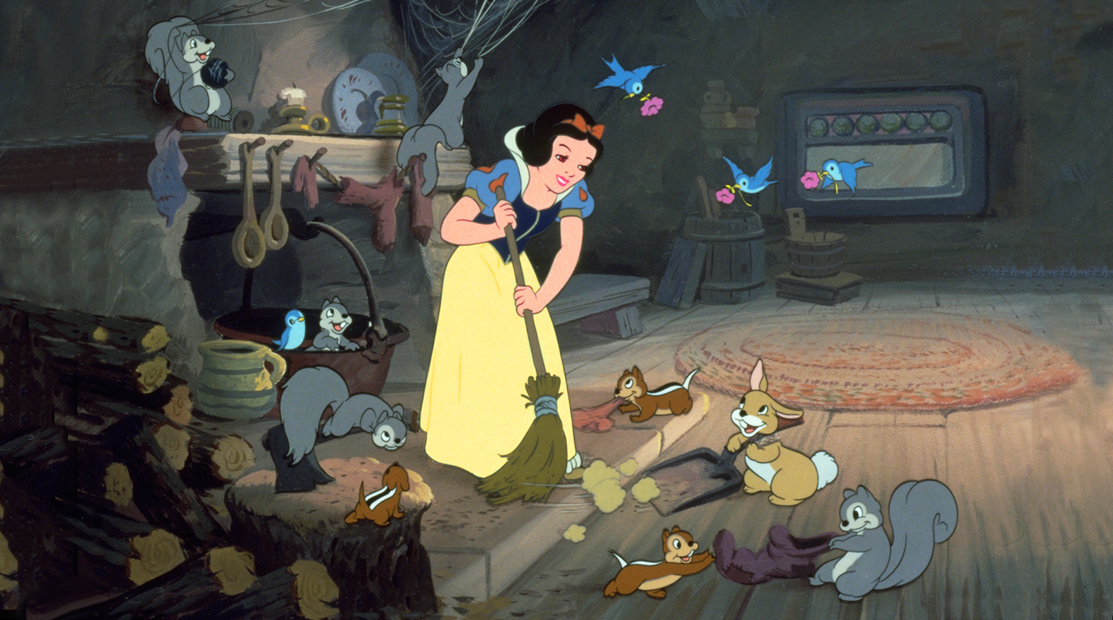
Snow White cleans the house.
verb
direct object
subject
predicate
The verb in the predicate is the action word. Sentences with direct objects use a special kind of verb called a transitive verb.
The direct object in the predicate is the thing that receives the action.

Slide 3
Transitive verbs are verbs that transfer the action from the subject to the direct object.
Snow White cleans the house.
Intransitive verbs are verbs that do no connect a subject to a direct object.
Snow White cries.
Snow White despairs.
Snow White scrubs the dishes.
Snow White sweeps the floors.
Note that some verbs can be both transitive and intransitive, depending on how they are used in the sentence.
Snow White sings.
Snow White sings a song of misery.
Snow White washes the windows.
Snow White takes Lexapro.

Slide 4

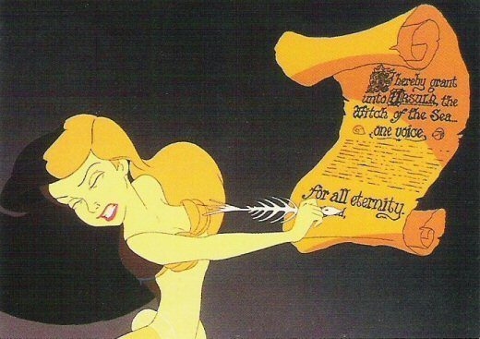
Transitive or Intransitive?
INTRANSITIVE
Ariel sings all the time.
TRANSITIVE
Ariel signs her name.
TRANSITIVE
Ariel forfeits her voice to win love.
Prince Eric loses interest in Ariel.
TRANSITIVE
Ursula laughs evilly.
INTRANSITIVE
Ariel regrets her decision.
TRANSITIVE
Ariel dies sad and alone.
INTRANSITIVE

Slide 5

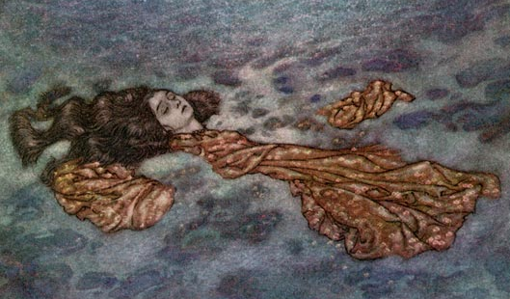
Transitive or Intransitive?... continued
Ariel lies down to daydream about Prince Eric.
In the original Hans Christian Anderson fairy tale, the Little Mermaid lays down her life so the Prince can be with another woman.
INTRANSITIVE
TRANSITIVE
The verb “lie” means to recline (as well as to be dishonest).
The verb “lay” means to place or set down.

Slide 6
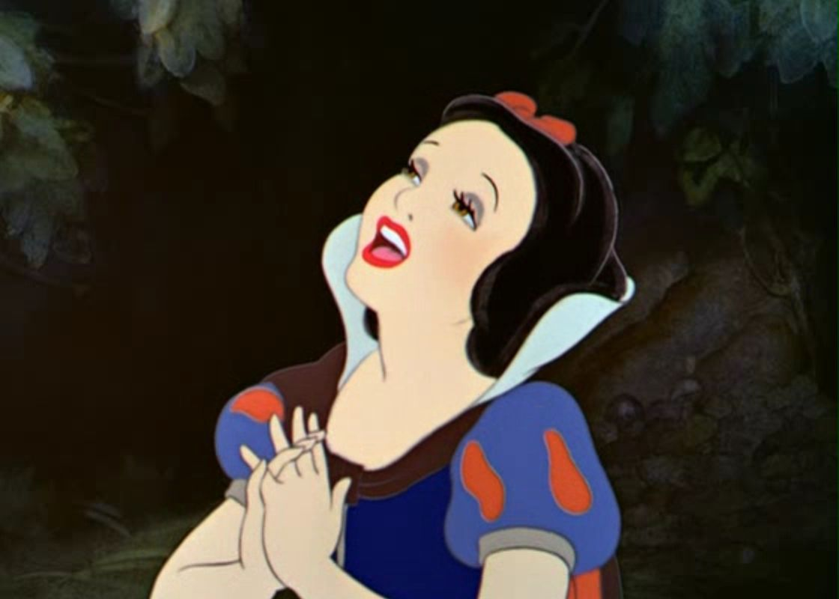
Snow White feels empty.
Be careful: not all sentences contain direct objects.
verb
predicate nominative
Snow White becomes a servant.
subject
predicate
verb
predicate adjective
subject
predicate

Slide 7




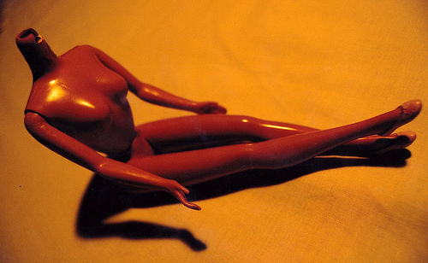
The word objectify means “to make into an object” or “to treat (someone) as an object rather than as a person” (Merriam-Webster’s Dictionary).

Slide 8
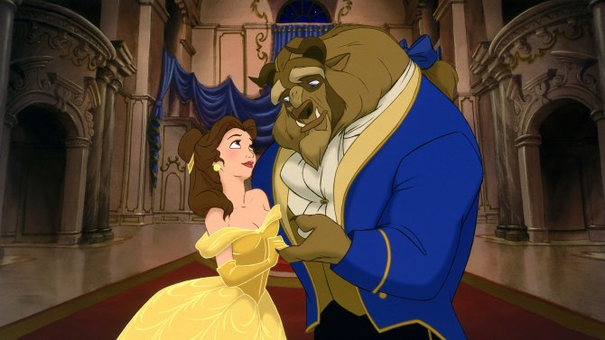
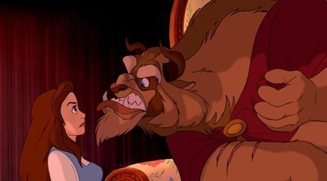
Direct objects can be nouns, pronouns, infinitives, gerunds, and noun clauses*.
subject
verb
direct object (noun)
Belle loved books.
subject
verb
direct object (pronoun)
Beast captured her.
subject
verb
direct object (infinitive phrase)
Belle didn’t want to see the signs of domestic abuse.
subject
verb
direct object (gerund phrase)
Belle feared angering Beast.
subject
verb
direct object (noun clause)
Belle believed that she could change Beast.
*a noun clause is a dependent clause that functions as a noun – they often start with “that,” “what,” or “how”

Slide 9
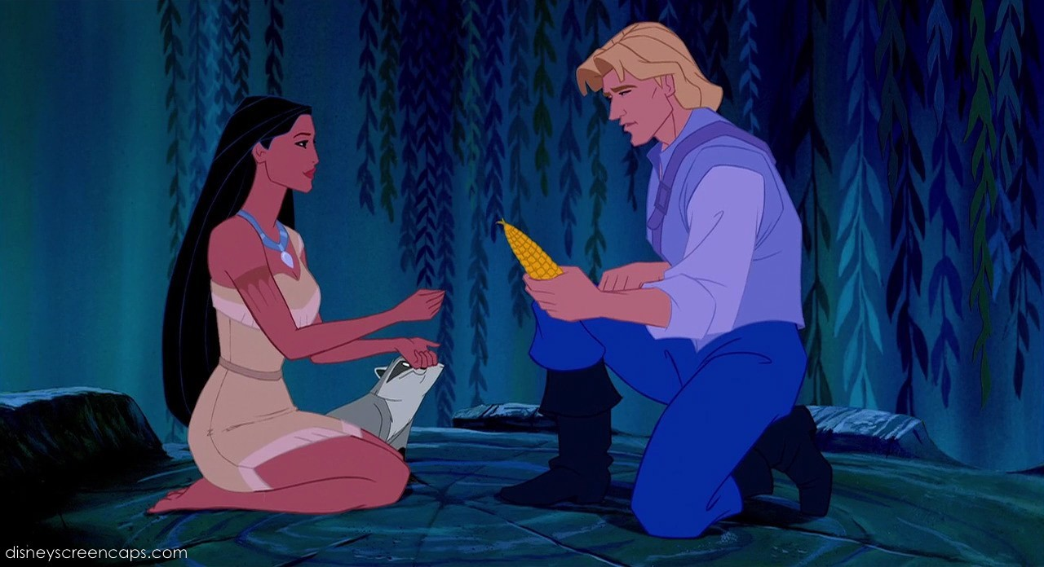
Pocahontas gives the corn to John Smith.
The indirect object receives the direct object.
A sentence must have a direct object to have an indirect object; not all sentences have indirect objects.
Pocahontas gives John Smith the corn.
subject
Indirect object
Be careful! This is not an indirect object!
verb
direct object
subject
verb
direct object
prepositional phrase

Slide 10
Sentences with indirect objects almost always follow this formula:
+
+
+
Subject
verb
indirect object
direct object.
Mother Earth tells Pocahontas a story.
Pocahontas shows John Smith the beauty of nature.
“Give me the gold!” says Governor Ratcliffe.
The English promise the Native Americans payment.

