Slide 1
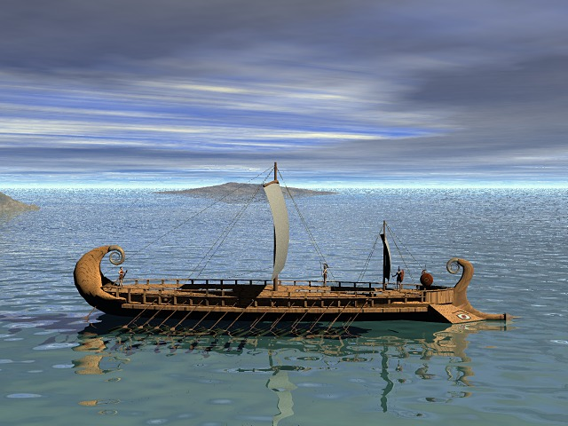
The Trojan War

Slide 2
So it begins,
“More than a thousand years before Christ, near the eastern end of the Mediterranean was a great city, very rich and powerful, second to none on earth. The name of it was Troy and even today no city is more famous. The cause of this long-lasting fame was a war. . . And he cause of the war went back to a dispute between three jealous goddesses.”
- Edith Hamilton Mythology

Slide 3
Paris, also called Alexander
Paris, a prince who was tending sheep- I know this is an unlikely job for a prince of Troy, but his father was told he would ruin his family and was sent away- was minding his own business when three beautiful goddesses: Hera, Athena, and Aphrodite came to ask an important question.

Slide 4
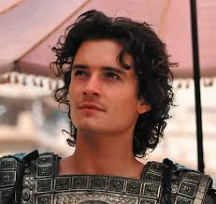
Who’s the fairest of us all?
Earlier that night, a golden apple was delivered with the inscription, “For the Fairest”
Every goddess wanted the apple, but the Aphrodite, Hera, and Athena were the three who seemed the most likely to fulfill the description of “fairest.” Zeus was asked to judge this contest, but wisely refused and sent them to Paris.

Slide 5
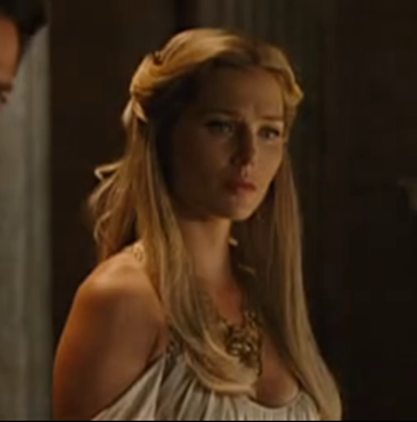
All three offered him bribes, but he chose Aphrodite who promised him the fairest woman in all the world.
Thus, the Judgment of Paris.
Choose me and I’ll give you a fair woman. . .

Slide 6
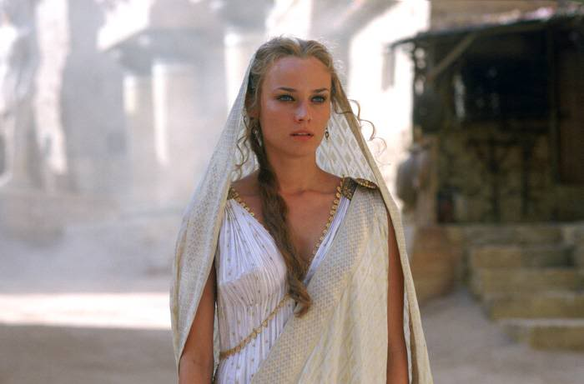
Who is the fairest woman of all?
The fairest woman of them all was Helen, daughter of Zeus and the queen of Sparta.
Unfortunately for Paris, she was already married to a man named Menelaus.
This didn’t matter to Aphrodite who led Paris to the home of Helen and Menelaus.

Slide 7
Hospitality
The bond between guest and host is sacred in ancient Greece.
It was considered the Hosts responsibility to do whatever possible to accommodate guests for however long necessary.
It was the Guests responsibility to respect the host’s home.

Slide 8
While the Cat’s away. . . The Mouse will play
Menelaus went to Crete to attend to some business.
Paris took this as his opportunity to get to know the woman Aphrodite promised him, Helen.

Slide 9
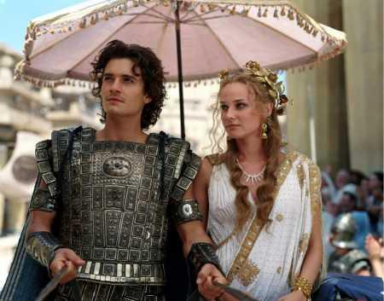
Paris, the criminal
Paris decided to take what Aphrodite promised him and whisked Helen, as well as some of Sparta’s riches, back to his home in Troy.

Slide 10
Newsflash, everyone hates Troy
Menelaus didn’t have to work very hard to convince people to attack Troy. Many wanted to destroy this majestic city for their own selfish reasons.
Plus, when every prominent man in Greece was wooing Helen, they took an oath to support whoever Helen decided to marry.

Slide 11
Odysseus
He already had a wife, Penelope, whom he loved very much.
Odysseus, always the trickster, refused to come when summoned and pretended he was insane.
When a messenger came to collect Odysseus, he was throwing salt into his fields instead of seeds and was plowing his field erratically. To test this claim, the messenger threw Telemachus, Odysseus’s son, in front of the plow.
Of course, Odysseus stopped his plow proving he wasn’t insane and was fit to go to war.

Slide 12
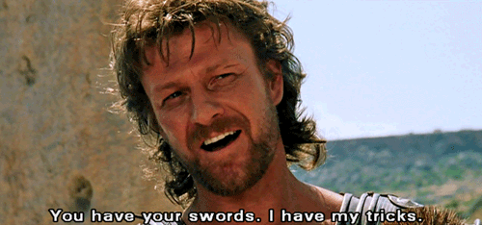

Slide 13
Odysseus’s first task
There was an amazing warrior named Achilles. His mother refused to let him go to war and dressed him as a girl. Odysseus was sent to find Achilles and bring him to the battlefield.
Always the trickster, Odysseus pretended to be a peddler and set up tables with jewelry, swords, makeup, etc. While all the maidens looked at girly things, Achilles, still dressed as a woman, went straight for the swords.
BUSTED. Odysseus quickly convinced Achilles to go to war.

Slide 14
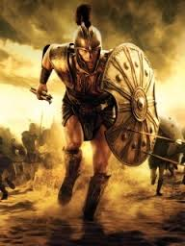

Slide 15
Hi, ho, hi, ho, it’s off to war we go
The men all met at Aulis to sail to Troy. They wanted to leave, but can’t. To appease the gods, they have to sacrifice, Iphigenia, Agamemnon's daughter. Agamemnon is the leader of the army and the brother of Menelaus.
Iphigenia is lied to and is told she was chosen to marry Achilles. When she arrived at her wedding, she was slaughtered. Talk about a red wedding.

Slide 16
Consequences
This act will have consequences later in the story! (spoiler alert- Agamemnon will survive the war and travel home. When he gets there, his wife and/or lover attack and murder him. The sacrifice of Iphigenia was his wife’s motivation for the murder)

Slide 17
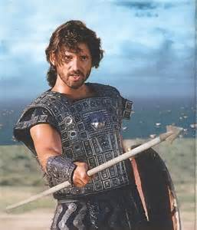
The Battle is ON
The Greeks had the benefit of having thousands of men fighting for them. Their MVP was Achilles, who knew he would die during this war. Also, Hera, Athena, and Poseidon were on their side.
The Trojans have the benefit of great walls and many sons. The best warrior was a man named Hector. He also knew he will die during this war. Aphrodite, Apollo, Artemis, and Ares were on their side.

Slide 18
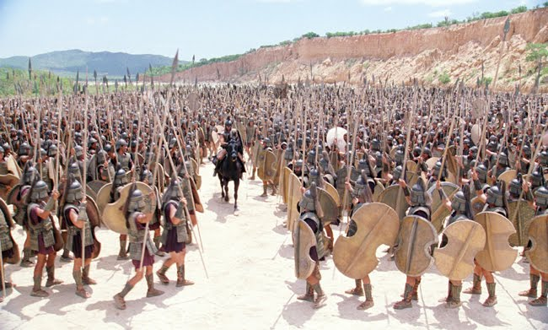
They fight for nine years and neither side had a clear advantage.

Slide 19
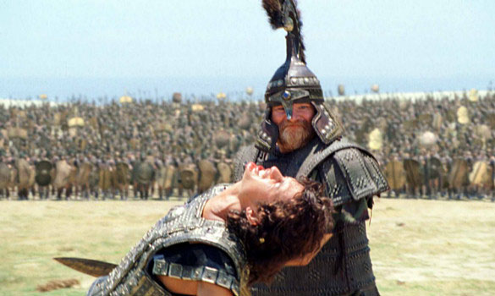
UNTIL. . .
After nine years of fighting, the troops decide to let Paris and Menelaus fight it out.
At this point, the Trojan people pretty much hate Paris for bringing this war to their gates.
Both men are fighting and just as Menelaus is about to drag Paris’s body to his kinsmen. . .

Slide 20
Aphrodite interceded to help Paris.
She whisked him away to Troy.
Everyone saw this as greatly unfair and both sides agreed that Menelaus would have won fair and square and the Trojans agreed to give Helen back.
This would have effectively ended the war

Slide 21
BUT. . .
Athena and Hera, still angry about Paris’s decision, don’t want to end the war until Troy was decimated.
SO, Athena convinced a Trojan soldier to break the truce and fire an arrow at Menelaus.
This enraged the Greeks and the war was on
. . .again.

Slide 22
The gods helped each side and again they were locked in battle after battle. There was never a side with a clear advantage.
Eventually, Hector, Troy’s greatest warrior was killed and Achilles knew it will not be long before he died too.
Achilles fought bravely and helped the Greeks kill many men for some time until the gods intervened again.

Slide 23
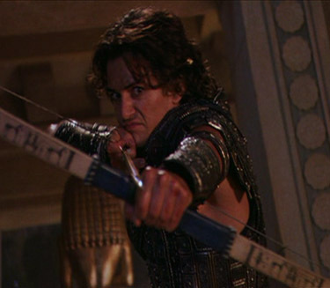
Apollo, god of truth and light, also known as the Archer-god, guides the arrow of Paris to strike Achilles in the heel, thus killing Achilles.

Slide 24
Back to Odysseus
Achilles armor needs to go to someone. A vote declared that Odysseus should receive the armor or Achilles. This was a huge honor.
With their hero killed, the Greeks were more discouraged than ever. Odysseus needs to step up to end this war.

Slide 25
What’s Odysseus to do?
Odysseus needs to do something. He hears about a prophet, Helenus, and decides to kidnap him. Helenus can tell them exactly what to do to win this war, so everyone can go home.

Slide 26
Odysseus the Convincer
Helenus informs Odysseus that the only way they can win is to use a particular weapon that is not in their possession.
Odysseus goes on a short journey to find this weapon and its owner. Once he meets the owner, he decides not to steal it, but to convince the owner to come with them. The owner, named Philoctetes, went on the battle field and on his first day kills Paris.

Slide 27
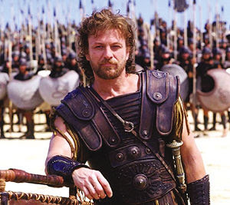
Paris, no great loss
NO one really cares that Paris is dead. The war rages on and everyone just wants to go home!!! Odysseus realizes that he has to get in the walls of the city if he wants to go home.
He thinks and finally comes up with a solution.

Slide 28
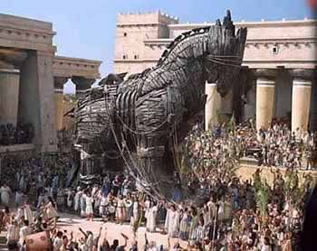
The Trojan Horse
Odysseus convinces his troops to sail away to a nearby island.
He and a few warriors will hide in a large wooden horse. They will leave behind a messenger who will claim that the giant horse is a gift for Athena.
The plan works and the Trojans believe the war is over. After celebrating, they go to sleep.

Slide 29
At this point, Odysseus and his men open the gates of Troy and signal for the other troops to sail back and enter the gates.
The Trojans were surprised and the Greeks ambushed them.
Aphrodite was the only god that day to help the Trojans. She even rescued Helen and delivered her to Menelaus. They sailed home.

Slide 30
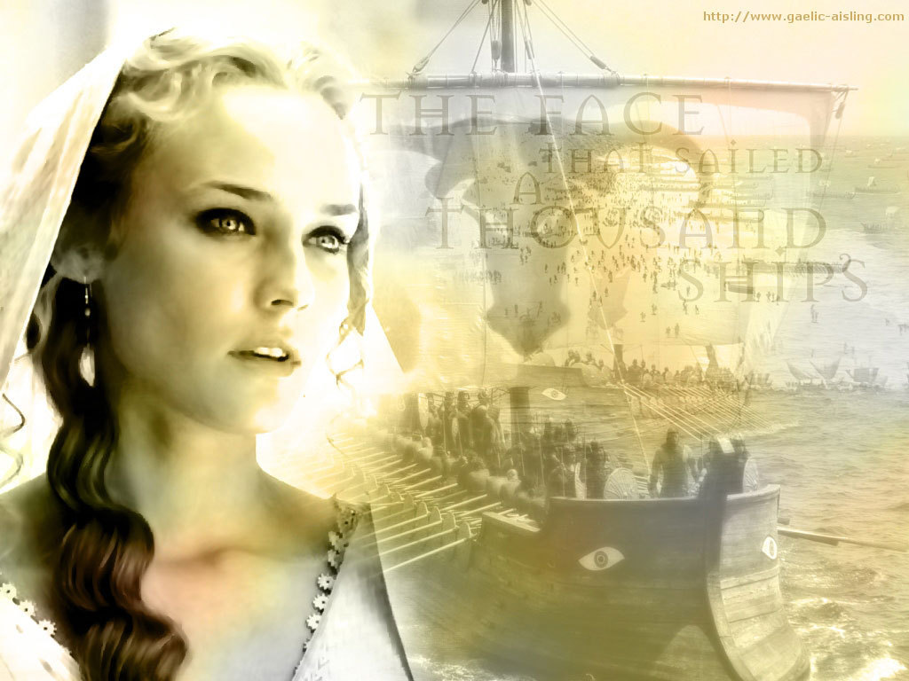

Slide 31
Don’t bite the hand that feeds you
The night of the final battle, the Greeks went too far and angered Athena. Also, the Greeks didn’t thank any of the gods for their help. Athena was once was their greatest ally. Now, she asked Poseidon, the god in charge of the sea, to help her make sure the Greeks couldn’t make it home. Poseidon, who previously hated the Trojans, decided to help her since Troy was laid to waste and he now has nothing better to do.

Slide 32
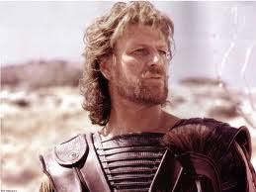
This leads us to the Odyssey
At this point, it has been 20 years since Odysseus has seen his homeland, Ithaca.
During this time things have gotten quite intolerable for his wife, Penelope, and son, Telemachus.
The other land owners of the island are essentially squatting in his house. Remember hospitality is considered essential, so Penelope can’t refuse these men. Also, she is pretty much defensless.
Since Odysseus has been gone for so many years, the men have decided that he is dead and Penelope should choose one of them as a husband.

Slide 33
Penelope, always faithful to Odysseus, claims she will marry one of them after she weaves an intricate funeral shroud.
Every day she weaves; every night she unweaves her work from that day.
Telemachus, now a grown man, is looking for answers. He decides to travel to Pylos to get news of his father’s fate. While he is away, the suitors plan his murder.

Slide 34
Will Odysseus make it home in time?
Will Penelope be caught unraveling her shroud?
Will the gods ever get a life and leave the humans alone?
To answer these questions read The Odyssey

