Slide 1
The Odyssey Book 11
Questions and Discussion

Slide 2
Recap
Circe tells Odysseus that before continuing on his journey, he needs to hear a prophecy from Tiresias, the greatest fortune-teller in all of Greece. The prophecy will help him prepare for the dangers that await him at home on Ithaca.
The only problem? Tiresias is dead. To hear what he has to say, Odysseus will need to travel to the Underworld.

Slide 3
A Bit about Hades
Hades was both the name of the Greek god of the underworld and the name of the underworld itself. It’s where souls would go after death.
It was far from a paradise. If you were bad during life you were punished; if you were morally middle-of-the-road, you didn’t suffer, but didn’t have anything to enjoy; if you achieved great things on earth, you would stay somewhere pretty nice. But the Greeks generally thought that life after death was pretty boring and worthless.
Isle of the Blessed
Elysian Fields
Fields of Asphodel
Fields of Punishment
Tartarus

Slide 4
The Rivers of Hades
Lethe – Forgetfulness
Acheron – Distress
Puriphlegethon – Fire-Flaming
Cocytus – Lament
Styx - Hate

Slide 5
How to Die in the Ancient Greek World
Your family prepares your body for death. They place with it items that you might find useful in the afterlife (clothes and other offerings) and they put gold coins over your closed eyes or in your mouth.
Hermes, the Messenger God, comes and guides your soul to the entrance of Hades.
You would give your gold coins to Charon, who would take you on his ferry over the River Styx.

Slide 6
The Nekyia
I […] slashed the lamb and the ewe,
letting their black blood stream into the wellpit.
now the souls gathered, stirring out of Erebus,
brides and young men, and men grown old in pain,
and tender girls whose hearts were new to grief;
many were there, too, torn by brazen lanceheads,
battle-slain, bearing still their bloody gear […]
Meanwhile I crouched with my drawn sword to keep
the surging phantoms from the bloody pit
till I should know the presence of Tiresias.
“Nekyia” is the name for the 11th book of the Odyssey. It’s also the Greek world for summoning the dead.
For the dead to be able to speak, they have to drink blood.
So Odysseus digs a hole in the ground and slits the throats of a lamb and ewe, filling the hole with their blood.
This attracts all of the spirits of the dead – they all clamor around the blood, trying to get a sip, but Odysseus holds them off with his sword (even the spirit of his dead mother) until Tiresias can arrive.

Slide 7
A Familiar Face
One shade came first – Elpenor, of our company,
Who lay unburied still on the wide earth
As we had left him – dead in Circe’s hall,
Untouched, unmourned, when other care compelled us […]
[Elpenor says] ignoble death I drank with so much wine.
I slept on Circe’s roof, then could not see
The long steep backward ladder, coming down,
And fell that height. My neckbone broke […]
O my lord, remember me, I pray,
Do not abandon me unwept, unburied,
To tempt the gods’ wrath, while you sail for home;
But fire my corpse […]
And build a cairn for me […]
Heap up the mound there, and implant upon it
The oar I pulled in life with my companions.
Odysseus sees one of his crew members, Elpenor, as a ghost there in Hades.
He asks him what happened, and Elpenor tells him that he got drunk and fell off of a roof, breaking his neck. (It’s not quite clear how he is able to speak without drinking the blood.)
He begs Odysseus to give him a proper funeral so that he can rest in peace. Particularly, he asks him to bury him and mark his grave by sticking his oar in the ground. **THIS IS IMPORTANT.**

Slide 8
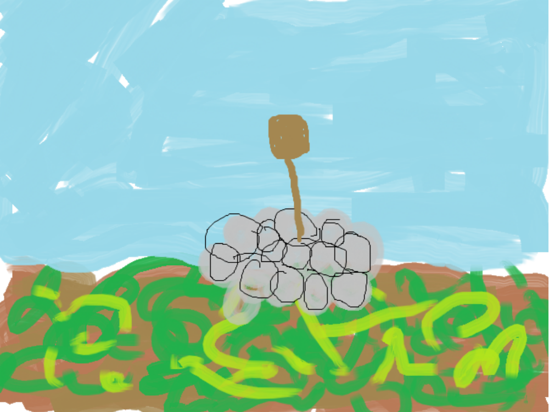
This is what Elpenor is asking Odysseus to do for him.

Slide 9
The Prophecy, Part 1
Tiresias tells him:
The god who thunders on the land prepares it,
not to be shaken from your track, implacable,
in rancor for the son whose eye you blinded […]
You’ll find the grazing herds of Helios […]
avoid those kine [cows…]
But if you raid the beeves, I see destruction
for ship and crew. Though you survive alone,
bereft of all companions, lost for years,
under strange sail shall you come home, to find
your own house filled with trouble: insolent men
eating your livestock as they court your lady.
Aye, you shall make those men atone in blood!
Poseidon isn’t going to forget about you blinding his son, and is going to make your journey back to Ithaca as difficult as possible.
Whatever you do, don’t eat the cattle of the Sun God. Anyone who eats them will die.
When you get back to Ithaca, there will be these suitors who have taken over your house and are trying to woo Penelope. Punish them!

Slide 10
The Prophecy, Part 2
But after you have dealt out death – in open
combat or by stealth – to all the suitors,
go overland on foot, and take an oar,
until one day you come where men have lived
with meat unsalted, never known the sea,
nor seen seagoing ships […]
The spot will be plain to you, and I
can tell you how: some passerby will say,
“What winnowing fan is upon your shoulder?”
Halt, and implant your smooth oar in the turf
and make fair sacrifice to Lord Poseidon […]
Tiresias tells him that the way to finally placate Poseidon is to take an oar and go to a land far, far inland, where people have never heard of the sea (and therefore Poseidon).
He’ll know he is in the right place when someone thinks the oar is a winnowing fan (a tool used for separating grains).
He is to leave the oar there, which is a way of teaching the people of Poseidon’s greatness and thereby making amends with the god.
But it’s also symbolic of…

Slide 11
a funeral, or the end of his journeys.

Slide 12
After finishing with Tiresias, Odysseus talks with many more ghosts in Hades, but you only need to know about three of them.

Slide 13
Anticlea (Odysseus’ Mother)
“Too long that woman in her enduring spirit waits
Within your halls. And the miserable nights
And the days always waste away for her as she sheds tears.
No one else yet holds your fine honor, but Telemachos
Possesses the acres securely, and he dines
On well-shared feasts, whereof it befits a judge to partake.
All invite him. But your father remains in one place
In the country and does not visit the city. No bed
He has, no bedclothes and mantles and glistening blankets,
But he sleeps all winter where servants do in the house,
In ashes by the fire, and he puts bad clothes on his flesh.”
Odysseus’ mother Anticlea has died of heartbreak for her son.
She has news for him from Ithaca – Penelope has not remarried yet and is waiting for him. But his father, Laertes, is in deep mourning for Odysseus.

Slide 14
Agamemnon
“Glorious son of Atreus, lord of men, Agamemnon,
What fate has overcome you of long-sorrowful death?” […]
“Poseidon did not overcome me in my ships […]
Aigisthos fashioned for me my death and my fate.
With my cursed wife [Clytemnestra] he killed me, inviting me to his house,
Feasting me […]
So I died a most grievous death […]
Who would set out within her mind such deeds as these,
The sort of disgraceful deed which that women plotted,
Devising murder for her wedded husband[…]
So never be mild yourself, henceforth, even to your wife.
Reveal to her no entire story you know well,
But tell her a part of it and let the rest be concealed.
Agammemnon, commander of the Greeks at the Trojan War, returned to his home and was murdered by his wife Clytemnesta’s (cousin of Penelope) lover Aigisthos.
He sort of had it coming – he had killed their daughter as a sacrifice to the gods before leaving for Troy, and he brought his own mistress back from Troy.
But the important thing to note is that Agamemnon is telling Odysseus to be wary of his wife when he returns to Ithaca.

Slide 15
Achilles
“Achilles, no man in the past or hereafter is more blessed than you.
When you were alive before, the Argives honored you
Equal to the gods. Now you greatly rule over the dead,
Being here as you are. So do not grieve now you are dead, Achilles.”
Thus I spoke, and he at once addressed me in answer:
“Noble Odysseus, do not commend death to me.
I would rather serve on the land of another man
Who had no portion and not a great livelihood
Than to rule over all the shades of those who are dead.”
Odysseus sees the ghost of Achilles looking kind of glum, and he tells him to cheer up, as he is so highly honored and respected.
Achilles says that he would rather be the slave to a poor man and alive than be the ruler of all of the Underworld, that’s how precious life is.
This is revolutionary – kleos (fame or glory) was the supreme value in the Iliad, and now Achilles, the greatest of all warriors, is saying that he would give all of that up to live a simple life on earth.

