Slide 1
Vocabulary in English I
An exciting adventure into the world of words!
Ms. Chapman’s Class
Bellaire High School, 2014-2015

Slide 2
Introduction
Congratulations! Over the course of this year, you will have the opportunity to learn hundreds of new words in our English class!
I’ll distribute a list of words at the beginning of the week, then we’ll talk about them each day, and you’ll have a quiz to test your understanding of them the following Monday.

Slide 3
Part I – What’s in it for You?
Part II – What Does it Mean to Know a Word?
Part III – How to Learn Words, Or: Vocabularying

Slide 4
Part I – What’s in it for You?

Slide 5
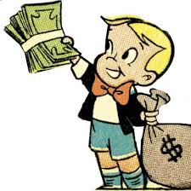
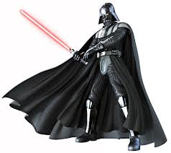
What’s in it for You?
Money
Power

Slide 6
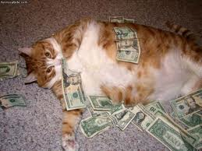
Money-Money-Money-MONEY
In the 1940’s the education researcher Johnson O’Connor discovered that a person’s vocabulary was the single best predictor of their career success.
  US Armed Forces scientists have determined that for every standard deviation higher a person scores on a vocabulary-based test, he or she can expect to see an annual salary increase of $10,000. (1)
A strong vocabulary is essential to performing well on standardized college admissions tests.
All because I took my vocabulary quizzes seriously...
(1) http://www.city-journal.org/2013/23_1_vocabulary.html

Slide 7

Power
But building and strengthening your vocabulary also makes you more powerful.
Behold! The might of VOCABULARY!!!

Slide 8

Power 2
The word “vocabulary” actually comes from the Latin word vocare, which means “to call” and is related to the word vox which means “voice.” Thus, by strengthening your vocabulary, you are strengthening your voice.
Think of AVOXES in The Hunger Games – the name literally means “without a voice.” (And side note – we get the word “language” from the Latin word lingua meaning “tongue” – thus, avoxes are not only without tongues but also without language.)

Slide 9

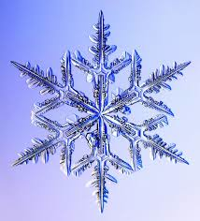

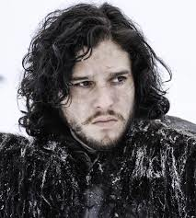
Power 3
Building the number of words you know also makes you mentally stronger.
Understanding more words means that you will understand more nuanced and specific ideas.
  You may have heard the old story about how the people who live near the Arctic have many more words for “snow” than we do in English – since they’re surrounded by the stuff, the thinking goes that while we might not be able to perceive the differences in different kinds of frozen H20, they possess the mental ability to appreciate the variety. While contemporary anthropologists aren’t exactly sure that that study is true, the fact remains that language shapes the way we think (and the better your mastery of language, the sharper your thinking – consider how you grew as a child when you learned different terms for the idea of “sad” – “depressed,” “frustrated,” “melancholy,” etc.).

Slide 10
“As vocabulary is reduced, so are the number of feelings you can express, the number of events you can describe, the number of things you can identify! Not only understanding is limited, but also experience. Man grows by language. Whenever he limits language, he retrogresses!”
Sheri S. Tepper, A Plague of Angels

Slide 11
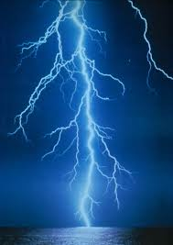
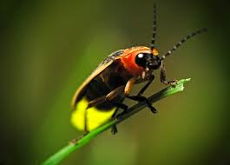
Power 4 - Writing
Improving your vocabulary will particularly help you with your writing. The French novelist Gustave Flaubert coined the phrase “le mot juste” (meaning the just or right word) to talk about his struggles to achieve in writing precisely what he meant to say.
And the American writer and humorist Mark Twain famously said that, “The difference between the right word and the almost-right word is the difference between lightning and lightning bug.”

Slide 12
“Writers fish for the right words liker fishermen fish for, um, whatever those aquatic creatures with fins and gills are called.”
-Jared Kintz

Slide 13
Part II – What Does it Mean to Know a Word?

Slide 14
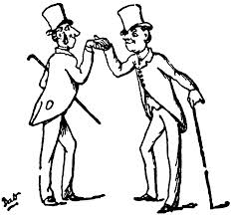
“How do you do, Mr. Word?”
Pleased to meet you, good sir!
Delighted to make your acquaintance, my dear fellow!
Think about what it means to know a person. If you met someone once and remembered his name, could you say that you really knew him?

Slide 15
NO!
You don’t know me!
WORD

Slide 16
If You Were Going to Get to Know a Person...
You might want to learn...
Where he came from and what made him who he is today
What kind of work he does
How he behaves in different kinds of situations
His personal style

Slide 17
The Same Goes for Words!!!
Where he came from and what made him who he is today
What kind of work he does
How he behaves in different kinds of situations
His personal style
Etymology
Part of Speech
Multiple Definitions
Occasion

Slide 18
Etymology
Etymology is the study of the history and the origins of words
We can learn more about what a word actually means by examining how it came to be
  For example, we will be discussing how the society of Panem in The Hunger Games is highly stratified. Many of you might know that a synonym for “stratified” is “unequal.” But if we look at how we got that word, our appreciation for it begins to grow.

Slide 19

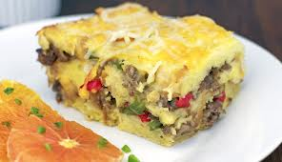
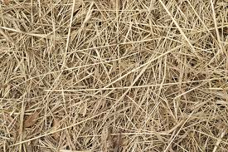
stratified
BREAKFAST STRATA!!!
Geology strata!
strata [“layer”] + facere [Latin – “to do or make”]
sternere [Latin – “to strew”]
stratum [Latin – “something spread or laid down”]
(like a layer of straw, perhaps???)

Slide 20

IT ALL MAKES SENSE!

Slide 21
stratified
Etymology 2
derivative
root
stratum [Latin]

Slide 22
If you Google your word plus “etymology,” you can sometimes get a cool map of its roots plus lots of other interesting information.
Cool Trick

Slide 23
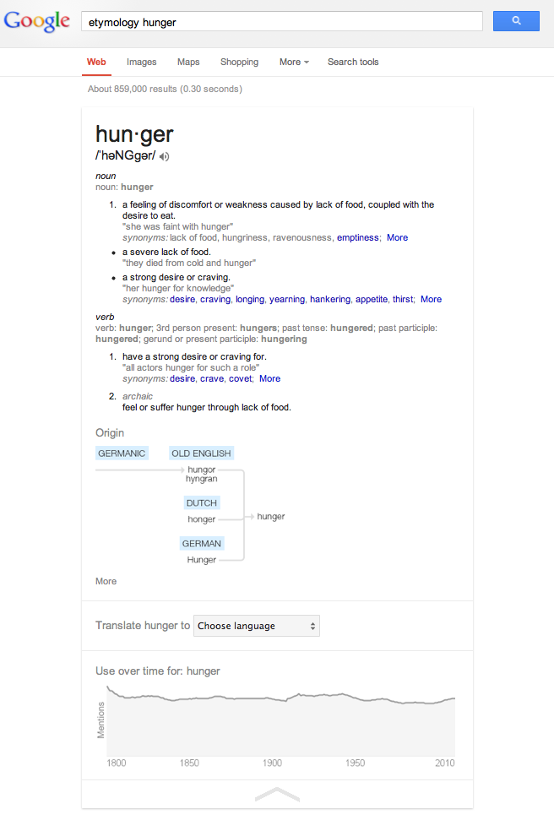
The frequency of mentions of the word “hunger” has declined slightly over time. Why might that be?

Slide 24
Part of Speech
Does the word function as a noun, verb, adjective, adverb, etc.? (How should you use the word?)
Note – what it means to use a word correctly can change over time. (I just Googled the word “hunger.”) Keep in mind that while there are rules, language is always changing!

Slide 25
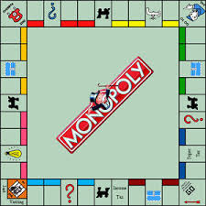
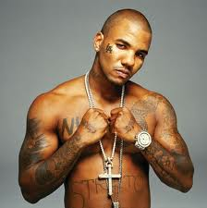
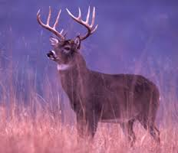
Multiple Definitions
Keep in mind that just like a person can behave in different ways in different situations, so can a word.
The game
The game
The Game

Slide 26
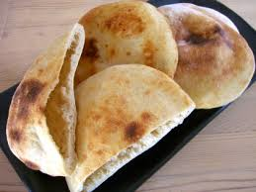
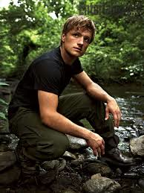
Note
Words that are written the same way but have different meanings are called “homographs.”
Words that sounds the same way (but are spelled differently) but have different meanings are called “homophones.”
Pita
Peeta

Slide 27
Occasion
To know a word, you also need to understand when it’s the right time to use it. You probably wouldn’t bring your grandmother to the Homecoming dance, and you shouldn’t use a phrase like “IDK” in a formal academic essay.

Slide 28
Keep in Mind...
The authors of Greek and Latin Roots: Keys to Building Vocabulary (Rasinski, Padak, Newton, and Newton) note:
“Knowing a word is not an all-or-nothing matter.” (13)
Getting to know new words this year will be a lot like making new friends – it might take an investment of time and energy on your part, but ultimately, you’ll be rewarded for your efforts.

Slide 29
Part III – How to Learn Words, or: Vocabularying

Slide 30
Caveat Lecter
[Which is Latin for “Reader, Beware”]
There isn’t one single way to learn vocabulary words. Finding the best methods for you will probably take some trial and error. The following slides offer some suggestions for possible ways that you could prepare for your vocabulary quizzes.

Slide 31
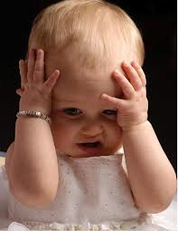
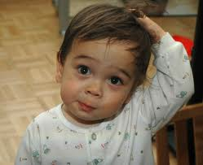
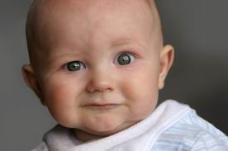
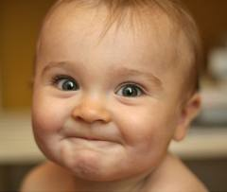
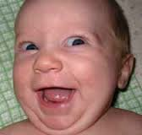
Consider the Depth of Your Understanding
For each word, consider where on the spectrum of understanding you fall:
Never heard the word – no idea
Recognize the word, but don’t know what it means
Recognize the word and have a sense of whether it’s positive or negative
Can use the word, but struggle to define it
Can use the word and explain its meaning

Slide 32
Consider the Different Kinds of Understanding
Can you pronounce the word?
Can you spell the word?
Can you define the word?
Can you use the word?
Can you use the word at the right time?

Slide 33



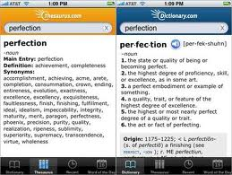
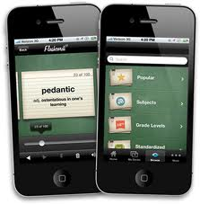
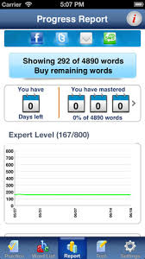
Apps for Vocabulary
The classic choice for word nerds! The app gives you lots of definitions, and for a small fee, examples of uses in sentences. It also has pronunciation for most words!
You can make your own decks of cards to practice. Best of all, you can import your definitions from Dictionary.com so you don’t have to type them all.
Created by MIT to offer a customized standardized test preparation system with sophisticated progress tracking. Use it in your spare time to get ready for the PSAT!

Slide 34
Other Ideas for Studying
Make a personal connection to the words. Think of them as they relate to your own life.
  St. Louis University calls this “deep-processing,” and says, “deep-processing implies that these words become part of you.” (1)
When you encounter a word you don’t know, make a habit of looking it up. It’s easier than ever with a smartphone!
If you’re a visual person, try drawing pictures (they can be little doodles!) in addition to writing sentences.
Practice saying the words aloud as you study them – this will strengthen the connections you are making in your brain!
Study words multiple times over the week, not just the night before the quiz.
http://www.slu.edu/colleges/AS/languages/classical/latin/tchmat/grammar/lvocab2.html

