Slide 1
Poetry Study – Shakespeare and Hip-Hop
A PowerPoint essay and lesson from Ms. Chapman.

Slide 2
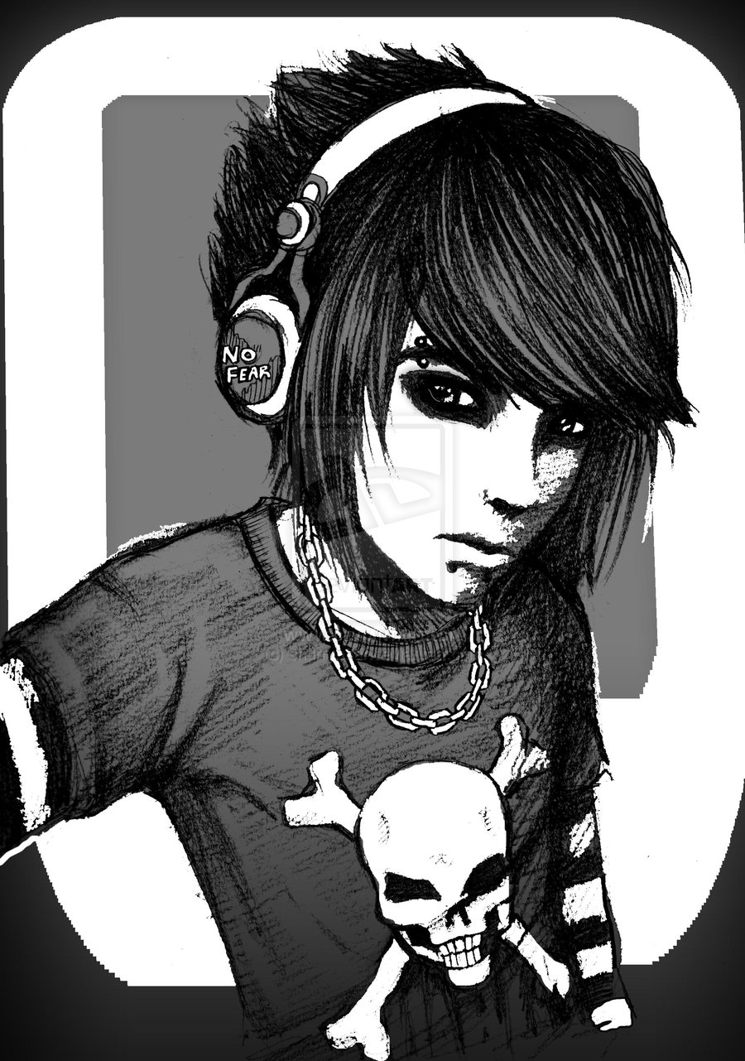
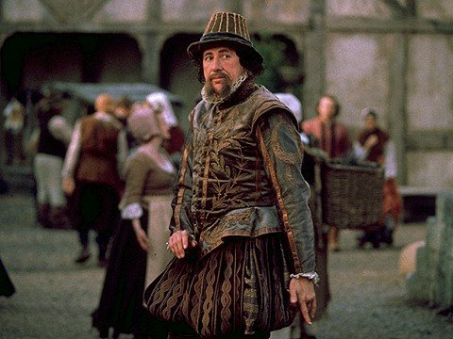
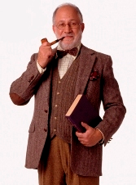
When I was growing up, I thought the only people who really liked Shakespeare were a bunch of jerks.
Hra, ha-ha, Shakespeare, what a wit! Although you probably wouldn’t appreciate him, because you’re not as intelligent and ancient as I am. Pass the Grey Poupon!
My soul is so dark… Shakespeare is the only one who understands me… I’m going to write two lines of his poetry that I found on the Internet on my binder in Sharpie.
I’m wearing ridiculous pants.

Slide 3
Basically, I thought Shakespeare’s works were way overrated because of the culture of adulation that surrounded them. I felt like the hyperbole used to describe him couldn’t be genuine.
Of course, I hadn’t actually read any Shakespeare at this point in my life….
Whenever I am struggling with life, I just turn to Shakespeare’s wisdom.
The best writer of the English language!
A person who hasn’t read Shakespeare can’t claim to be educated.

Slide 4
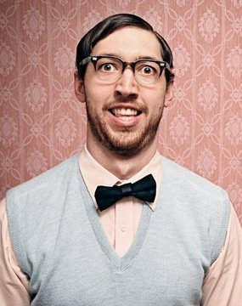
Another person whom I thought was a jerk was my freshman biology teacher. (An opinion I stand by, 13 years later.)
I don’t know why they call it rap music. There’s no music – just a bunch of thugs shouting.*
And here, Mr. Shofner would do what I knew even then was a very stupid, racist impression of how he thought rappers talked and walked, pretending that his pants were sagging and throwing made-up gang signs. I despised that man so much.
*If you are wondering what Mr. Shofner’s opinions on rap have to do with biology, the answer is nothing. Other nuggets of wisdom Mr. Shofner shared with us included: 1) the country was going to fall apart if Al Gore was elected President, 2) those of us who celebrated Halloween would probably wind up in Hell, 3) being gay was unnatural and wrong. Also, he told us that evolution was scientifically impossible.
(Not actually Mr. Shofner – he looked worse.)

Slide 5
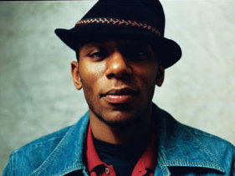
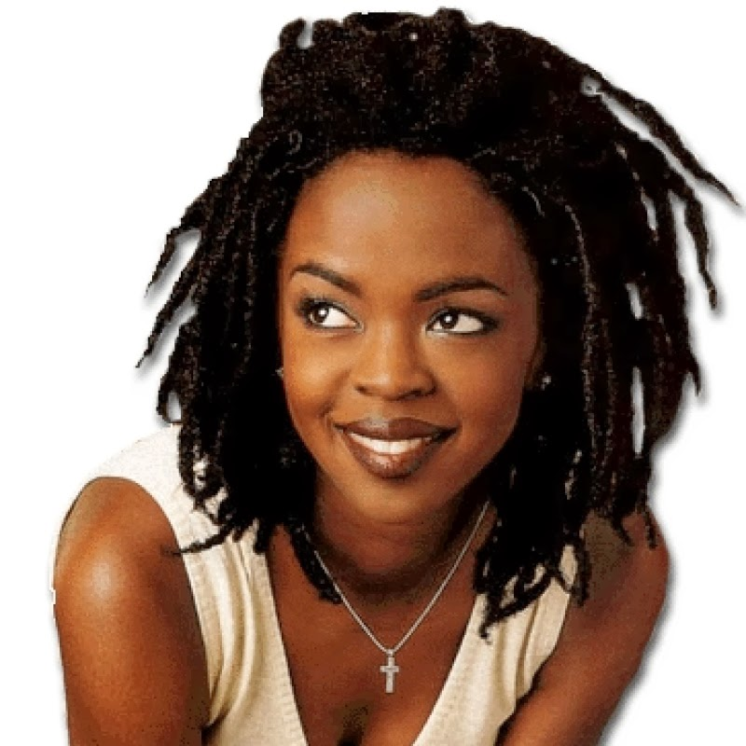
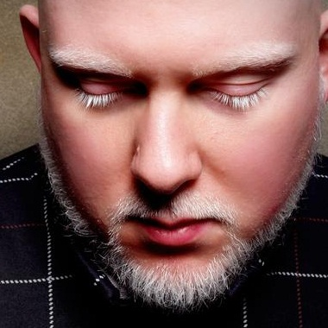
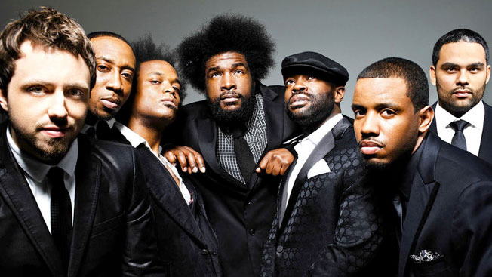
As a kid and a teenager, I loved rap.
I loved the rhythm and the beat, I loved how clever the lyrics were, and I loved the emotion that was present in it. (I didn’t love some of the content in some of the songs, but that’s a story for another day.)
Here were some of my favorites:
Mos Def
Lauryn Hill
Brother Ali
The Roots

Slide 6

I went through high school and college pretty ambivalent about Shakespeare’s works – what I read, I enjoyed, but it never blew me away.
But then I became an English teacher, and I needed to find a way to help my students to be excited about Shakespeare in a way that I never was.

Slide 7
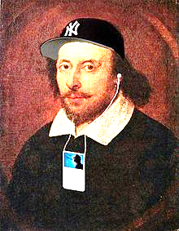
Suddenly, it dawned on me…
Shakespeare was gangsta!
The same techniques that rap and hip-hop artists used were strategies that Shakespeare employed hundreds of years ago to make his poetry and drama popular!

Slide 8
First of all, Shakespeare wrote for a popular audience.
Many of the people who attended Shakespeare’s plays were working class poor people. Admission was a penny (the average laborer in those times earned five pennies per day), and those who could afford it stood on the ground (that’s why they were called “groundlings”) right in front of the stage. The audience was often rowdy and impolite.
Although we read Shakespeare today, in his time his works were meant to be performed – that is, heard orally. “The audience was used to the spoken word, and soon became trained in blank verse, delighting in monologues, debates, puns, metaphors, stump speakers, and sonorous declamation.” At this time, only the wealthiest people had access to an education and could read. But as an oral form of literature, Shakespeare's plays were accessible to people of all social classes.
Furthermore, the content of Shakespeare’s works was highly appealing to a popular audience. Violence, scandal, and bawdy humor drive the plots. Plus, he had lots of dirty (some, really dirty) jokes.
Since the 1990’s, hip-hop has been one of the most popular genres of music in the United States. Although it was originally born out of a young, urban, African-American culture, today its popularity is omnipresent, extending to all parts of the world.
  If I had to lay money on it, I would say a big part of what leads some people to criticize rap and hip-hop as “low culture” is the fact that so many people enjoy that kind of music. Less popular genres – classical, for example – give the appearance of being more exclusive and therefore more elite.
Like Shakespeare’s works, hip-hop is form of art meant to be experienced orally. Anyone who understands spoken language can enjoy and appreciate it – you don’t have to have a college education.

Slide 9
Secondly, both Shakespeare’s works and hip-hop are characterized by their linguistic complexity.
Puns, metaphors, rhyme, imagery, alliteration – Shakespeare’s language has it all! He can build a fantastic character and tell a great story, but a lot of what makes him a genius is how he uses words in such beautiful, clever, original ways.
“Additionally, rap's potential for political advocacy stems from the function of its predecessors, African-American rhyming games, as forms of resistance to systems of subjugation and slavery. Rhyming games encoded race relations between African-American slaves and their white masters in a way that allowed them to pass the scrutiny of suspicious overseers. Additionally, rhyming games allowed slaves to use their creative intellect to provide inspiration and entertainment. For example, by characterizing the slave as a rabbit and the master as a fox, "Bre'r Rabbit tales" disguised stories of slaves outwitting their masters and escaping plantations behind the facade of a comical adventure. Hip-hop journalist Davey D connects the African oral tradition to modern rap: ‘You see, the slaves were smart and they talked in metaphors. They would be killed if the slave masters heard them speaking in unfamiliar tongues. So they did what modern-day rappers do--they flexed their lyrical skillz.’” (Blanchard)

Slide 10
Some examples…
“I love you like a fat kid loves cake…” (J. Cole, “Sparks Will Fly”)
"Fair is foul, and foul is fair…" (Macbeth, I, i)
“But, soft! what light through yonder window breaks? It is the east, and Juliet is the sun.” (Romeo and Juliet)
“Real G’s move in silence, like lasagna…” (Lil Wayne, “6 Foot 7 Foot”)
I’m just a hooligan who’s used to usin' hallucinogens
Causin' illusions again
Brain contusions again
Cutting and bruisin' the skin
Razors, scissors and pins
Jesus, when does it end? (Eminem, “3AM”)
“I pack heat like I’m the oven door…” (Jay Z, “Heart of the City [Ain’t No Love]”)
“If music be the food of love, play on…” (Twelfth Night: I, i)

Slide 11
Both Shakespeare’s works and rap are noted for their rhythmic sophistication – it’s not just about the words, but the beat.
In Shakespeare’s works, we see a particular kind of rhythm called “iambic pentameter.” That means one line composed of an alternating pattern of stressed and unstressed syllables, for a total of 10 beats.
Like this: baBOOM / baBOOM / baBOOM / baBOOM / baBOOM
Or like this: I AM a Pirate WITH a WOODen LEG. (That’s not Shakespeare, but it’s fun.)
Remember, Shakespeare wrote in this pattern on top of composing lines that were beautiful for their meaning.
Rhythm is an important component of rap and hip-hop as well. The word “rap” literally means “to knock or to beat” (as in, “As someone gently rapping, rapping at my chamber door” from Edgar Allen Poe’s “The Raven”).
The emphasis on beat in rap probably comes from the use of drums in traditional African music.
Interlude: What’s the big deal about iambic pentameter? (Click here.)

Slide 12


Iambic Pentameter
(Not at all the same thing.)
So to get a little more specific, each one of those pairs of syllables (each “ba-BOOM”) is called an “iam.” If you put five of them (the prefix “penta”), you get a total of 10 syllables.
I have absolutely no idea why this is the case, but for some reason an odd number of iams tends to make humans feel reflective and a bit melancholy, and an even number of iams feels lighter and sillier. Like this:
  “Now is the winter of our discontent” (five iams)
  “Come live with me and be my love” (four iams)
    Why is this? Well, I asked my guitar teacher, and his theory was that even numbers give us a sense of completion, while odd numbers make us feel that something is amiss.
Okay, so what’s the big deal about iams? Is there some reason why people like them? Well, can you think of something that we’re all very familiar with that beats like, “da-DUM, da-DUM, da-DUM?” …

Slide 13
Both Shakespeare’s works and rap/hip-hop are often deeply reflective about and critical of the world around us.
Shakespeare shook things up. He challenged the status quo of race relations in Elizabethan England with characters like Othello (a Venetian of African descent) and Shylock (a Jewish merchant). He often criticized women’s oppression through his works.
“Rap has developed as a form of resistance to the subjugation of working-class African-Americans in urban centers. Though it may be seen primarily as a form of entertainment, rap has the powerful potential to address social, economic, and political issues and act as a unifying voice for its audience.” (Blanchard)

Slide 14
Some examples…
Hath not a Jew eyes? Hath not a Jew hands, organs, dimensions, senses, affections, passions? Fed with the same food, hurt with the same weapons, subject to the same diseases, healed by the same means, warmed and cooled by the same winter and summer as a Christian is? If you prick us, do we not bleed? If you tickle us, do we not laugh? If you poison us, do we not die? And if you wrong us, shall we not revenge? (Shylock, The Merchant of Venice)
Mr. Wendal has freedom,
a free that you and I think is dumb
Free to be without the worries of a quick to diss society
for Mr. Wendal's a bum
His only worries are sickness
and an occasional harassment by the police and their chase
Uncivilized we call him,
but I just saw him eat off the food we waste
Civilization, are we really civilized, yes or no ?
Who are we to judge ?
When thousands of innocent men could be brutally enslaved
and killed over a racist grudge (“Mr. Wendel,” by Arrested Development)

Slide 15
Some examples…
To be, or not to be, that is the question—
Whether 'tis Nobler in the mind to suffer
The Slings and Arrows of outrageous Fortune,
Or to take Arms against a Sea of troubles,
And by opposing end them? To die, to sleep—
No more; and by a sleep, to say we end
The Heart-ache, and the thousand Natural shocks
That Flesh is heir to? 'Tis a consummation
Devoutly to be wished.
(Hamlet, Hamlet)
Come on come on
I see no changes. Wake up in the morning and I ask myself,
"Is life worth living? Should I blast myself?"
I'm tired of bein' poor and even worse I'm black.
My stomach hurts, so I'm lookin' for a purse to snatch.
[…]
Give the crack to the kids who the hell cares? One less hungry mouth on the welfare.
(“Changes,” by Tupac)

Slide 16
So, your assignment:
You will sign up to present either a sonnet from Shakespeare or a selection (100 words or more) from a rap/hip-hop song one day over the next three weeks at the beginning of class.
I must approve of your selection when you sign up. If you choose a rap/hip-hop song, we may need to edit portions for strong language and content. You can find collections of both Shakespeare’s sonnets and popular songs online, but I’m happy to help you.
On the day that you present, you will deliver a short (~ one minute) introduction to your work. You will write this yourself. Introduce the title and the author of your work, and any relevant historical/biographical details. Tell us, your audience, what the major themes of the work are, and what you liked about it. Make a point of explaining what we should pay special attention to and listen for as you recite.
Recite your poem. For this assignment, you may bring cue cards up to the front, but you may not just read directly from the paper. I want to emphasize that this is a performance – we should be dazzled by your delivery. I’ll give you a rubric like the one we used for our earlier set of poems.
This is worth a double daily grade.

Slide 17
Sources
Mabillard, Amanda. Shakespeare's Audience: The Groundlings. Shakespeare Online. 20 Aug. 2000. (April 23, 2014) < http://www.shakespeare-online.com/essays/shakespeareaudience.html" >.
http://www.bard.org/education/studyguides/Midsummer/audiences.html#.U1hH5vldWSp
http://www.shakespearesglobe.com/uploads/files/2014/01/audiences.pdf

