Slide 1
Graphic Novels
By: Mrs. Christopher

Slide 2


Slide 3
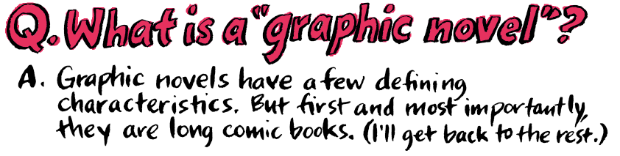

Slide 4


Slide 5
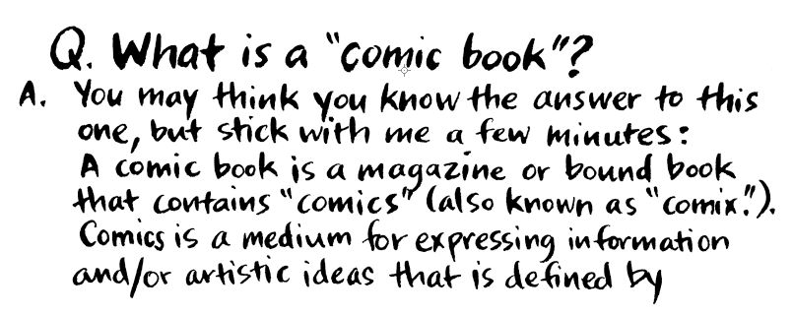
BAM!

Slide 6
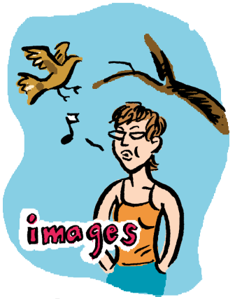
GRAPHIC NOVELS ARE….

Slide 7
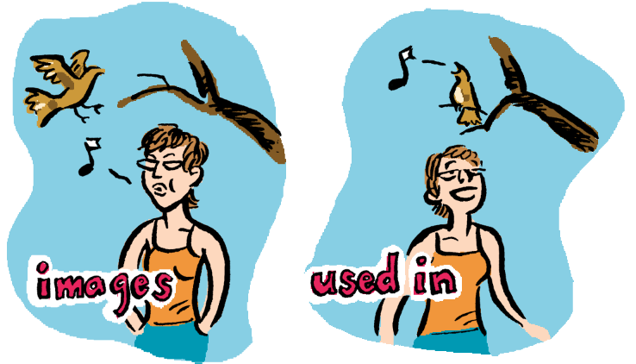
GRAPHIC NOVELS ARE….

Slide 8
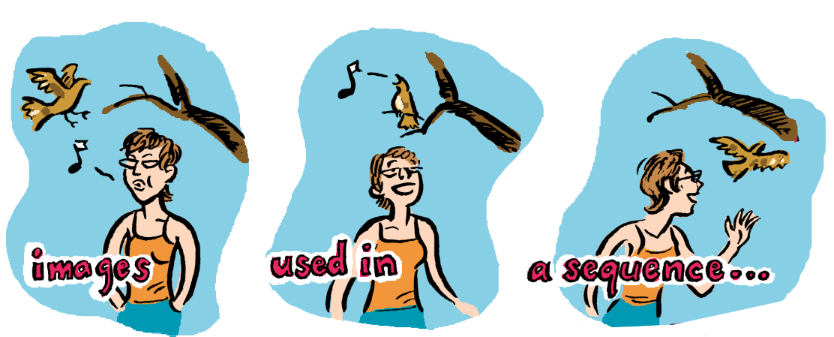
GRAPHIC NOVELS ARE….

Slide 9
GRAPHIC NOVELS ARE….
Graphic novels use text and pictures to present information.
Graphic novels use the same format as comic books.
Graphic Novels differ from comics in that they usually contain stand-alone stories with complex plots.

Slide 10
What are the major types of graphic novels?
* Superhero Story
* Magna
* Non-fiction
* Adaptations or Spinoffs
* Satire
* Fantasy
* Personal Narratives
* Can you guess what type of graphic novel Perspeolis is?????

Slide 11
Perspeolis is……
PERSONAL NARRATIVE

Slide 12

Do you know the parts of a graphic novel?

Slide 13
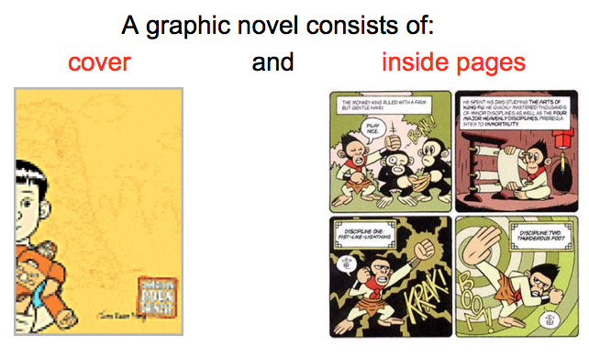
The Parts of a Graphic Novel

Slide 14
Graphic Novel – Page Elements
*Panels – squares or rectangles that contain a single scene.
*Gutters – space between panels.
*Word Balloons – contain communication between/among characters.
*Thought Balloons – contain a character’s thoughts.
*Captions – contain information about a scene or character.
*Sound Effects – visual sound clues (POW!) This is also called…..????

Slide 15
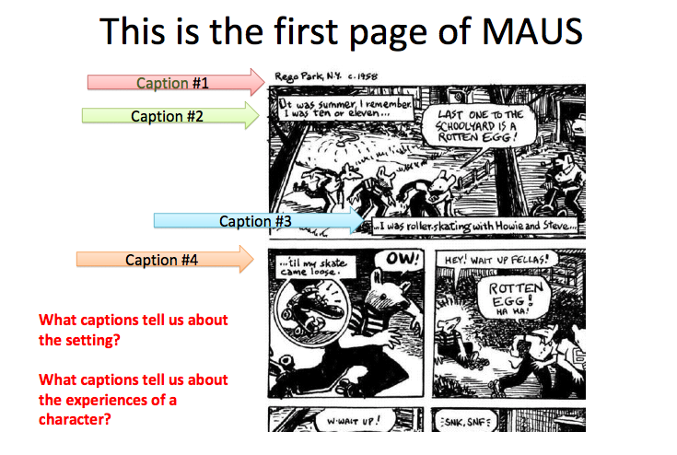
CAPTIONS

Slide 16
Dialogue
*What characters say to each other.
*Conveyed through word balloons.
*Each word balloon has a “tail” to let you know who is talking!

Slide 17
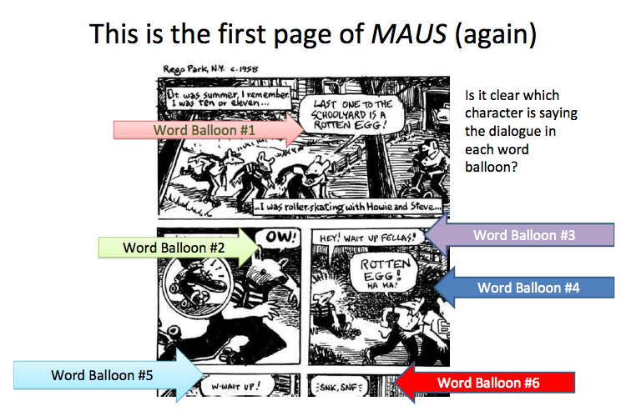

Slide 18
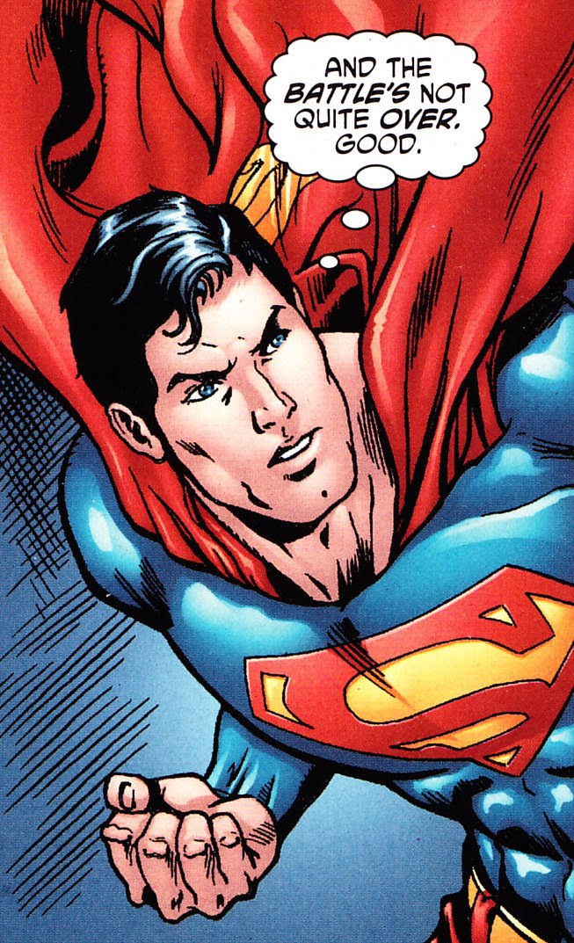
Thought Balloons

Slide 19
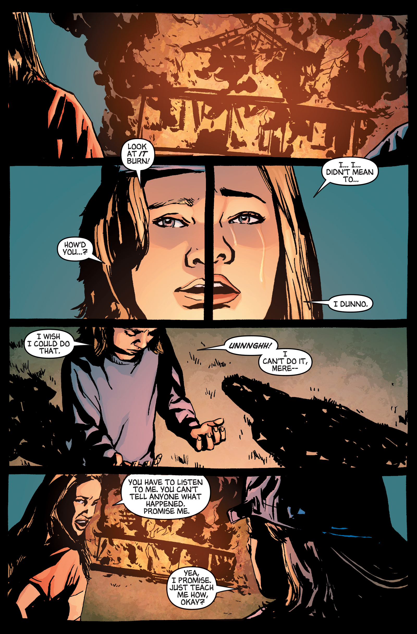
Panels

Slide 20
Gutters

Slide 21
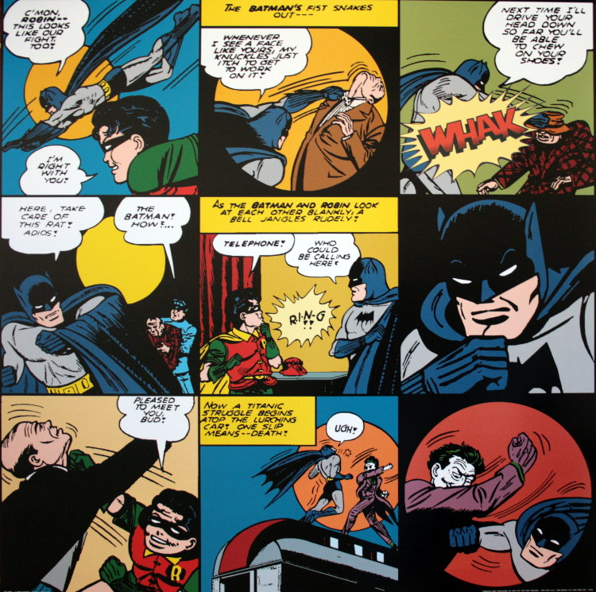
Sound Effects

Slide 22
What to look for in words and pictures….
*In the captions and word balloons, some words are emphasized by being BIGGER or BOLDER than others.
*This lets the reader know that there is a lot of EMOTION behind these specific words.

Slide 23
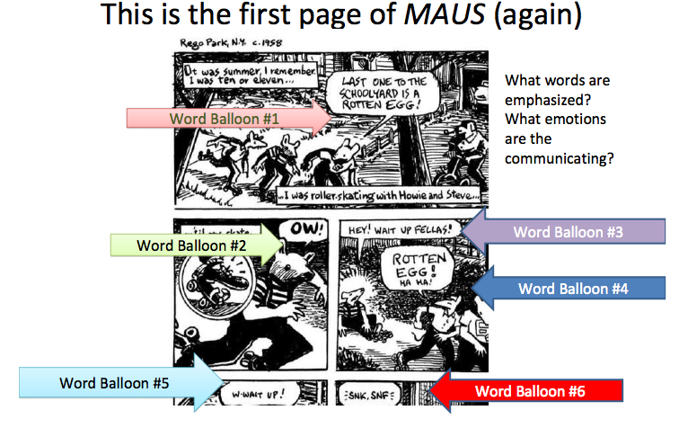

Slide 24
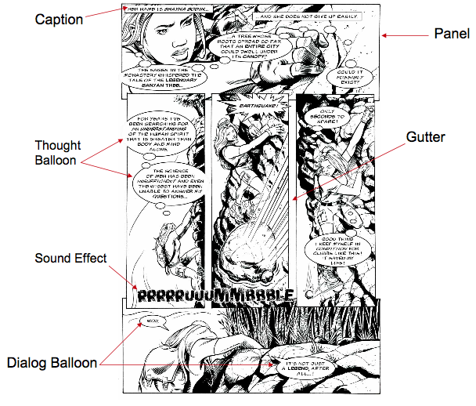

Slide 25
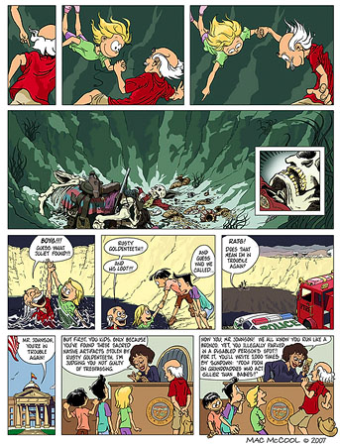
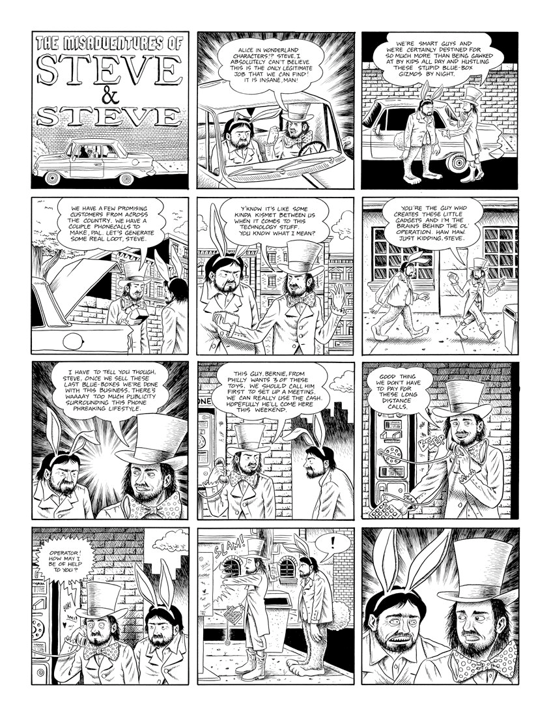
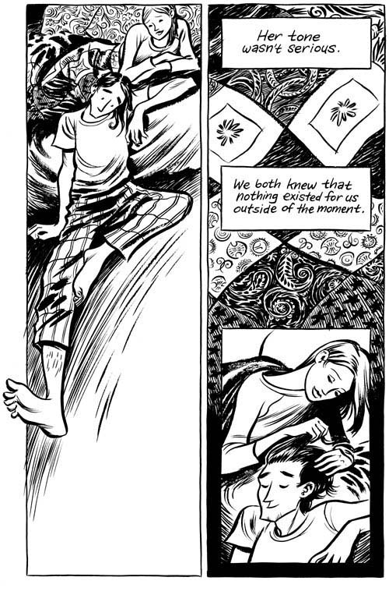
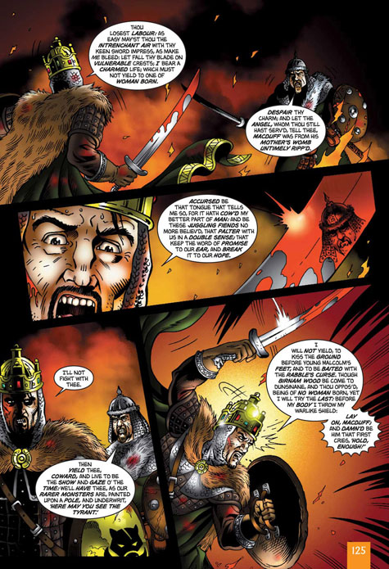
Do you know how to read a graphic novel? Are there any certain strategies?

Slide 26
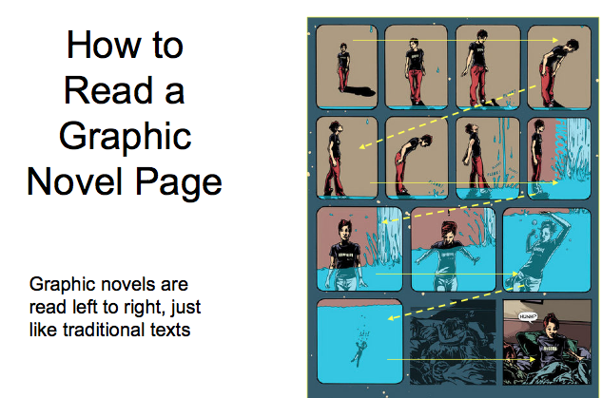

Slide 27
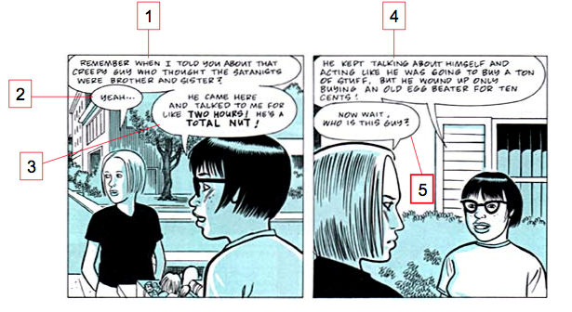
Word Balloons….

Slide 28
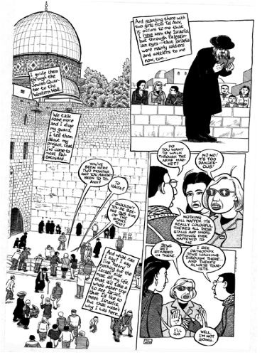
Sometimes it can be a bit more complicated…..
BUT…..

Slide 29
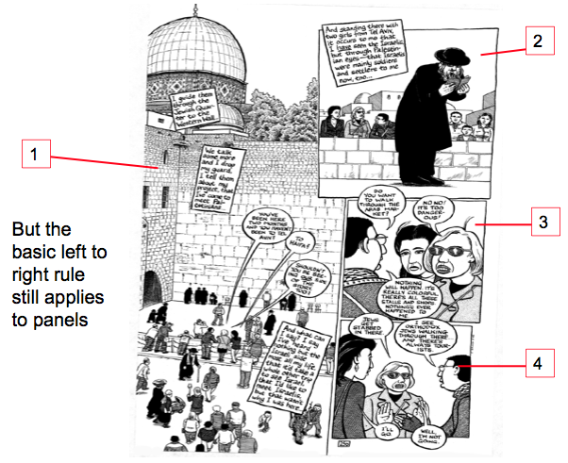

Slide 30
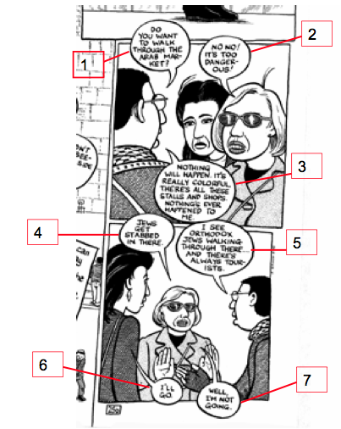
For word balloons too…..

Slide 31
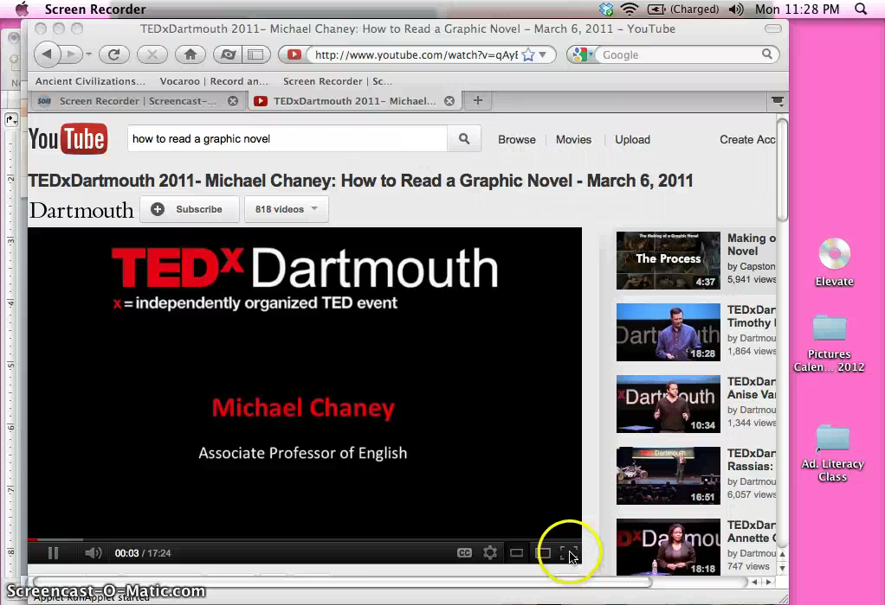
Video – About Graphic Novels

Slide 32
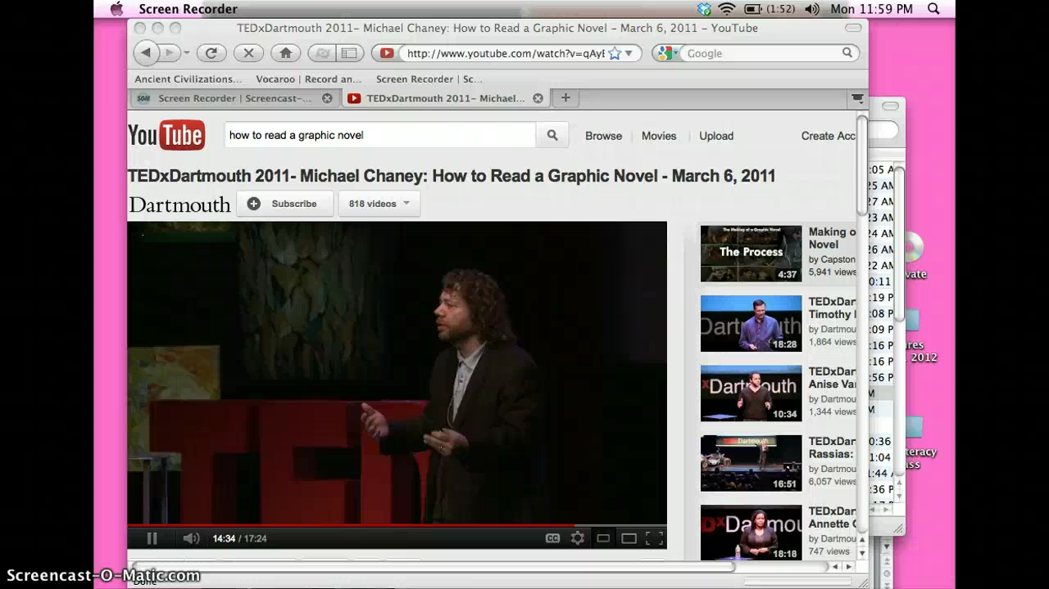

Slide 33
HOMEWORK – Frayer Model
Definition | Characteristics
Examples | Elements
GRAPHIC NOVELS

