Slide 1
Subjunctive Mood

Slide 2
What is a Mood?
In grammar, a “mood” can be thought of as describing the kind of job a sentence accomplishes. Other moods you might know include the imperative (giving a command – “Finish your homework.”), the interrogative (asking a question – “Have you finished your homework?”), and the indicative (describing something – “Edgar finishes his homework.”).

Slide 3
The Purpose of the Subjunctive
The “subjunctive” is a way of expressing thoughts about a situation that doesn’t actually exist – a “counterfactual condition.” It’s like talking about what might be going on in a parallel universe.
For example, has someone ever prefaced some advice they want to give you with the phrase, “If I was you…?” That’s actually not correct. What they literally are expressing when they say that is, “If, in the past, I have been the person whom you are…”

Slide 4
The Most Important Thing You Need to Know About the Subjunctive
Past Indicative Conjugation
Subjunctive Conjugation
I was
you were
he/she/it was
we were
they were
(if) I were
(if) you were
(if) he/she/it were
(if) we were
(if) they were

Slide 5
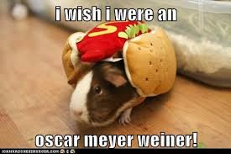
not was!

Slide 6
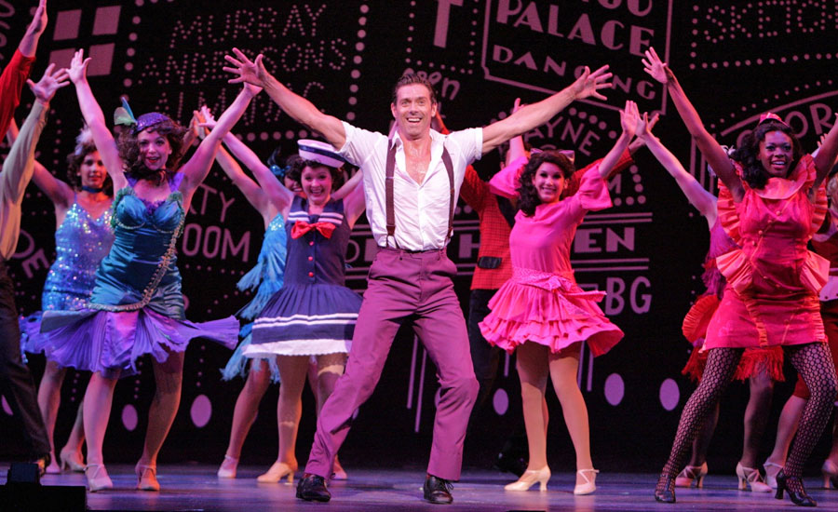
And Now… The Subjunctive as Expressed Through Musical Theater!

Slide 7
Example from Fiddler on the Roof
http://www.youtube.com/watch?v=RBHZFYpQ6nc

Slide 8
Example from Guys and Dolls
http://www.youtube.com/watch?v=aLooMzB_lgc

Slide 9
Vocabulary Examples
I wish that my father were not so blustery with my younger siblings – he needs to follow through with punishments when they misbehave.
If I were stronger, I could hoist you over my head and spin you around like the Olympic ice skaters.
If he were to fall for our gimmick, we would make lots of money off of him.
I wish I were a less clumsy person, so that I didn’t have to put this stinging antiseptic on my scraped knee.

Slide 10
Subjunctive Vocabulary Sentences
20 sentences total (you choose which words [not the ones from the example], and they don’t have to be in order)
Sentences 1-5 have to use the first person subjunctive form of “to be” and the word “wish.” (“I wish I were…”)
Sentences 6 – 10 have to use the first person subjunctive form of “to be” and the word “if.” (“If I were…”)
Sentences 11 – 15 have to use the third person subjunctive form of “to be” and the word “wish.” (“He wishes he were…”)
Sentences 16 – 20 have to use the third person subjunctive form of “to be” and the word “if.” (“If he were…”)

