Slide 1
Active and Passive Voice

Slide 2
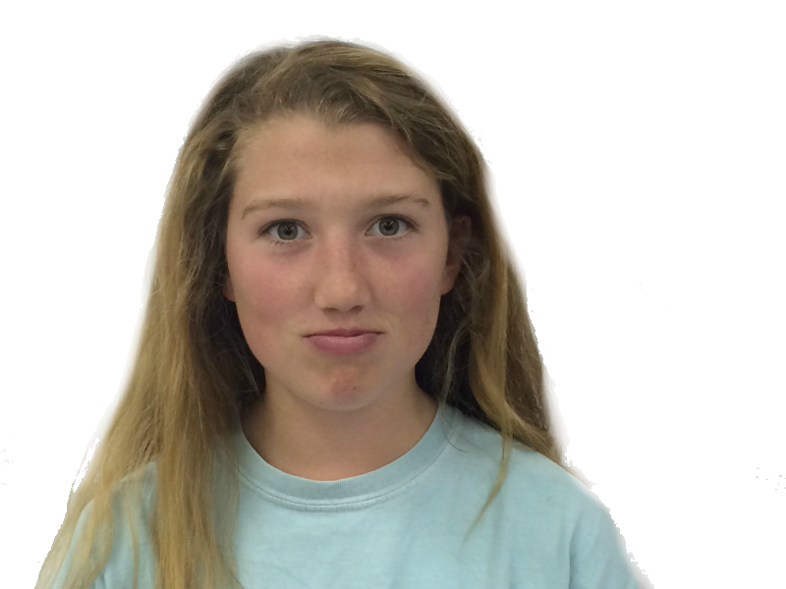
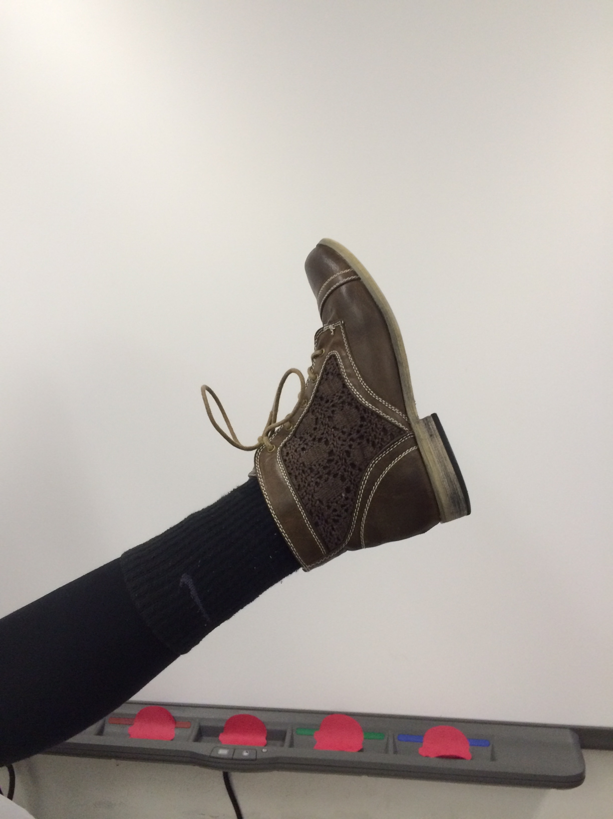
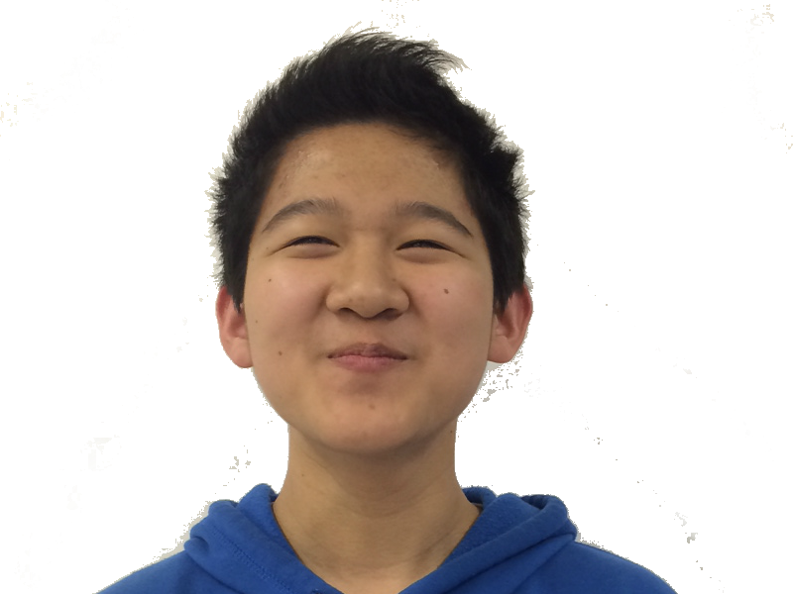
What is active voice?
Active voice is used when the subject of a sentence performs an action. For example…
Maddy
kicks
Phillip.
(our subject – the main character of the sentence, and the one performing the action)
(our verb – the action of the sentence)
(our object – the one receiving the action; in this case, the kick)

Slide 3
What is active voice?
The structure of this sentence makes Maddy, and her choice to kick Phillip, the focus. The reader gets more of Maddy’s perspective – why is she kicking Phillip, we wonder?
Maddy
kicks
Phillip.
(our subject – the main character of the sentence, and the one performing the action)
(our verb – the action of the sentence)
(our object – the one receiving the action; in this case, the kick)

Slide 4
What is passive voice?
Passive voice is used when the subject of a sentence is performed upon, or receives the action. For example…
Phillip
was kicked
by Maddy.
(our subject – the main character of the sentence, and the one receives the action)
(our verb – the action of the sentence; used with a helping verb, or a form of “to be”)
(our prepositional phrase – the person performing the action)

Slide 5
What is passive voice?
The structure of this sentence shifts our focus to Phillip’s perspective. How does it feel to be kicked, we wonder?
Phillip
was kicked
by Maddy.
(our subject – the main character of the sentence, and the one receives the action)
(our verb – the action of the sentence; used with a helping verb, or a form of “to be”)
(our prepositional phrase – the person performing the action)

Slide 6
Passive voice does not require a prepositional phrase.
The sentence could just work like this:
Phillip
was kicked.
(our subject – the main character of the sentence, and the one receives the action)
(our verb – the action of the sentence; used with a helping verb, or a form of “to be”)

Slide 7
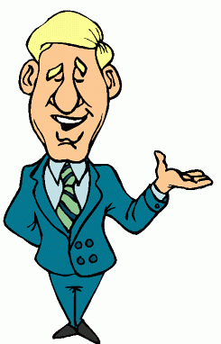

Why might you want to use passive voice?
There are two major effects of using passive voice, as opposed to active…
The chemicals were mixed…
Mistakes were made…
calls attention to the chemicals, and not the person mixing them
calls attention to the mistakes, and not the person who made them
Passive voice emphasizes the receiver of the action – it’s often used in scientific writing.
Passive voice minimizes the “doer” or the person responsible for the action.

Slide 8
Practice – active or passive?
The gaunt cowboy rode his faithful horse off into the sunset, in search of his one true love.
ACTIVE – How would you rewrite it to make it passive?
A spurious claim that the Whitaker family practiced witchcraft was made by their old rivals, the Godwins, who coveted their lands.
PASSIVE – How would you rewrite it to make it active?
Bruce Wayne ostensibly had no interests outside of gambling and partying.
ACTIVE – How would you rewrite it to make it passive?
An aspirin palliated the woman’s headache.
ACTIVE – How would you rewrite it to make it passive?
The configuration of furniture was not approved by the interior designer.
PASSIVE – How would you rewrite it to make it active?

Slide 9
Sentences
You will write sentences 1 – 10 in active voice. Highlight the subject of the sentence (the actor) in one color, the verb in a second color, and the object in a third color.
Sentences 11 – 20 should be written in passive voice. Highlight the subject of the sentence (that which is acted upon) in one color, the verb in a second color, and the prepositional phrase (you sentences must have a prepositional phrase) in a third color.
Sentences 21 – 25 should be written in passive voice. However, the actor in these sentences should be deliberately omitted. Highlight the subject of the sentence in one color, and the verb in a second color.

