Slide 1
In Cold Blood
Part 1 Discussion
Bellaire High School, English 1 Pre-AP

Slide 2
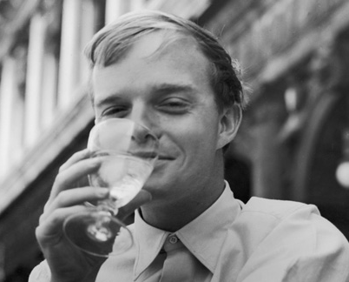
About the Author
Truman Capote was born in 1924 and raised in Alabama (where he was childhood friends with Harper Lee, the author of To Kill a Mockingbird). He moved to New York City as a young man, where he also became a famous socialite (people fought to get into his parties).
His other famous works include Other Voices, Other Rooms and “Breakfast at Tiffany’s.”

Slide 3
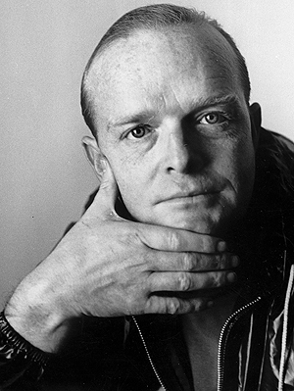
About the Writing
Capote got the idea to write about the Clutter murders after reading an article describing the crime in the New York Times.
He went to Kansas to interview the community with the idea of writing an article, but decided that there was enough material for a book. However, Capote wanted to try a new approach to writing a nonfiction book, in which the story read like fiction. He called his experiment a “nonfiction novel.”
Ultimately, Capote spent four years researching and writing for this project.

Slide 4
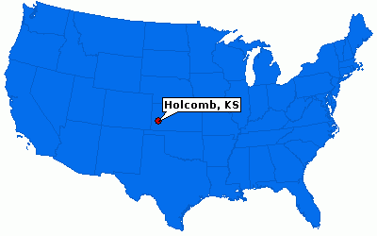
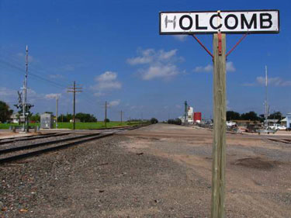
The Setting
Kansas is part of the Great Plains, a strip of geography that runs up and down the North American continent. Because of the harsh, dry landscape, it was one of the last regions to be settled in America. (For this reason, it was also the last refuge for Native Americans.) Because of the rural, remote nature of these towns, communities tend to be close-knit, traditional, and hospitable.
Holcomb was a tiny town that, in many ways, was representative of what America in the middle of the 20th century thought of itself – the descendants of hard-working immigrants making a living off of the land.

Slide 5
Read pages 1 – 3…
Notice how Capote paints a picture of the lands where the story is take place.
Consider how the setting is essential to the story – what specific details do you think will be important to the way that the plot progresses?

Slide 6
The Characters

