Slide 1

The Odyssey Book 9
Questions and Discussion

Slide 2
Who’s Yo’ Daddy?
“But first my name, let that be known to you […]
I am Laertes’ son, Odysseus.”
This is called a “patronymic” – literally, a “father name.”
This is a special kind of Homeric epithet used frequently in the Iliad and the Odyssey. (“Achilles, son of Peleus,” “Athena, daughter of Zeus,” “Menelaus, son of Atreus,” etc.)
Greek society was patrilineal (lineage traced through the father) and patriarchal (ruled by men). Women had less power and occupied a subordinate status.

Slide 3
Doubts about the Story
“What shall I
say first? What shall I keep until the end?
the gods have tried me in a thousand ways […]
I have been detained long by Calypso,
loveliest among goddesses, who held me
in her smooth caves, to be her heart’s delight,
as Circe of Aeaea, the enchantress,
desired me, detained me in her hall.
but in my heart I never gave consent.
where shall a man find sweetness to surpass
his own home and his parents? In far lands
he shall not, though he find a house of gold.
After leaving Calypso, Odysseus is shipwrecked on the shore of the island Scheria, land of the Phaeacians.
He is treated as an honored guest and taken to the court of King Alcinoos and lavishly entertained. After they feast, Alcinoos asks Odysseus to tell them the story of how he got there.
So everything we know about his adventures is told from Odysseus’ perspective! We have to take his word that these magical encounters happened as he described them. (Remember, Odysseus is an admitted liar.)

Slide 4
Lotus Eaters and Temptation
“They fell in, soon enough, with Lotus Eaters,
who showed no will to do us harm, only
offering the sweet Lotus to our friends-
but those who are this honeyed plant, the Lotus, never cared to report, nor to return:
they longed to stay forever, browsing on
that native bloom, forgetful of their homeland.
One of the biggest threats Odysseus and his men face is temptation – in this case, the temptation of the abyss, an end to their sufferings.

Slide 5
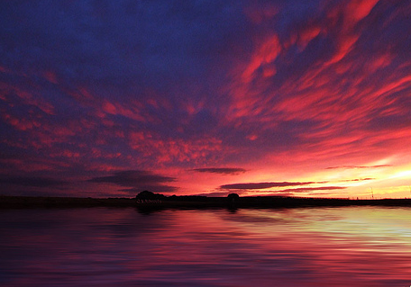
Rosy-Fingered Dawn
“When the young Dawn with finger tips of rose
Came in the east, I called my men together
And made a speech to them […]”
This is one of the most famous (and beautiful!) epithets in the Odyssey.

Slide 6
Curious Odysseus
My men came pressing round me, pleading:
Why not take these cheeses, get them stowed, come back,
throw open all the pens, and make a run for it?
we’ll drive the kids and lambs aboard. We say
put out again on good salt water!”
Ah, how sound that was! Yet I refused. I wished
to see the caveman, what he had to offer-
no pretty sight, it turned out, for my friends.
The crew tell Odysseus they don’t want to hang around, but Odysseus just has to find out what kind of men live on the island.

Slide 7
Xenia – Greek Laws of Hospitality
In ancient Greece (as throughout much of history), if you were travelling somewhere you had to rely on the kindness of strangers. There weren’t hotels or restaurants, so you were stuck hoping someone would put you up.
The obligation to provide hospitality is deeply embedded in Greek culture (among others). There are myths in which a stranger seeks charity, only to reveal himself later as a god.
Guests and hosts had reciprocal obligations.
  Hosts were supposed to take someone in, feed them, give them a place to sleep, and provide them with presents. AND you were supposed to do all of this with no questions asked – you couldn’t even ask your guest his name, at least before you had let him rest and given him a meal.
  Guests were supposed to be on their best behavior. They had to leave their weapons outside, be respectful toward their hosts, and not overstay their welcome. (So when Paris ran off with Helen, Menelaus’ wife, it was especially scandalous because Menelaus had taken him in as a guest.)
    Guests were also supposed to only seek hospitality at a home equivalent to their social standing – if you were a poor person, you would seek shelter at a modest house, and if you were a prince, you would ask to be taken in at the royal court in a strange land.

Slide 8
Xenia – Greek Laws of Hospitality
The Cyclopes aren’t human and don’t respect human laws. How do you think they are going to feel about xenia?
Odysseus and his men just go into Polyphemos’ cave and make themselves at home. (His crew also suggest stealing from the Cyclops.) Are they being good guests?
In the next land we found were Cyclopes,
giants, louts, without a law to bless them […]
We lit a fire, burnt an offering,
and took some cheese to eat […]
[they meet the Cyclops and he asks them what they are doing in his cave]
“We are from Troy, Achaeans, blown off course […]
It was our luck to come here; here we stand,
beholden for your help, or any gifts
you give – as custom is to honor strangers.
We would entreat you, great Sir, have a care
for the gods’ courtesy; Zeus will avenge
the unoffending guest.”

Slide 9
What’s in a Name?
The name “Polyphemos” actually means “wordy” (from “many words”). Does that describe the Cyclops? Is Polyphemos good with words?

Slide 10
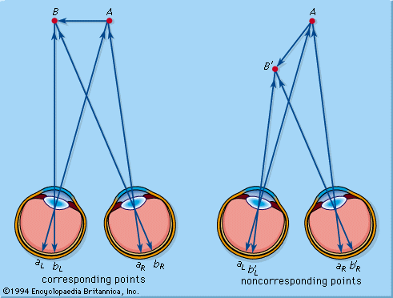
A Quick Science Lesson
In terms of vision, our depth perception – that is, our ability to see in three dimensions and judge an object’s distance from ourselves – comes from having two eyes. Because the left eye and the right eye see from slightly different angles, those two images combined give us our 3D reality.
If someone only had one eye, though, the world would appear more flat – like a painting. They would not have depth perception.

Slide 11
Arrogant Odysseus
[Odysseus yells at Polyphemos after he and his men have escaped]
“Cyclops, if ever mortal man inquire
How you were put to shame and blinded, tell him
Odysseus, raider of cities, took your eye:
Laertes’ son, whose home’s on Ithaca!”
Odysseus just can’t resist telling Polyphemos his real name. I bet that’s going to work out well for him.

Slide 12
Who’s Yo’ Daddy?, Part 2
Oh, snap! Looks like Odysseus chose the wrong Cyclops to blind.
All that remarkably specific information Odysseus gave Polyphemos when he was taunting him? It’s like he robbed a bank and left a copy of his driver’s license.
And he stretched his hands out in his darkness
Toward the sky of stars, and prayed Poseidon:
“O hear me, lord, blue girdler of the islands,
if I am thine indeed, and thou art father:
grant that Odysseus, raider of cities, never
see his home: Laertes’ son, I mean,
who kept his hall on Ithaca. Should destiny
intend that he shall see his roof again
among his family in his father land,
far be that day, and dark the years between.
let him lose all companions, and return
under strange sail to bitter days at home.”

