Slide 1
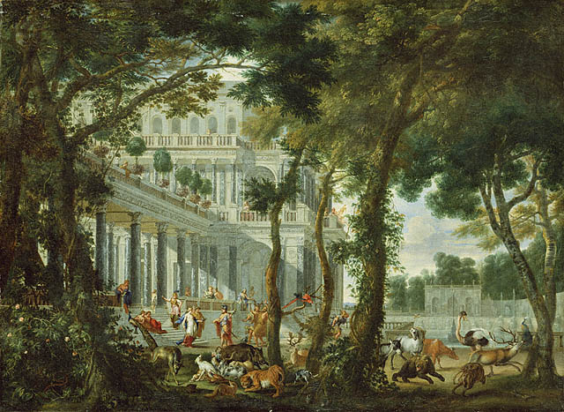
The Odyssey Book 10
Questions and Discussions

Slide 2
What’s in a Name?
The name “Circe” means “the encircler.”
The name of her island, “Aiaia,” means “island of wails.”

Slide 3
A Brief Digression
[After Odysseus and his men land on Aiaia, they’re starving.]
When we had got out there, for two days and two nights
We lay still, eating our hearts with pain and fatigue alike.
I just think that’s beautiful and sad.

Slide 4
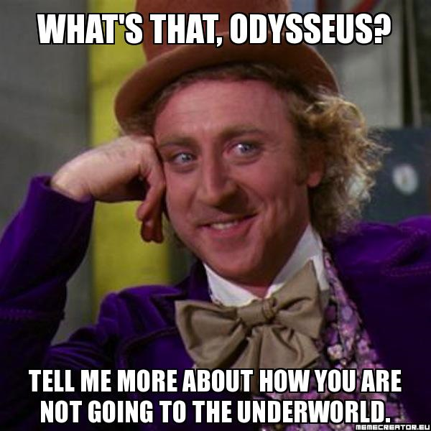
Some Irony
While he and his crew are on the beach, Odysseus makes a speech to try to rally his men:
“My friends, though we are grieving, we shall not yet go down
To the halls of Hades before the fated day arrives.”

Slide 5
Weaving Women
Low she sang in her beguiling voice, while on her loom
She wove ambrosial fabric sheer and bright,
By that craft known the goddesses of heaven.
[… Polites says] “Dear friends, no need for stealth: here’s a young weaver
Singing a pretty song […]
Weaving was one of women’s primary tasks in ancient Greece.
For upper-class women, this could be a pleasant and satisfying duty. They wove more as a form of art rather than necessity – their fabrics were often great tapestries that told stories. In a culture that repressed women, this could be a great outlet for expression and a chance to tell their stories.
Homer’s women are often weavers. Athena was the goddess of weaving, Circe and Calypso both weave, and of course Penelope is famous for her weaving.

Slide 6
Transfiguration
She led them in and sat them in seats and armchairs.
She mixed for them cheese and barley and green honey
With Pramnian wine. And she stirred into the food
Woeful drugs that make one forget his fatherland wholly.
But when she had given it and they had drunk, she at once
Struck them with her wand and shut them up into sties.
They had the heads of swine and the voice and the hair
And the body, but the mind was steady as before.
We’re going to read a poem called “Circe’s Power” by Louise Gluck. In preparation for that, pay particular attention to the fact that Circe changes the men in body only – they are still the same mentally. You could argue that this is a special kind of cruelty, but it also might say something about the nature of the men.

Slide 7
Hermes’ Advice
So Odysseus learns from Circe to be distrustful of nymphs.
The key to getting the upper hand, Hermes says, is to practice restraint against temptation.
At the moment when Circe hits you with her very long wand,
Draw your sharp sword at once from along your thigh
And rush upon Circe as if intending to kill her.
She will be afraid of you and ask you to go to bed.
And from that point on do not refuse the bed of the god,
So she may free your companions and guide you yourself.
But order her to swear a great oath by the blessed gods
That she plot no other bad trouble against your person,
Lest when you are naked she make you unmanly and a coward.

Slide 8
Calypso’s Advice
[…] go on yourself to the moldy hall of Hades.
Odysseus lives with her for a year and then asks to leave. Calypso agrees, but tells him that first he needs to travel to the Underworld to hear a prophesy from Tiresias.

