Slide 1
The Odyssey Book 1
Discussion Points and Questions

Slide 2
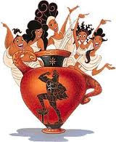
Homer’s Invocation of the Muse
Sing to me of the man, Muse, the man of twists and turns […]
Launch out on his story, Muse, daughter of Zeus,
start from where you will – sing for our time too.
So, Homer is doing some interesting things here. He’s claiming divine inspiration for the story that he is about to tell (muses were minor goddesses of the arts), which means not only that it’s a story that should be really great, but that he’s not responsible if you don’t like what you hear.
  This actually introduces an idea that’s central to the plot of the Odyssey – to what degree are human beings responsible for their actions, as opposed to merely the pawns of the gods?
These layers of authorship – it’s Odysseus telling the story, but wait, it’s actually Homer, but wait, it’s actually a muse – have some basis in reality. Most Homer scholars agree that Homer didn’t invent all of the Odyssey by himself, but instead drew on stories that had been told by many people for many years. His crucial role was committing them to paper in a unified epic.
And in saying “sing for our time too,” Homer also gives himself a nod – his story, he says, has timeless value.

Slide 3
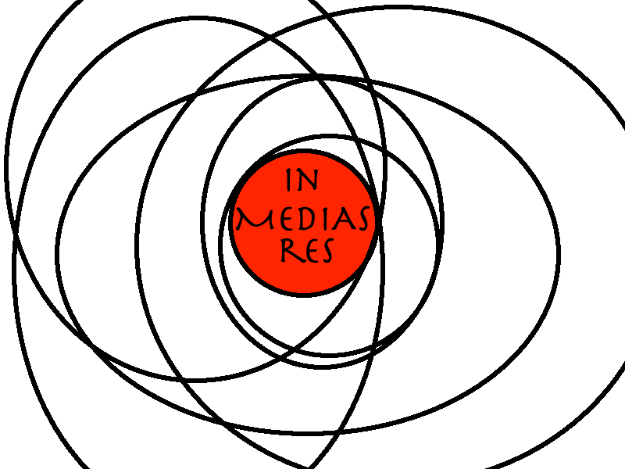
in media res
Many cities of men he saw and learned their minds,
many pains he suffered, heartsick on the open sea,
fighting to save his comrades home.
But he could not save them from disaster, hard as he strove – […]
Launch out on his story, Muse, daughter of Zeus,
start from where you will.
“in media res” literally means “in the middle of things”
The story starts not at the beginning, but towards the center of the narrative arc, after big events have already happened.
This is a technique that many, many authors have adopted. It places the reader immediately in the action, and calls up a sense of urgency.

Slide 4

Polytropic Odysseus
In the Greek of the Odyssey, Odysseus most-frequent epithet is “polytropos” – which is a bit hard to translate, but can mean:
“skilled in all ways”
“of twists and turns”
“versatile”
This is Odysseus’ defining characteristic. Over and over again, he proves hard to pin down. He is crafty, cunning, and deceitful. This is what allows him to survive.
This represents a new kind of hero, especially as compared with the Iliad. Achilles was strong, he was brave, he was honorable, but he didn’t have a lot between the ears.
  It’s important to note that Odysseus was a hero *for his time* - he represented the heroic form of what the Greeks valued. The Romans, and later the Italians, thought he was a scoundrel (Dante placed him in the deepest circle of Hell for his lies).

Slide 5
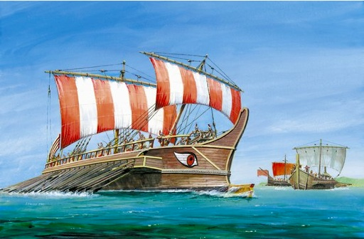
The Crew and the Suitors
fighting to save his life and bring his comrades home.
But he could not save them from disaster, hard as he strove –
the recklessness of their own ways destroyed them all,
the blind fools, they devoured the cattle of the Sun
and the Sungod wiped from sight the day of their return.
So Homer is saying that Odysseus tried really hard to be a good leader and get his men back to their country (Ithaca) safely, but is that really true? Reeeeally true? The facts of the matter are that he started out with about 600 men, made some (can we say “questionable?”) choices about how to lead his ships, and it turned out that he was the only one who survived.
Incidentally, just like Odysseus, the Ithacan men whom he’s leading back from war with Troy have sons too. They have been away for so long that the kids that they left are now full-grown men. And guess what they’re up to? Trying to convince Penelope to marry them. The first lines of the book tell us what happen to the crew, and you’ll have to guess what happens to their sons, the suitors…

