Slide 1
Week 3 Vocabulary
English I, Bellaire HS

Slide 2
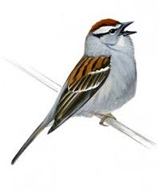
trill
Mi-mi-mi-mi-mi-mi-mi!!!
The word “trill” comes from Italian and refers to a “musical ornament consisting of a rapid alternation between two adjacent notes.” (Wikipedia)
Link to an example of a trill: http://upload.wikimedia.org/wikipedia/commons/4/4d/Trill_example_Bach_A-B-C.mid
What trills besides a bird?

Slide 3
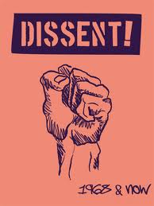
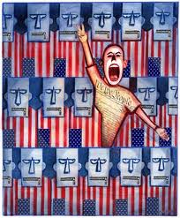
dissent
“Dissent” comes from dis (Latin, meaning “differently”) and sentire (Latin, meaning “to feel” – the same root as “sentimental,” one of our words from last week).
A “dissident” is a person who actively opposed an established social order.
What are some recent news events involving dissidents?

Slide 4
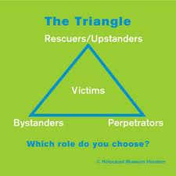
condone
“Condone” comes from the Latin condonare meaning “to refrain from punishing.”
Were the Germans who were not active in the Nazi party during WWII responsible for the deaths of those in the Holocaust, since they condoned their government’s behavior?
What do you condone that you think you ought not to?

Slide 5
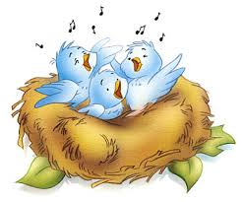
warble
“Warble” comes from Middle Dutch, wervelen meaning “to turn or whirl.”
A warbler is also a kind of bird.
What is the relationship between the derivative and its root?

Slide 6
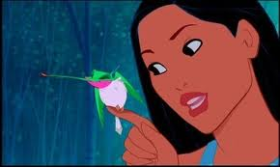
flit
“Flit” comes originally from the Old Norse flytja, meaning “to remove or bring,” which came into English as “fleet” (as in the ships) and then the Middle English flit which meant to move house.
Draw a diagram of how we got the word “flit” in our modern-day usage.

Slide 7
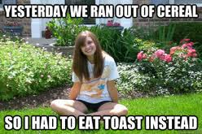
anticlimactic
Comes from Latin anti, meaning “against,” and Greek klimax meaning “ladder.”
Wikipedia lists a famous example of anticlimax as in the resolution in War of the Worlds, in which Martians try to take over the Earth only to be defeated when they all catch a cold.
Write a one-sentence story in which the ending is an anticlimax.

Slide 8
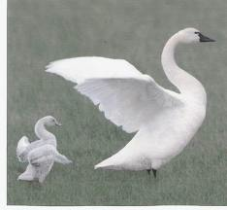
mentor
“Mentor” comes from the Greek story of The Odyssey, in which Telemachus, Odysseus’s son, receives guidance and advice from a character named Mentor (actually the goddess Athena is disguise).
Who has been the greatest mentor in your life? Explain.

Slide 9
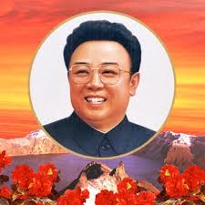
dictate
“Dictate” comes from the Latin word dicere, meaning “to say” – as in, a dictator is someone who says what’s going to happen.
“Taking dictation” refers to the transcription (writing down) of spoken words.

Slide 10
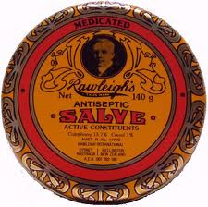
savior
“Savior” comes from the Latin salvare meaning “to save.”
In The Hunger Games, Katniss applies a salve to her wounded leg. What is the connection between this plot point and the root word “salvere?”

Slide 11
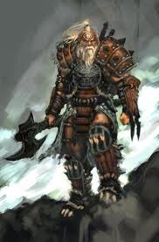
barbarism
We get the word “barbarism” (and the related word “barbarian”) from the Greek word barbaroi, which mean “all who are not Greek.” The Greeks thought that anyone who was not Greek spoke in a funny language that sounded like “bar-bar-bar.”
Today, the word “barbarism” has lots of negative connotations. How is barbarianism subjective (based on one’s opinion rather than fact)?
Why do people tend to think of strangers as barbaric?

Slide 12
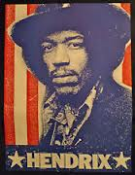
anthem
“Anthem” comes from the Greek antiphona meaning “verse response.”
Why do countries have national anthems?

Slide 13
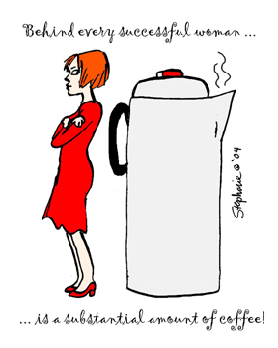
substantial
“Substantial” comes from Latin substantia meaning “being, essence, or material.” That word, in turn, came from the Latin stare meaning “to stand.”
What does it mean to be a substantial person?
What qualities should substantial writing have?

Slide 14
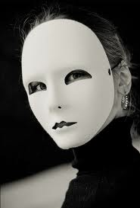
affectation
“Affectation” comes from Latin affectare, meaning “to strive for.”
“Affectation” is not the same thing as “affection!”
In what way was Miley Cyrus’s recent VMA performance an affectation? Explain thoroughly.

Slide 15
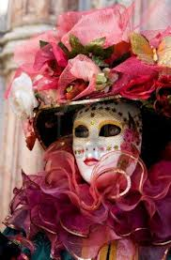
flamboyant
We get the word “flamboyant” from the Latin word flamma meaning flame.
Another word we get from flamma is “flamingo.” Why?
Would you consider flamingos to be truly flamboyant? Or is it just an affectation?

Slide 16
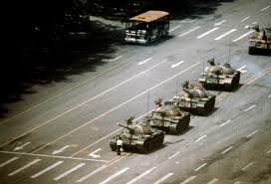
suppress
“Suppress” comes from two Latin words – sub, meaning “down or under” and premere meaning “push against.”
In what ways are you suppressed?

