Slide 1
List 4 Vocabulary Words
Bellaire High School, English 1

Slide 2

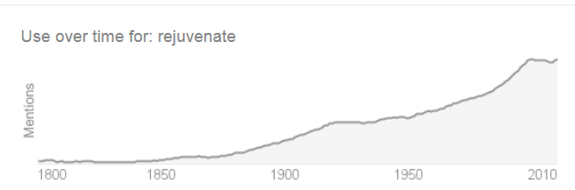
rejuvenate
“Rejuvenate” comes from Latin juvenis meaning “youth.” So to “rejuvenate” means to “make young again.”
Question: Knowing the meaning of juvenis, explain what a “juvenile delinquent” is.
Question: This is the use of “rejuvenate” over time. Explain the trend.

Slide 3

Abstain
“Abstain” comes from two Latin words – ab, meaning “away from” and tenere, meaning “to hold.” “Abstain,” then, means to withhold or keep back.
Question: What do you try to abstain from?
Question: Do you agree with “abstinence-only” sex education in high schools?

Slide 4

deluded
“Delude” comes from two Latin words – de, meaning “down,” and ludere meaning “to play.” If someone is “deluded,” then, he’s playing in a way that’s harmful.
Question: Describe a time when you knew someone who was deluded.

Slide 5

gall
“Gall” was originally a kind of irritating sore on the body. From that meaning, we got the sense that a person who is “galling” is annoying or bothersome. Today, more specifically, it means someone who is so arrogant or impudent to the extent that we’re kind of surprised and shocked.

Slide 6

abate
“Abate” basically means “to stop.” We get the word from Latin – battuere, meaning “to beat.”
Question: Explain the relationship between the root and its derivative.
Question: Give a theory on what the expression “waiting with bated breath” means.

Slide 7
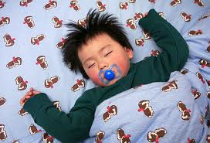
quell
We get “quell” from the Old English cwellan, "to kill, murder, execute.”
Question: Explain how the word “quell” is used in the Hunger Games for the Quarter Quells.

Slide 8

befuddle
“Befuddle” was originally a German term, meaning “to confuse with drink.”
Question: What is your most befuddling subject at school this year?

Slide 9
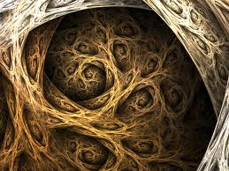
eradicate
We get “eradicate” from Latin eradicare, meaning “to root out.”
Question: Why is it important to kill weeds at the roots rather than just their tops if you want your garden to thrive?

Slide 10
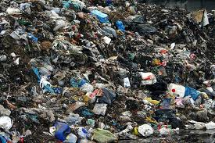
putrid
“Putrid” comes from Latin putrere meaning “to rot.” “Pus” comes from the same root.
Question: Describe the most putrid smell you have ever encountered – be detailed.

Slide 11

sate
We get “sate” from Old English sadian, "to satiate, fill; be sated, get wearied.”
Another great word that relates to “sate” and “satiate” is “slake” – it too is a synonym for “satisfy” or “allay,” but refers more specifically to thirst.
Question: Describe an appetite that you have for something other than food (a metaphorical appetite) – what sates you?

Slide 12
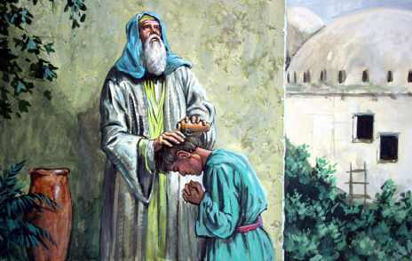
anoint
“Anoint” comes from Latin inungere, meaning “to smear on.”
To anoint literally means to smear someone with oil, water, or some other liquid. Metaphorically, however, it refers to something spiritual. Many religions imbue special significance to the ceremony of anointing someone.
  The name “Christ” comes from the Greek word for “Anointed One.”
  To “anoint” also often can mean to appoint someone as a leader.
Question: Why do you think ancient people thought the practice of anointing was so spiritually significant?

Slide 13
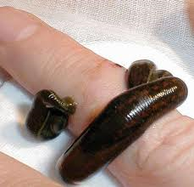
leech
We get this word from the Old English luchen, meaning “to pull.”
The word “leech” can be used as a verb figuratively to describe someone who is sucking away resources.
In pre-modern medicine, physicians would often apply leeches to people because they thought illnesses were in the blood and needed to be drained.
Question: Describe someone you know who acts like a leech.
GROSSSSSSSSSSSSSSSS!

Slide 14
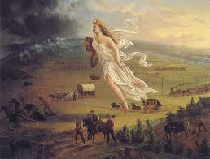
manifest
The word “manifest” comes from two Latin words – manus, which means “hand,” and festus, meaning “to strike.” Therefore, if something is manifest, it’s like it’s so obvious you’re being slapped by a hand.
Explain what “Manifest Destiny” means, with specific attention to the word “manifest” – what does the term say about how Americans viewed westward expansion?

Slide 15
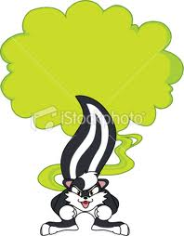
noxious
“Noxious” comes from the Latin word noxa, meaning “hurt or injury.”
Question: How is the word “noxious” similar to “putrid?” How are they different?

Slide 16

pervade
“Pervade” comes from two Latin words – per, meaning “through,” and vadere, meaning “to go.”
Question: Describe an idea that is pervasive in our culture.

Slide 17
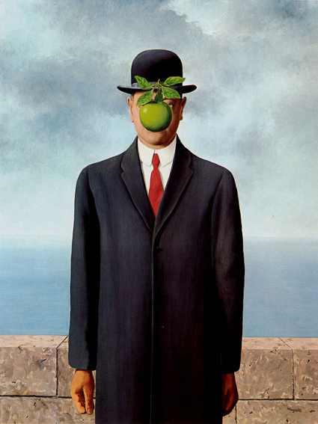
surreal
The word “surreal” comes from French, from sur, meaning "beyond" and réalisme, meaning "realism." Surreal, then, means beyond reality.
Question: This word first came into being in 1927. We often invent words as we need them. Why might we have needed the word surreal in 1927, in particular?

Slide 18

wrack
This word comes from the Old English wrecan, meaning “disaster.”
Question: What does “nerve-wracking” literally mean?

Slide 19
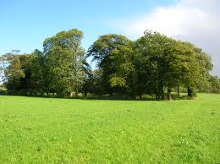
copse
The word “copse” came to us from the French coupeiz, which meant a “cut-over forest.”
Choose two of these words, and explain how a “copse” is similar to and different from them:
  Thicket
  Grove
  Forest
  Woods
  Timberland
  Jungle
  Orchard

Slide 20
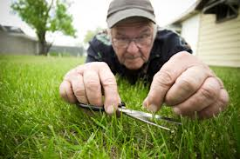
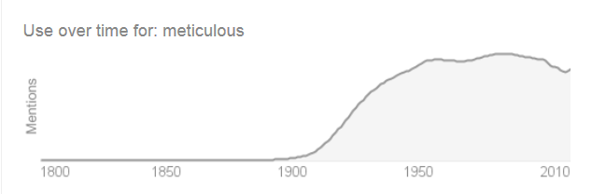
meticulous
“Meticulous” comes from Latin metus, meaning “fear” – someone who is “meticulous,” then, is “full of fear.”
Question: Explain the relationship between the root and its derivative.
Question: Explain the trend of the use of the word over time:

Slide 21
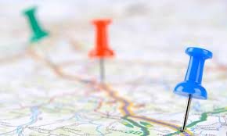
proximity
We get “proximity” from the Latin word proximus, meaning “nearest.”
There is a star called Proxima Centauri that is about 4 light-years away, and which scientists hypothesize could support life in its solar system.
Question: Explain what the word “approximate” means, using the definition of proximus.

Slide 22

rendezvous
This word comes to us from two French words – rendez, “to present,” and vous, meaning “yourself.”
This was originally a military term, used to tell troops when and where to meet.
Today, “rendezvous” often has the connotation of a romantic meeting.
Question: With whom would you most like to have a rendezvous?

Slide 23

wily
“Wily” may be related to the Old English word wicca, meaning “wizard” – a person who can play tricks.
Question: Draw a line on your page that looks like this:
Arrange these characters in the order that you think best: Katniss, Peeta, Gale, Prim, Rue, Cato, Glimmer, Foxface, Haymitch, Effie, President Snow
Least Wily
Most Wily

Slide 24
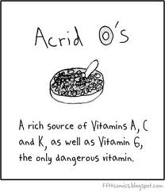
acrid
Here are some of the possible roots of “acrid”:
  Latin – acer - "sharp, pungent, bitter, eager, fierce”
  Greek – akis - "sharp point”
  Greek – akantha – “thorn”
  Greek – acme – “summit, highest point”
  Sanskrit – acri – “corner, edge”
  Lithuanian – akstis – sharp stick
  Welsh – ochr – “edge, corner, border”
  Old English – ecg – “sword
Question: Give a theory about why these many diverse languages all have a world that sounds so similar with such a close meaning.
Question: Explain how “acrid” is similar to and different from “pungent” and “noxious.”

Slide 25
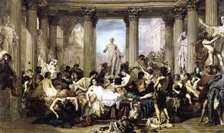
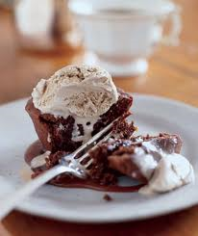
decadent
This word came from the French decadent, meaning “in a state of decline or decay.” The term only began to mean “extremely self-indulgent” (as in chocolate cake or other rich desserts) in the 1970’s.
Question: What is the connection between “in a state of decline or decay” and “extremely self-indulgent?”

Slide 26

famished
“Famished” comes from Latin fames, meaning “hunger or starvation.”
Question: “Feast or famine” is an expression that refers to having either too much or not enough of a certain thing. Use that expression in a sentence, giving lots of context.

Slide 27

salvage
“Salvage” comes from the Latin salvare, meaning “to save.”
Question: “Salvage” has the same root as one of our previous words, “savior.” Explain how both of those words are related.
Question: What is something you have salvaged?

Slide 28
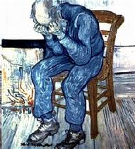
despondent
We get “despondent” from the Latin desperare, meaning “to lose hope” (de – away; sperare – to hope).
Question: What would make you despondent?

Slide 29
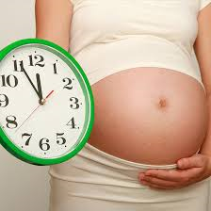
induce
We get “induce” from the Latin inducer, meaning “lead into, bring in, introduce, conduct, persuade” (in – in; ducere – to lead).
When it is time for a baby to be delivered but the birthing process hasn’t started naturally, doctors will sometimes induce labor.
Question: Another word that we get from ducere is “educate.” How does “to educate” mean “to lead?”

Slide 30

lethargy
“Lethargy” comes from the Greek word lethe, or “forgetfulness.”
In the Greek Underworld, the river Lethe was the River of Forgetfulness – dead souls would drink from it to forget their lives on Earth.
Question: What are the three most lethargic animals, in your opinion?

Slide 31

novice
“Novice” comes from the Latin word novus, meaning “new.”
Question: As a freshman at Bellaire, what are some areas in which you are still a novice?

