Slide 1
Vocabulary List 3
Bellaire High School

Slide 2
Vocabulary Discussion
As we talk about each word, write the word and its number and answer the corresponding question in a complete sentence on a sheet of notebook paper.
Do a thorough, thoughtful job – I have noticed that the people who take this assignment more seriously get better quiz scores.

Slide 3
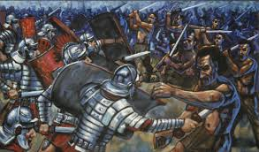
civilize
“Civilize” comes from the Latin civilus, meaning “relating to a citizen, relating to public life, befitting a citizen; popular, affable, courteous.”
The Online Etymology Dictionary notes: “The sense of "polite" was in classical Latin, from the courteous manners of citizens, as opposed to those of soldiers.”
Question A: In what way might the Romans have thought that soldiers were not civilized?
Question B: How is the meaning of the word “civilize” related to the meaning of the word “civilization?”

Slide 4
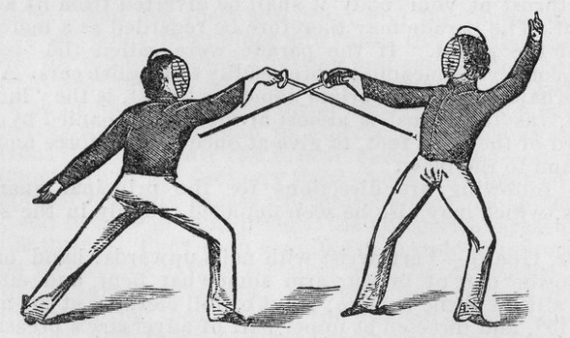
adversary
We get the word “adversary” from two Latin words – ad, meaning “towards,” and versus, meaning “to turn. Thus, an adversary is literally someone you are turned towards – as in, fighting.
Question: Who is your greatest adversary?

Slide 5
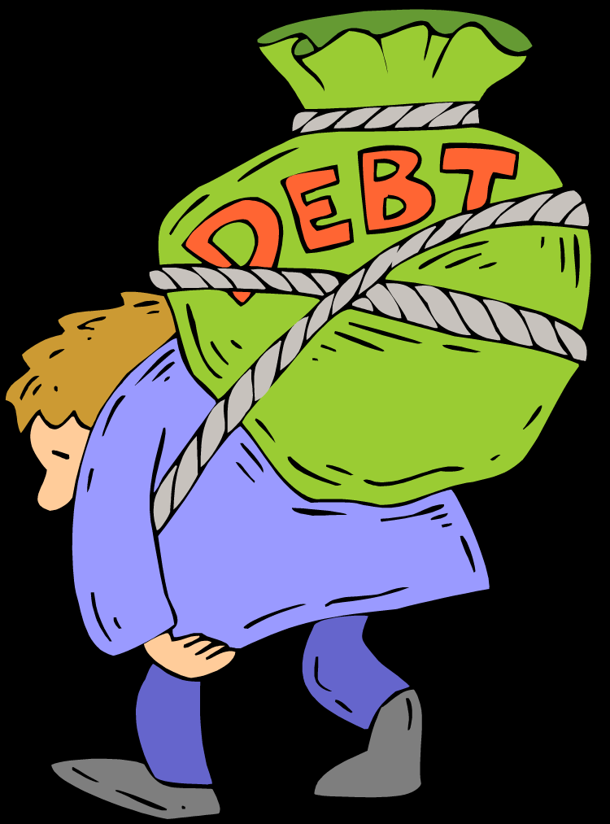
debt
“Debt” comes from Latin debere, meaning “to owe.”
Question: What is an intangible (not a physical thing or money) debt that you owe to someone?

Slide 6

emaciated
“Emaciated” comes from the Latin word macer, meaning “thin.”
Question: In the 1990’s, fashion designers began to use models who looked not just slender, but emaciated. Why would they use this advertising strategy to sell their clothing? Should advertisers be prohibited from promoting this kind of image as glamorous because of the risks of promoting anorexia and bulimia to teens?

Slide 7
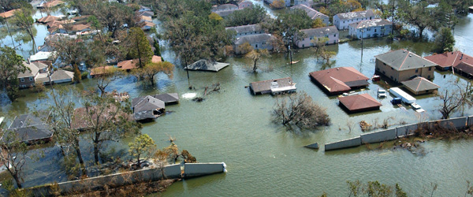
deluge
“Deluge” comes from the Latin word diluere, meaning “to wash away.”
Question: List three stories you know of in which a flood plays a big role in the plot.

Slide 8
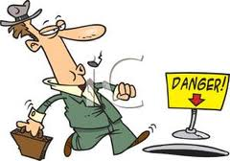
oblivious
“Oblivious” comes from the Latin word obliviosus, meaning "forgetful, that easily forgets; producing forgetfulness.”
Question: Draw a diagram that explains the relationship between the words “oblivious,” “obliviosus,” and “oblivion.”

Slide 9
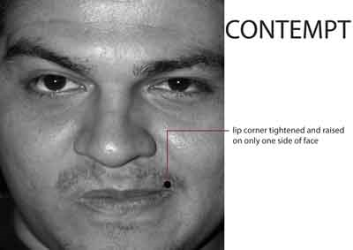
contempt
We get the word “contempt” from the Latin contemnere, meaning “to scorn or despise.”
Question: You may have seen on television that when a person inside a courtroom is misbehaving, a judge will hold him or her “in contempt of the court.” Knowing the history of “contempt’s” origins, explain what this means.

Slide 10
scraggly
scraggly
scruffy
We get “scraggly” from the Norwegian word skragg, which means "a lean person."
Question: Draw a triple Venn diagram for “scraggly,” “scruffy,” and “emaciated.” Fill it out.
emaciated

Slide 11
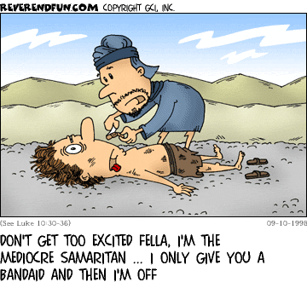
mediocre
The word “mediocre” comes from Latin medius meaning “middle.”
Question: Explain the relationship between the root (medius, meaning “middle”) and its derivative (mediocre).

Slide 12

irredeemable
“Irredeemable” comes from Latin redimere, "to redeem, buy back.”
Question: Explain the relationship between the root and its derivative.
Question: Explain what the concept of “redemption” means in traditional Christian theology. (Note – we’re talking about this question as it relates to the literature we’re studying – Hunger Games – and not in terms of what you should believe.

Slide 13
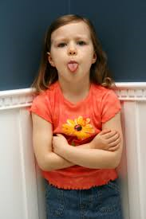
defiant
“Defiant” comes from Latin disfidare, "renounce one's faith," which comes from Latin dis-, "away,” and fidus, "faithful.“
Question: Talk about a time you defied your parents.

Slide 14
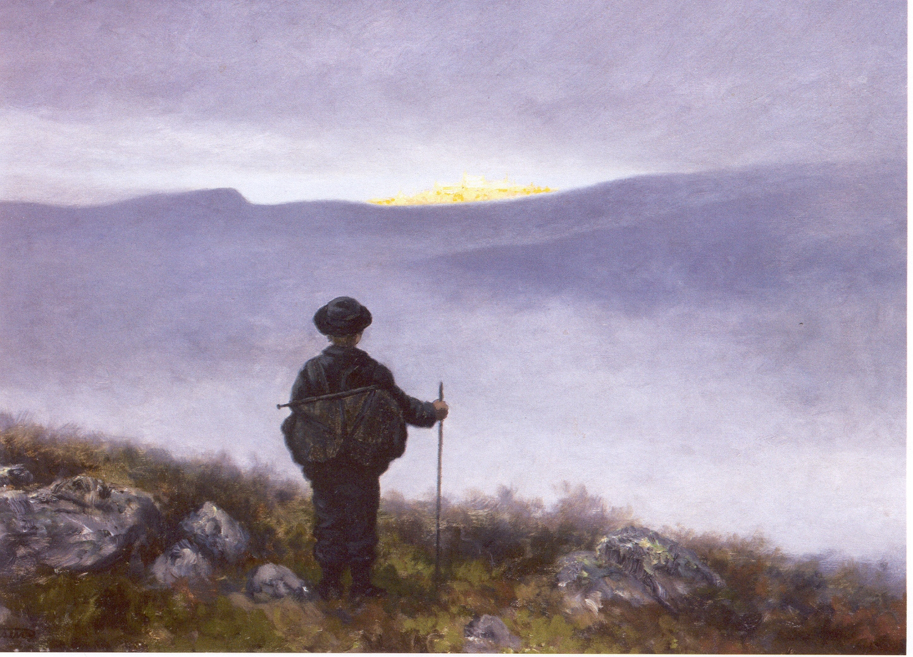
quest
“Quest” comes from Latin questa, which means "search or inquiry.”
Question: What is the relationship between a “quest” and a “question?”

Slide 15
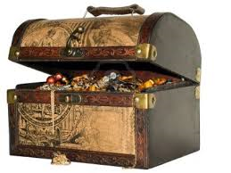
spoils
“Spoils” comes from Latin spolium, meaning "armor stripped from an enemy, booty.”
Question: There is a famous saying that goes, “To the victor go the spoils.” Give an example of how this might be true, in a context other than war.

Slide 16

aloof
According to the Online Etymology Dictionary, “aloof” was “[o]riginally a [Dutch] nautical order to keep the ship's head to the wind, thus to stay clear of a lee-shore or some other quarter; hence the figurative sense of ‘at a distance, apart.’”
Question: In what kinds of situations do you stay aloof?

Slide 17
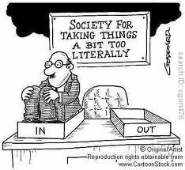
literal
“Literal” comes from Latin litera, meaning "letter, alphabetic sign, literature, books.” Something literal is exactly as it is written, then.
Question: Explain the different between “literal” and “figurative.”

Slide 18
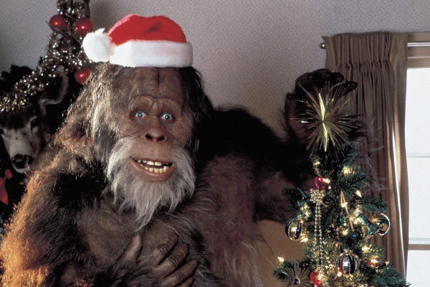
elusive
“Elusive” comes from Latin eludere, meaning "escape from, make a fool of, win from at play.”
Question: Give a creative, original theory on why either Bigfoot of the Loch Ness Monster is so elusive. Specify whether you are discussing Bigfoot or the Loch Ness Monster.

Slide 19
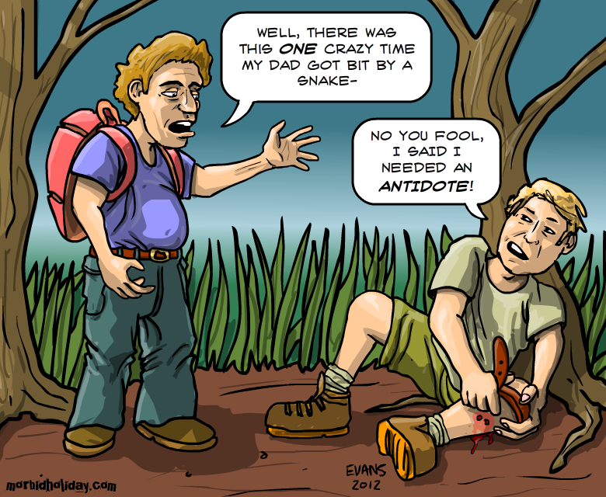
anecdote
“Anecdote” comes from the Greek anekdota, meaning "things unpublished.”
Question: What is the relationship between the root and its derivative?

Slide 20

dominate
“Dominate” comes from the Latin word dominus, which means “master.”
Question: Keeping the meaning of the root word dominus in mind, what do you think it means to have “dominion” over a group of people?

Slide 21
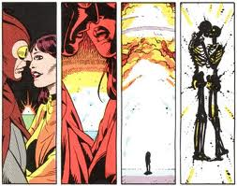
star-crossed
We get the phrase “star-crossed” from Shakespeare’s Romeo and Juliet, as he describes the titular (what do you think “titular” means?) characters:
"From forth the fatal loins of these two foes,
A pair of star-cross'd lovers take their life"
Question: Spot the grammatical error in the second line of the quotation above.
Question: Shakespeare also wrote about stars metaphorically in his play Julius Caesar, in which one character says to another:
“The fault, dear Brutus, is not in our stars, / But in ourselves, that we are underlings.“
What does this mean?
Plus one million, billion cool points if you know where this comes from.

Slide 22
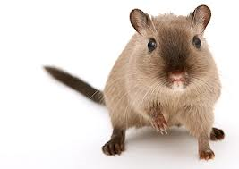
gnaw
“Gnaw” comes from the Old English word gnagan, which also means “gnaw.”
Question: List three things you might gnaw. Imagine you are a gerbil.
This is you. You are adorable. Look at your little nose.

Slide 23
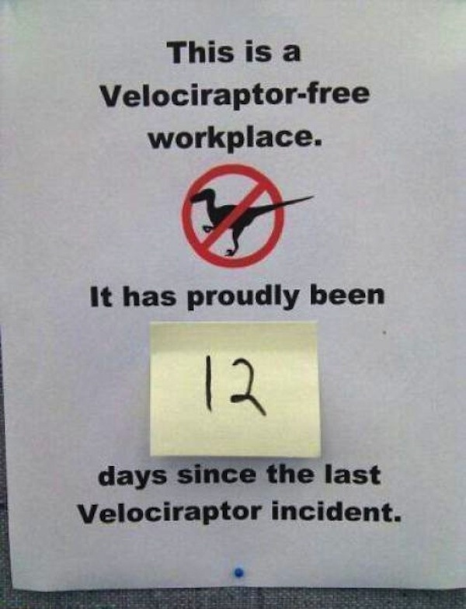
arbitrary
We get “arbitrary” from Latin arbitrarius or "depending on the will, uncertain."
Question: Describe a time when you were upset about someone’s arbitrary decision.
I just arbitrarily chose this picture.

Slide 24
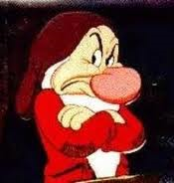
surly
The Online Etymology Dictionary writes of “surly” – “Middle English sirly ‘lordly, imperious’ (14c.), from sir. The meaning ‘rude, gruff’ is first attested 1660s.”
Question: So “surly” actually means “sirly” (as in, “like a sir”) – explain how.

Slide 25
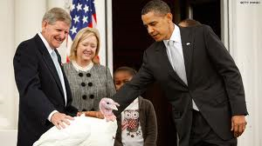
reprieve
The Online Etymology Dictionary writes of “reprieve” – “Meaning ‘to suspend an impending execution’ is recorded from 1590s; this sense evolved because being sent back to prison was the alternative to being executed.”
Question: Explain what it means to “grant someone a reprieve.”

Slide 26
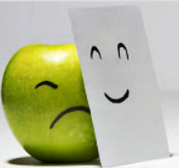
pretense
We get the word “pretense” from the Latin verb praetendere, which means “to pretend.”
Question: What is the relationship between the words “pretense” and “affectation?”

Slide 27
sullen
The Online Etymology Dictionary writes of “sullen” – “1570s, alteration of Middle English soleyn ‘unique, singular,’ from Anglo-French solein, formed on the pattern of Old French soltain, from Old French soul "single" (see sole (n.2)). The sense shift in Middle English from ‘solitary’ to ‘morose’ occurred late 14c.”
  So basically, it used to mean “alone,” and then the meaning shifted to “glum.”
Question: Create and fill out a Venn diagram for the words “sullen” and “surly.”
surly
sullen

Slide 28

banal
We get “banal” from the Old French word banel or "communal.”
Question: What is the relationship between the root and its derivative?

Slide 29
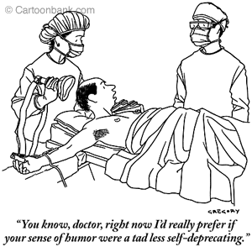
self-deprecating
Question: What is self-deprecating humor?

Slide 30
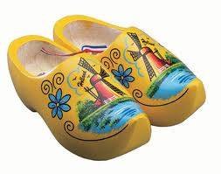
bluff
We get the word “bluff” from the Dutch bluffen, "to brag, boast.”
Question: Why are Dutch words so much fun to say?
Question: What does it mean to “call someone’s bluff?”
Question: If you had a dog, would you call it “Bluff?” If you did indeed call it “Bluff,” how would you feel about someone else calling it to them?

Slide 31
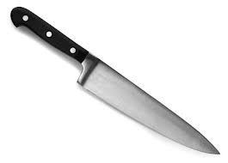
cutting
We get the word “cut” from the Old French couteau, or "knife."
Question: Explain what a “cutting” remark would be.

Slide 32
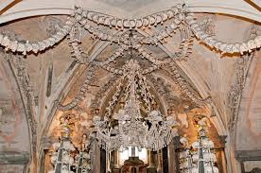
catacombs
We get the word “catacombs” from the Latin phrase cata tumbas, or “at the tombs.”
Question: Would you go into a catacombs? Why or why not?
This is a chandelier made of bones in the Czech Republic. Made of bones!

