Slide 1
The Hunger Games Vocabulary – Chapter 1

Slide 2
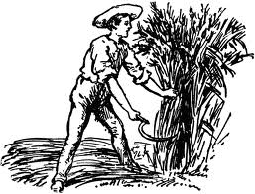
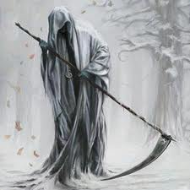
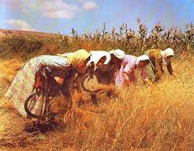
reap
The word “reap” comes from the Old English word ripe meaning (surprise) “ripe”
One of the most famous uses of the word “reap” comes from the Bible, in Galatians 6:7-9:
  Be not deceived; God is not mocked: for whatsoever a man soweth, that shall he also reap.
  For he that soweth to his flesh shall of the flesh reap corruption; but he that soweth to the Spirit shall of the Spirit reap life everlasting.
  And let us not be weary in well doing: for in due season we shall reap, if we faint not.

Slide 3
reap
What do you expect to reap this year in school?
What sort of emotional connotations does the word “reap” carry?

Slide 4
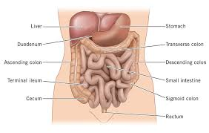
entrails
The word “entrails” comes from the Latin word intralia, meaning “inward parts, or intestines”
What metaphorical uses of the word entrails can you imagine? (Talking about something other than human guts!)

Slide 5
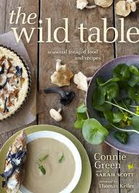
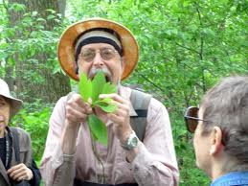
forage
The word “forage” comes from the Old French word feurre, meaning “straw”
  What’s the connection between these two terms?
In a zombie survival situation, how would you forage for food?
What do people forage for besides food?

Slide 6
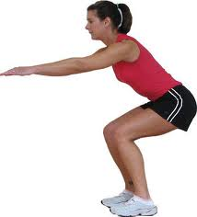
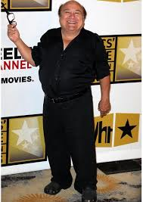
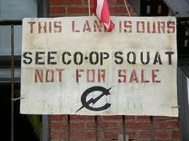
squat
The word “squat” comes from the Latinword coactus, meaning “to compress, or force together”
Why are people who occupy a building without permission called “squatters?”
Do you think squatters should be allowed to live in the places they have occupied for years, even if they don’t own them?

Slide 7
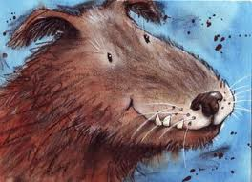
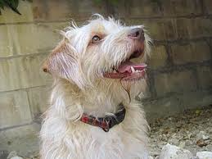
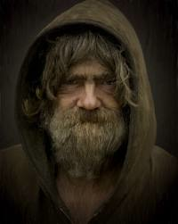
scruffy
The word “scruffy” entered the English language in the 1650’s, and originally meant “covered in dandruff” (from Old English “scurf” meaning “rough and dirty”)
What sort of connotations does the word “scruffy” carry today? Mostly positive or negative?
Are scruffy dogs cute?

Slide 8
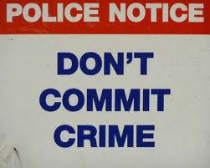
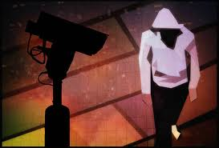
deterrent
The word “deterrent” comes from Latin deterrere, meaning “to frighten off, discourage, prevent, hinder, or avert.”
In the 20th century, people thought that the threat of nuclear war could be avoided by a deterrent called “Mutually Assured Destruction” – in which no country wants to begin a nuclear war because the costs are so high. What are the problems with this theory?
What are the best ways to deter crime?

Slide 9
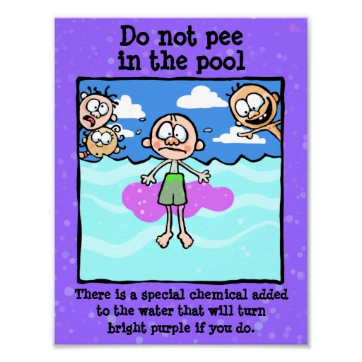

Slide 10
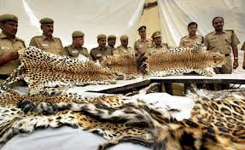
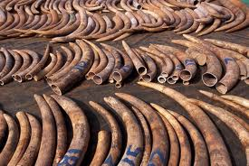
poach
The word “poach” comes from the French word pocher, meaning “to push, or poke.” It’s also derived from the Old English pocchen, meaning “enclosed in a pocket or bag.”
Poaching from the King’s forests was considered heroic in the Robin Hood legends.
How can we deter poaching, especially among impoverished people in the developing world who lack other job opportunities?

Slide 11

Poaching PSAs from the World Wildlife Fund

Slide 12

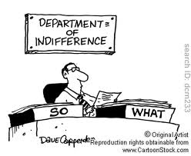
indifferent
Explain Edmund Burke’s famous saying, “All that is necessary for the triumph of evil is that good men do nothing.”
Do you agree with Elie Weisel (a Holocaust survivor and memoirist) when he says, “The opposite of love is not hate, it's indifference. The opposite of beauty is not ugliness, it's indifference. The opposite of faith is not heresy, it's indifference. And the opposite of life is not death, but indifference between life and death.” - ?

Slide 13
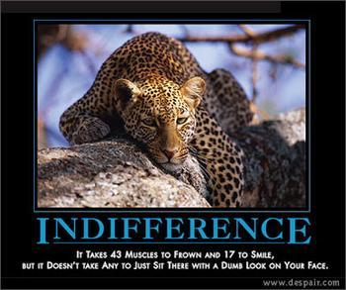
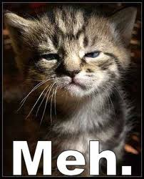
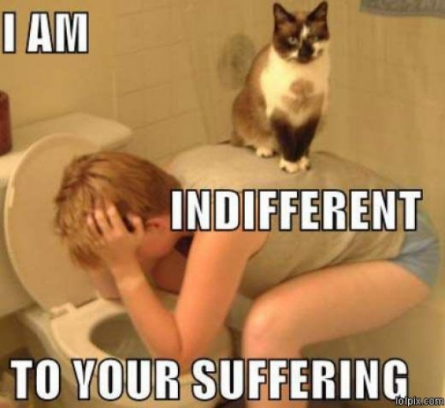
Cats – the most indifferent species?

Slide 14
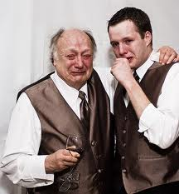
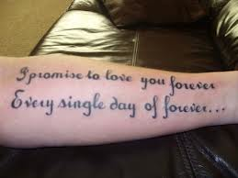
sentimental
The word “sentimental” comes from the Latin sentire, meaning “to feel.”
What kinds of connotations does the word “sentimental” carry?
What makes you sentimental?
Was this tattoo a good idea?

Slide 15


supple
The word “supple” comes from the Latin supplex, meaning “submissive.”
Give some examples of literal and figurative objects and people that could be supple.

Slide 16
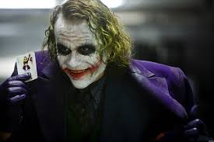
maniacally
The word “mania” comes from the Greek mania, meaning “madness or frenzy.”
What would make you maniacal?
Who are some famous maniacs?

Slide 17
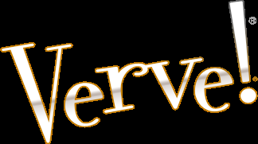
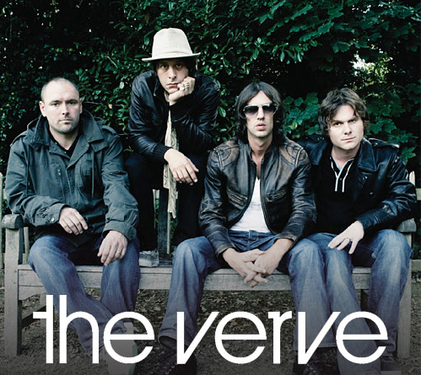
verve
The word “verve” ultimately derives from the Latin verba, meaning “madness or frenzy,” which probably coursed its way through the history of language to our modern usage with an intermediary meaning of “skilled with words” or “witty.”
The Verve is also a fantastic English band, whose 1998 hit “Bittersweet Symphony” was listed by Rolling Stone as number 392 out of the 500 Best Songs of All Time.

Slide 18
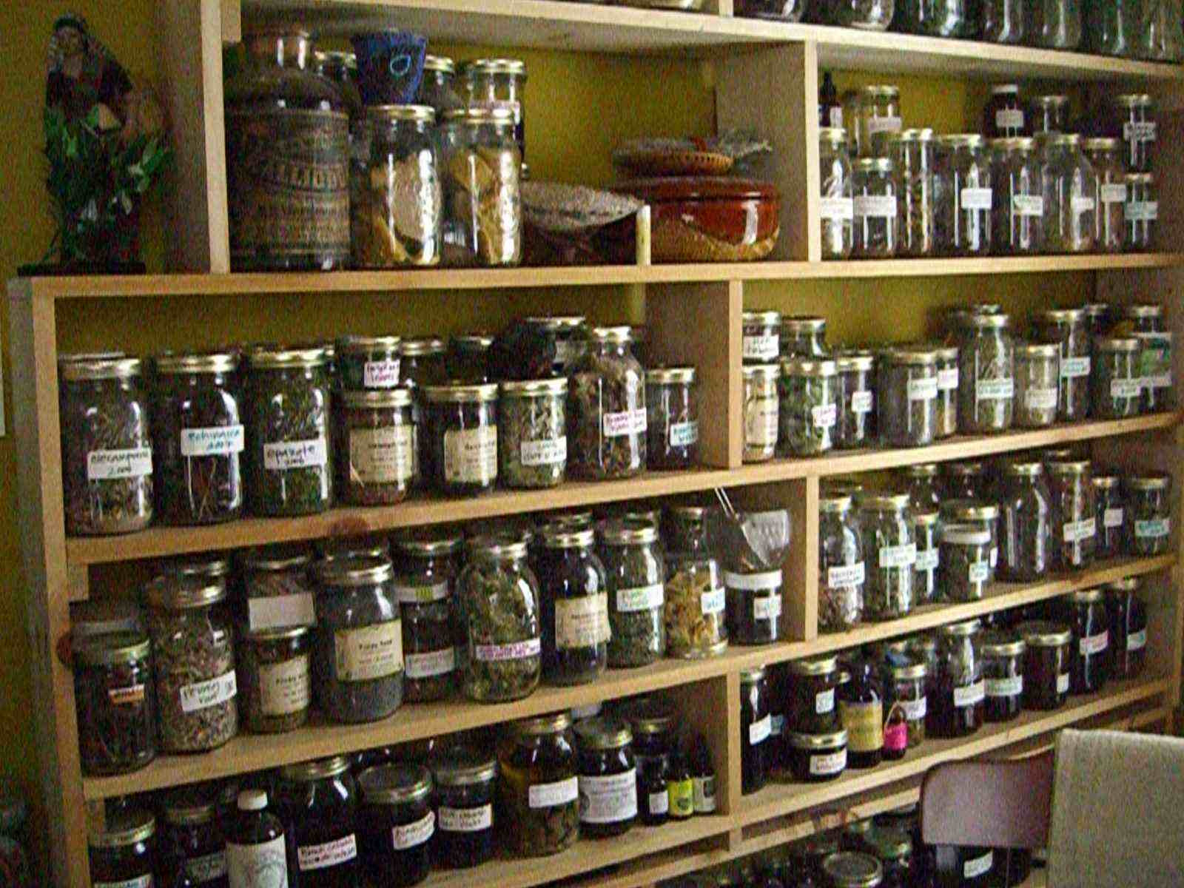
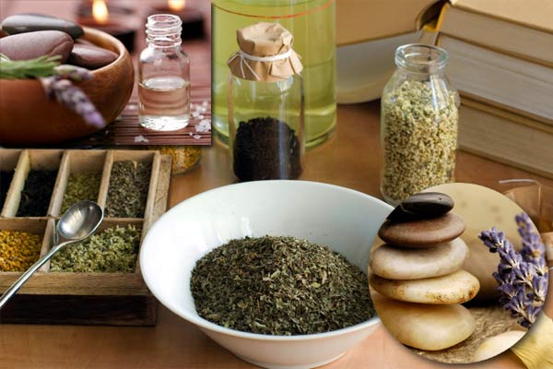
apothecary
The word “apothecary” comes from the Greek apotheka, meaning “barn or storehouse.”
Do you think it would be better to visit an apothecary or a traditional doctor?

Slide 19
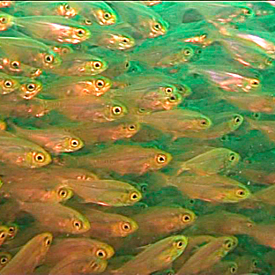
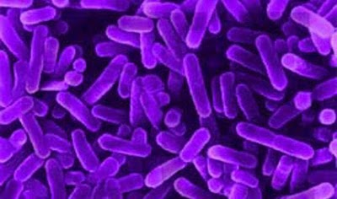
teem
The word “teem” comes from the Old Norse toema, meaning “empty” – as in, “to empty a vessel” and thus, “to flow copiously.
Give some examples of teeming other than fish and bacteria.

Slide 20
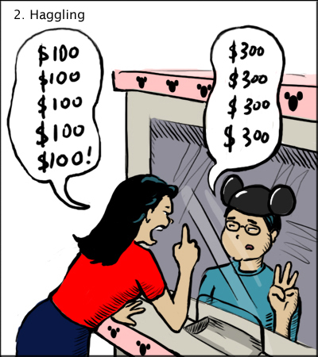
haggle
The word “haggle” comes from the Old Norse haggle, meaning “to chop” – it probably came to the meaning we know today through the notion of chopping away at a price.
When is it appropriate to haggle, and when should you accept a price can’t be negotiated?
Do you haggle about your grades with your teacher?

Slide 21
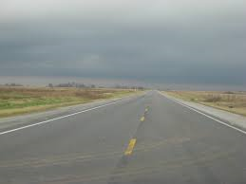
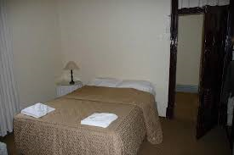
drab
The word “drab” comes from the French drap, meaning “drape” – particularly a piece of undyed cloth.
What kinds of clothes do you find drab today?

Slide 22
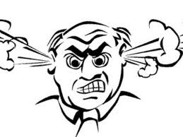
rant
The word “rant” comes from the Dutch ranten, meaning “talk, nonsense, or rave.”
Do you ever rant? If so, about what subjects?
How can people avoid ranting on a subject about which they feel passionately?

Slide 23
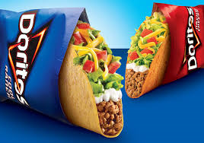
sustenance
The word “sustenance” comes from the Latin sustinere, meaning “to endure.”
What are the most important things to sustenance?
Where would you look for sustenance if you were stranded on a deserted island?

Slide 24
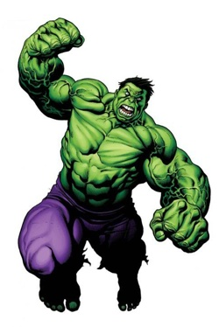
brutal
The word “brutal” comes from the Latin brutus, meaning “dull, stupid, or fierce.”
What is the relationship between the dull, stupid, and fierce, as concepts?
What does “brute force” mean?

Slide 25
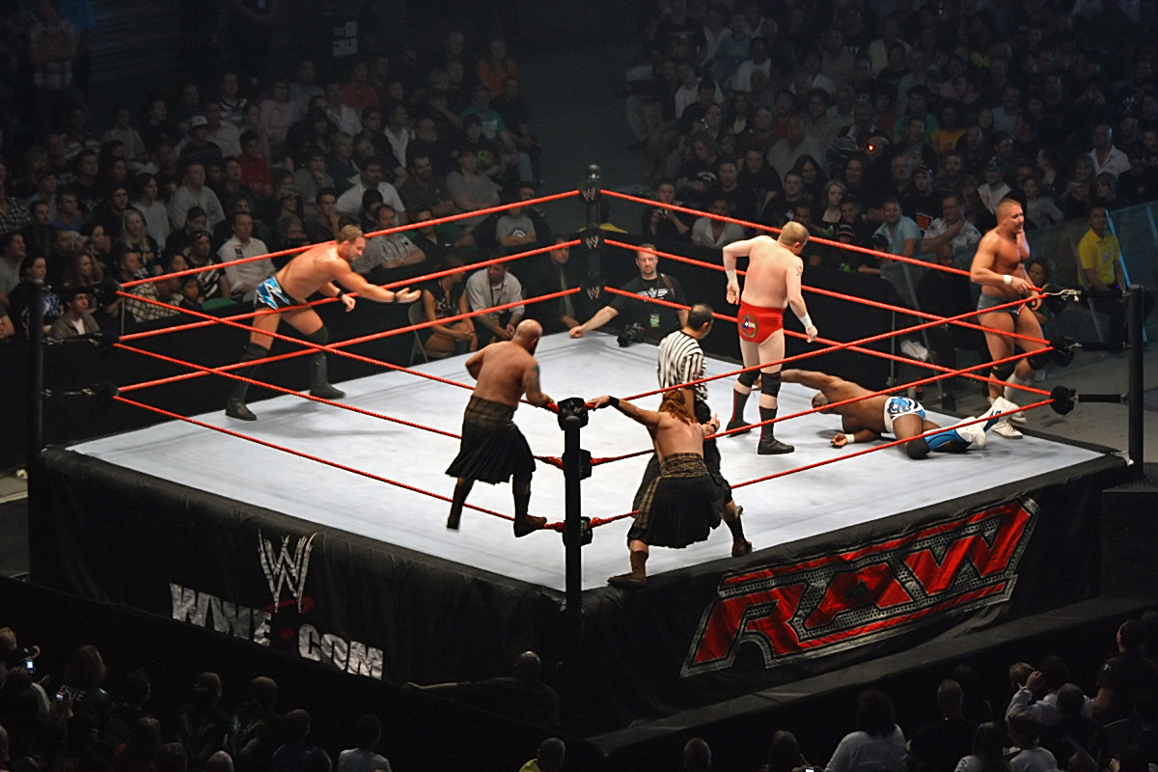
pit
The word “pit” comes from the Latin puteus, meaning “well, or shaft.”
“Pit” as a verb is usually used with the preposition “against,” and typically means “to set to fighting.”
Can you think of a time when you were pitted against a friend or family member?

